Slide 1
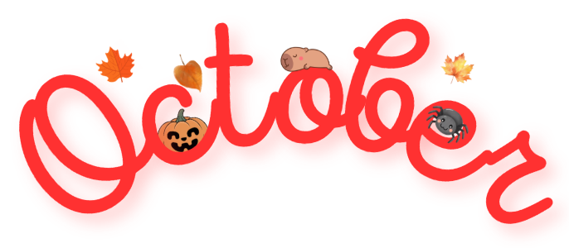


Grade #2 Newsletter - October in Review
Introduction
As the leaves turn golden and the nights grow longer, we are celebrating the spirit of Halloween! Read on … if you dare!
Mathematics
We learned about length and distance and how to measure how far objects are. We also learned how to add and subtract (with regrouping) two digit numbers. We reinforced knowledge by playing The Case of the Broomstick Burglar, where students had to solve the maths puzzle to find the Halloween thief!
Science
We learned about how animals change as they grow. We also discussed different animal habitats and the different needs of animals when finding shelter.
Language Arts
We learned about Subject and Object Pronouns, Nouns and how to write sentences using the future (Will + Verb). We also started our short novel study to get into the spooky spirit for Halloween - Gus Was A Friendly Ghost.
Social Studies
We continued working on their Digital Project - Great Inventions. We also started to look at the history of the First Nation Peoples of Canada and the history of Halloween!
Art
We learned about Yinka Shonibare and Ted Harrison with students re-creating artworks in their styles. We also made scary Halloween ghosts
Important Dates
:
Pictures, pictures, pictures!
31st October - Halloween
5th November - Completion date for Great Inventions Project
10th-11th November - Independence Day (school closed
27th November - Thanksgiving Day
5th December - St. Nicholas Day

