Slide 1
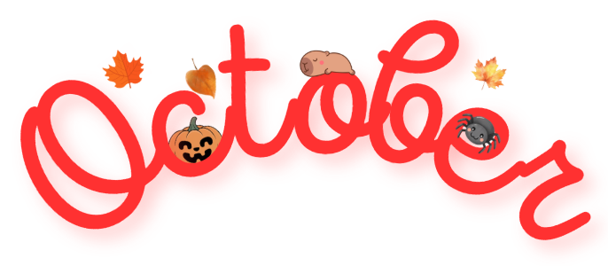
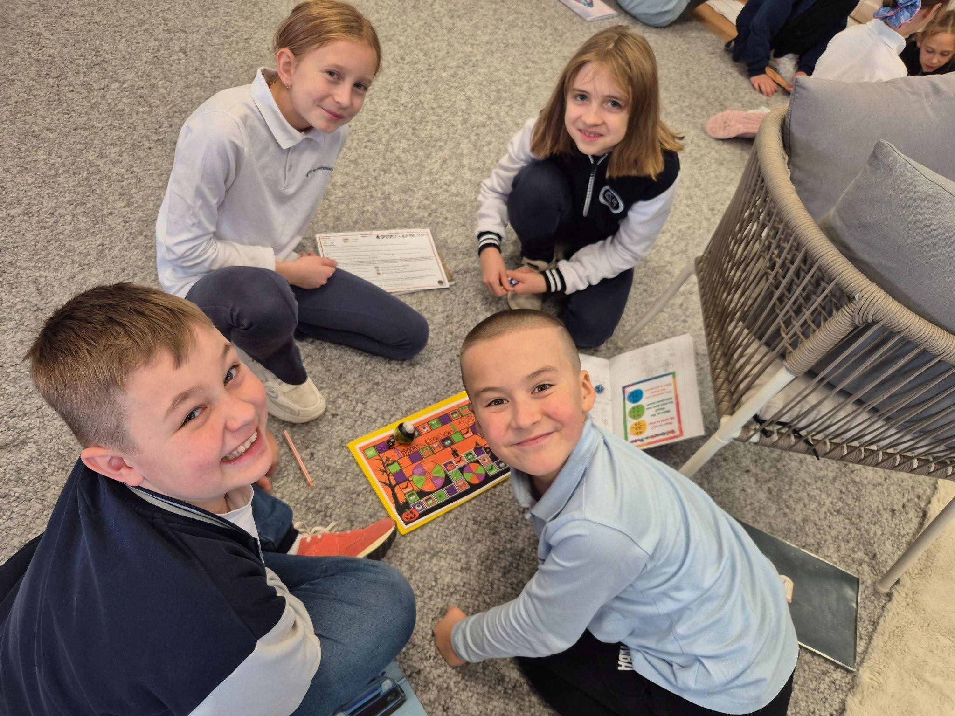
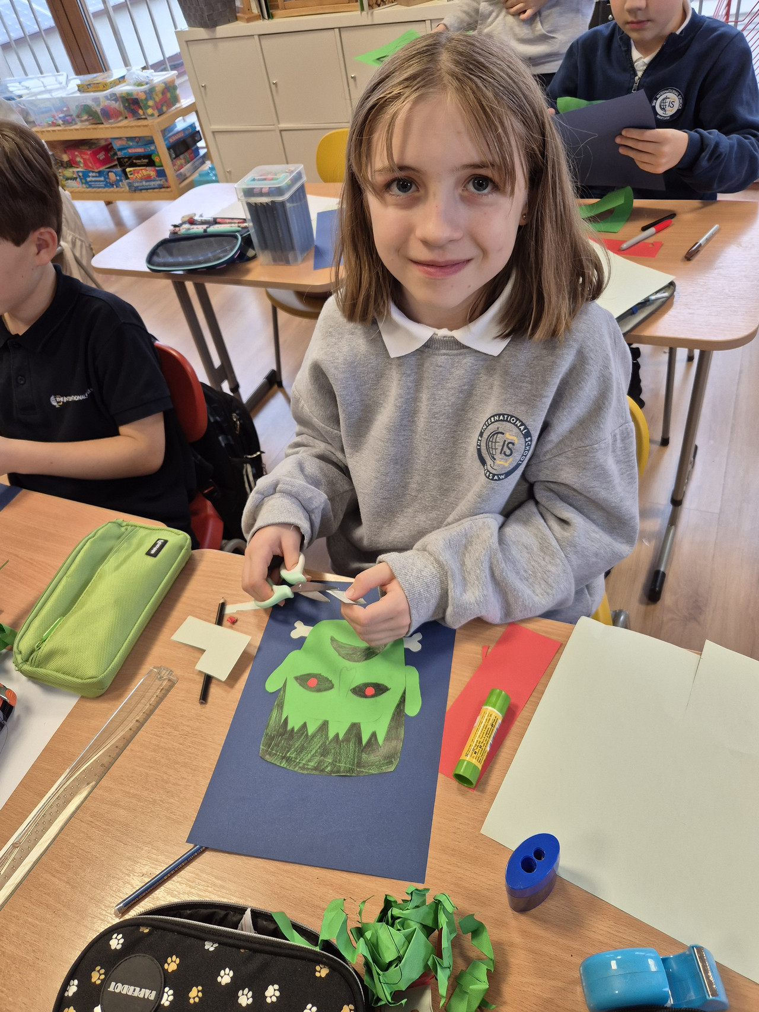
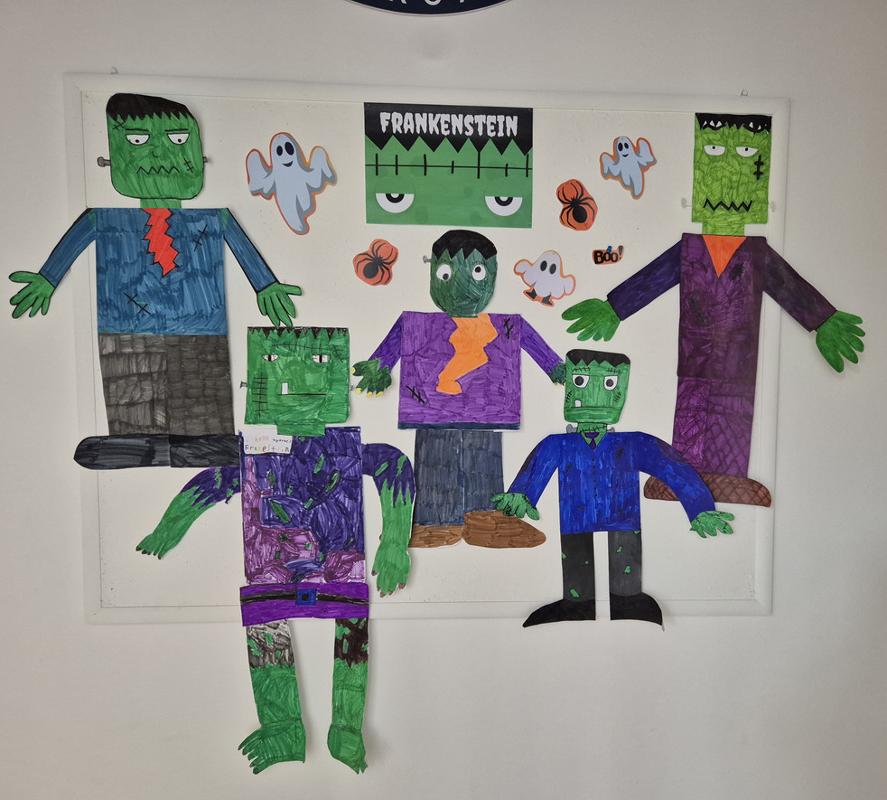
Grade #3 Newsletter - October in Review
Introduction
As the nights grow longer and the air feels colder, October brings with it the ‘monstrous’ spirit of Halloween!
Mathematics
We learned how to add and subtract (with regrouping) to three digits. We reinforced knowledge by playing - Dual with Frankenstein. We also reviewed Length and Distance of objects and Capacity and Mass.
Science
We discussed the different ways seeds are dispersed and why this plays an important role in our food chain.
Language Arts
We learned how to use the simple past with regular verbs and; prefixes and suffixes. We also started our short novel study - Mary Who Wrote Frankenstein. We have been discussing the ‘monstrous’ idea that came to the author of Frankenstein, Mary Shelley!
Social Studies
We wrapped up our Digital Project - My City and discussed in depth the challenges the First Nation Peoples faced in Canada. We also learned about the history behind Halloween!
Art
We looked at the Cubism movement and recreated self portraits. We also experimented and created our very own hideous Frankenstein!
Pictures, pictures, pictures!
Important Dates:
29th October - End date for Design your own City project
31st October - Halloween
10th-11th November - Independence Day (school closed
27th November - Thanksgiving Day
5th December - St. Nicholas Day

