Slide 1
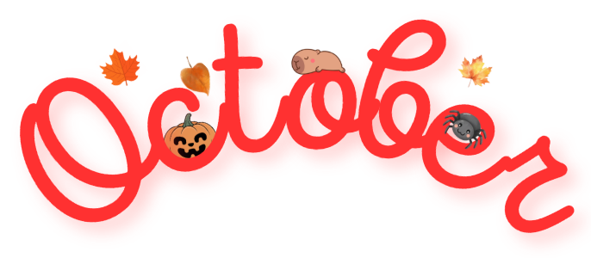
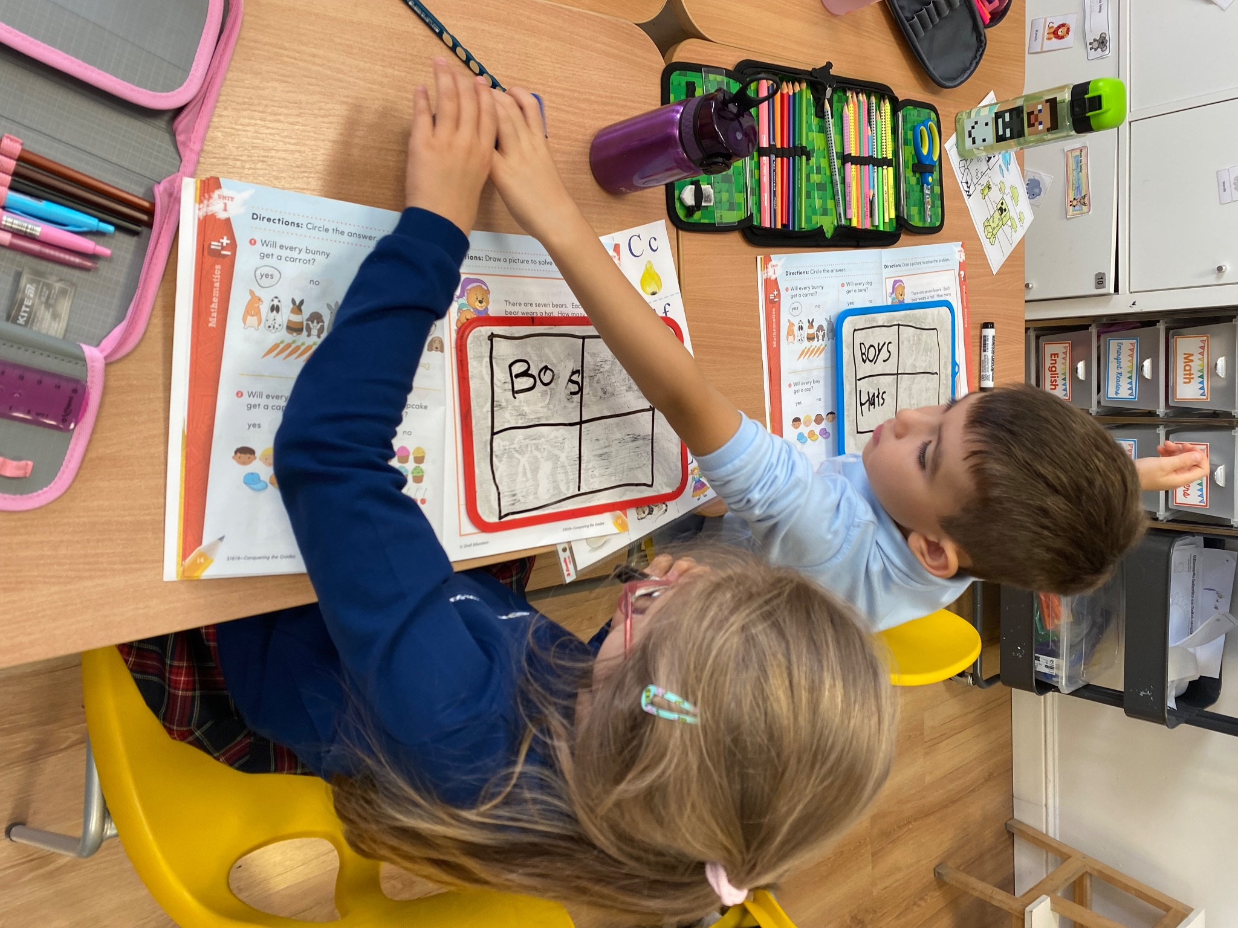
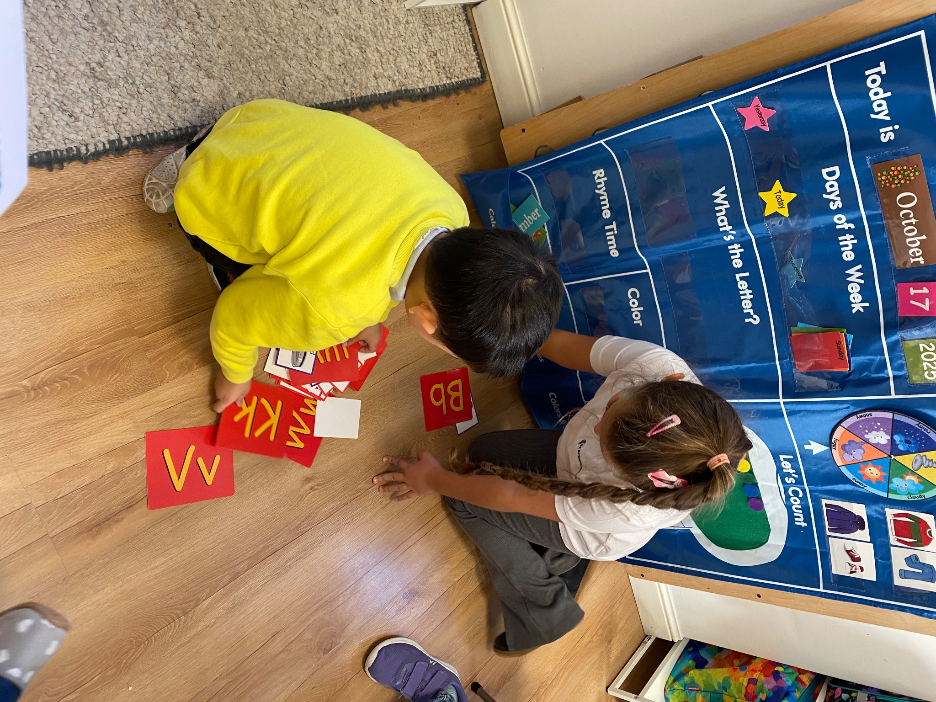
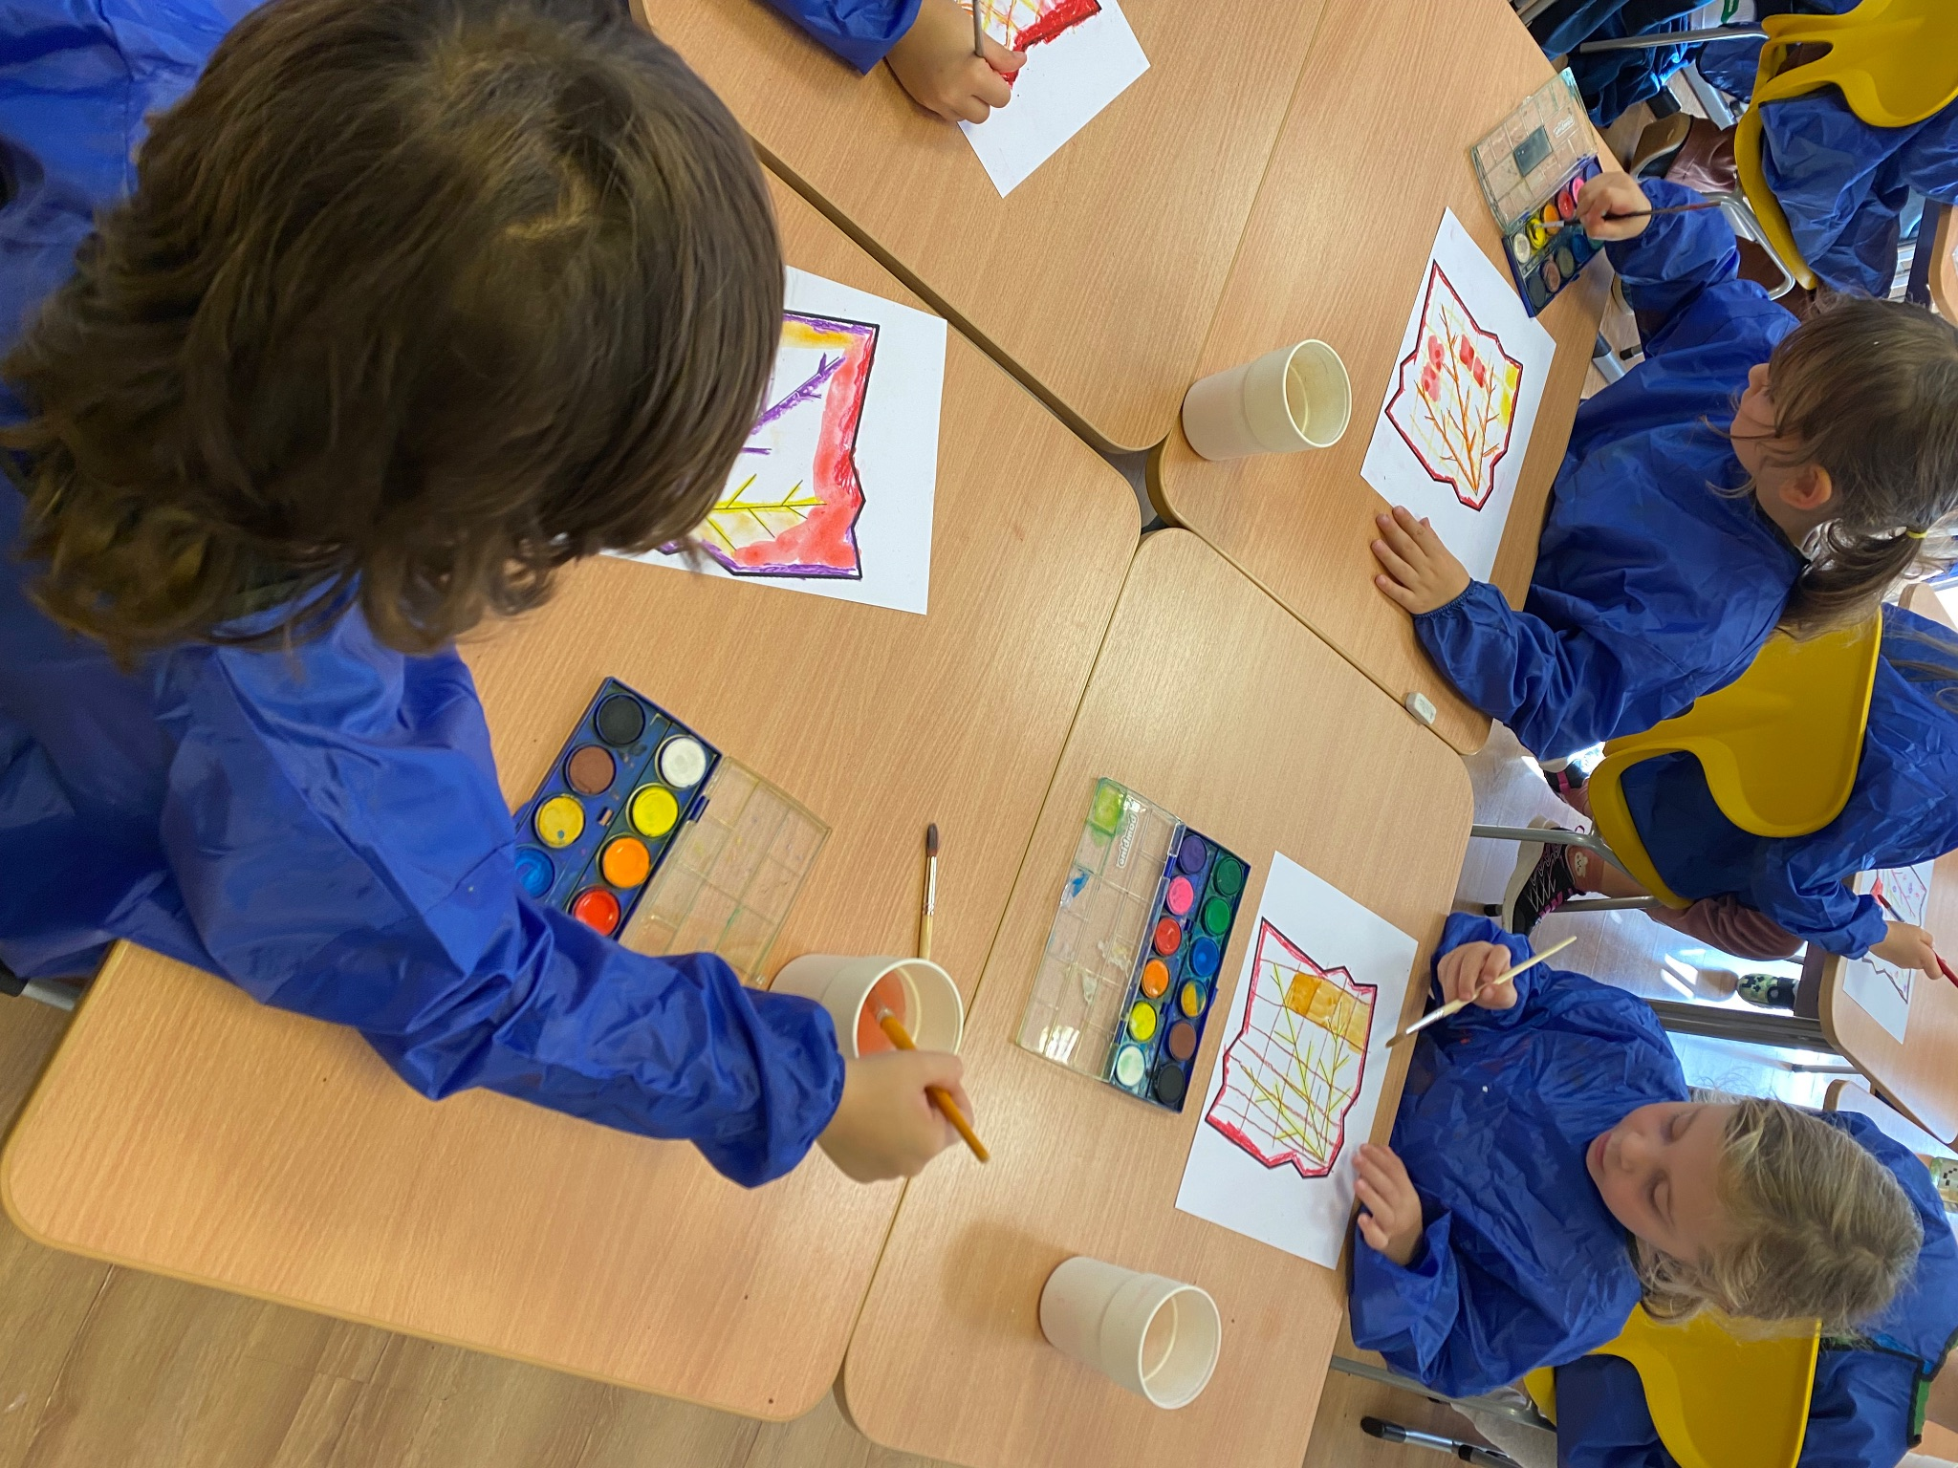


Grade 0 Newsletter - October in Review
Introduction
The month of Halloween has come and gone! Our Halloween topic was “gourds,” like pumpkins and acorn squash. There was a “Best Costume” award, candy and lots of crafts!
Mathematics
We continued learning numbers 1-10 with our math strategy animals and also solved word problems. We had an introduction to 2D shapes. Here’s a quiz: can you name shapes that are quadrilaterals?
Science
We learned the two forces that make the world go ‘round: push and pull! We completed real world activities to see how these forces help us move ourselves and objects around us and also paired up to demonstrate these forces. Lastly, we wrote our observations.
Language Arts
We learned more letter names and sounds, singing our song “Pump Up Your Muscles!” We learned when to use capital and lowercase letters and also completed our second writing task about policemen. We used our writing strategy animals like “Cal the Capitalizing Cardinal” to improve our writing process and mechanics!
Social Studies
We spoke about community helpers and their jobs, tools and places of work. We learned all about police, making a mind map for our pre-writing, and also spoke about how these community helpers make our towns and cities great!
Art
To conclude our unit on primary colors, we spoke about Monet and created primary-colored masterpieces. We made 3D paper pumpkins, a collaborative fall mosaic and all sorts of Halloween crafts!
Pictures, pictures, pictures!

