Slide 1

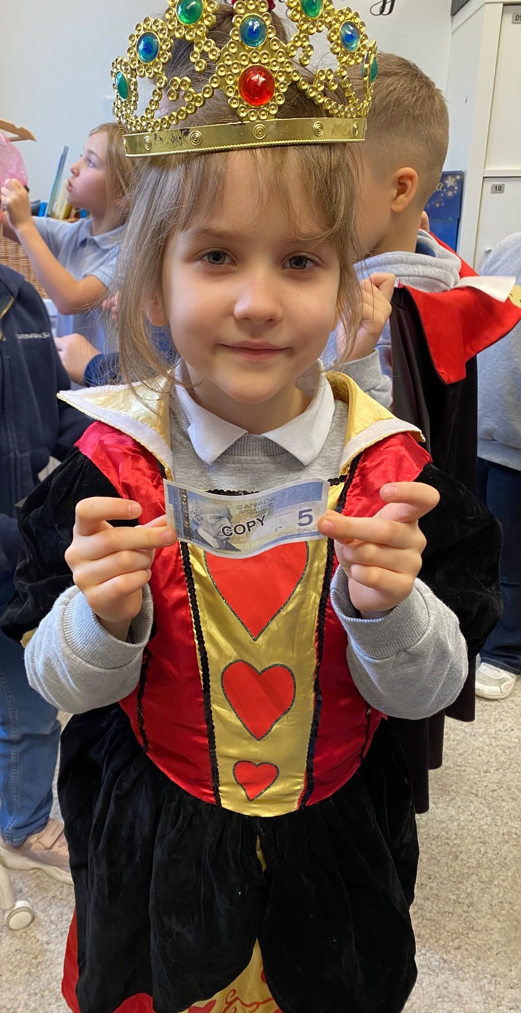
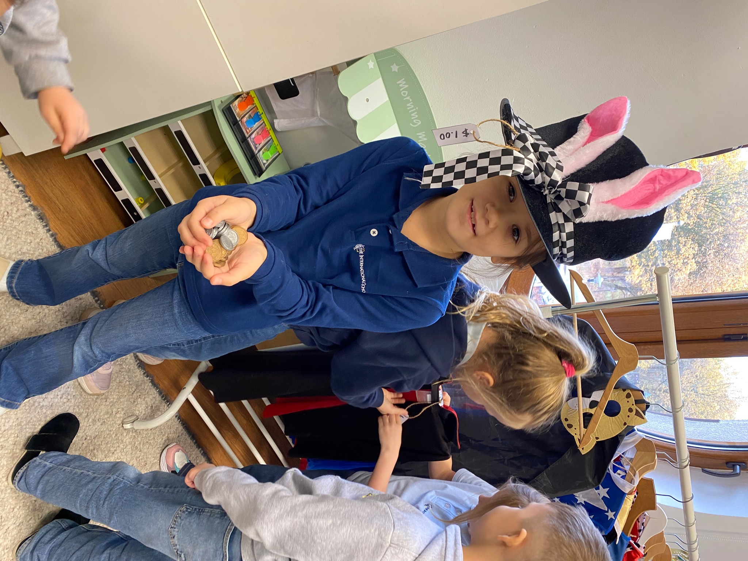
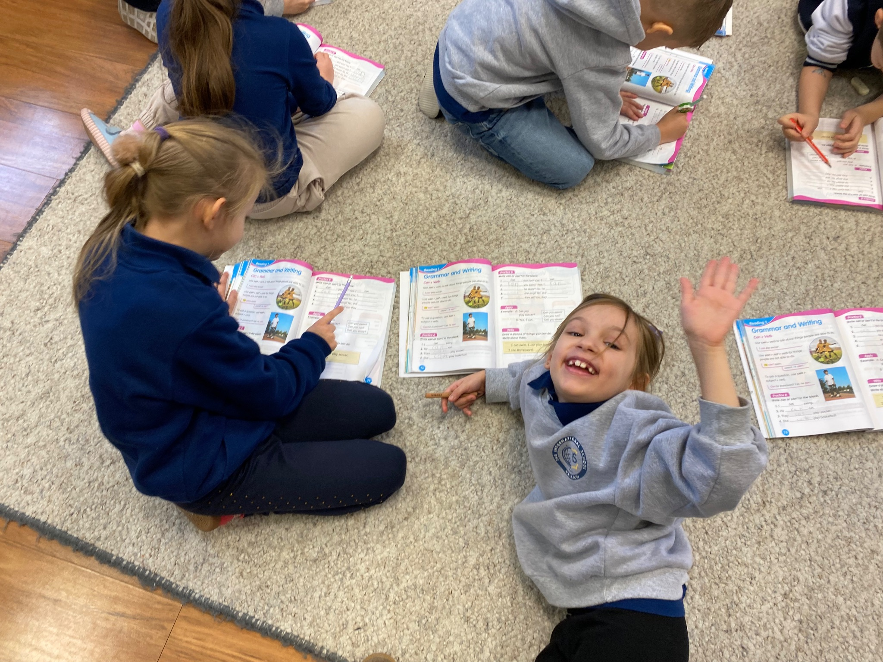


Grade 1 Newsletter - October in Review
Introduction
We had our first unit tests, continued our quizzes (acing them by the way!) and of course - Halloween! Our theme was “Costume Shop.” We had decorations galore and a mini costume shop in our classroom!
Mathematics
We finished ordinal numbers with the story “Seven Blind Mice” by Ed Young. We practiced addition to 1, 6 and 10 too. Next month we’ll skip count and learn about Canadian money!
Science
In Science we completed our unit on our five senses and sense organs. We began our unit on living things and learned new words like “reproduce,” and “photosynthesis.” The following units correspond perfectly with our first digital project: the Animal Research Project!
Language Arts
We began unit 2 which talks about communities! We completed our second pair activity where we brainstormed words with specific letter sounds. This month we’ll work on our first digital project and prepare to present it to the class - our first presentation!
Social Studies
We began learning about special people and places. There were some interesting important places named: like the Lego store and a horseback riding academy! Next up, we’ll make booklets about why we love our community.
Art
We worked on drawing and painting stylish Mary Cassatt hats. Afterwards, we drew our first profile pieces of our school art careers. We can’t forget we made some fun Halloween crafts too!
Pictures, pictures, pictures!

