Slide 1


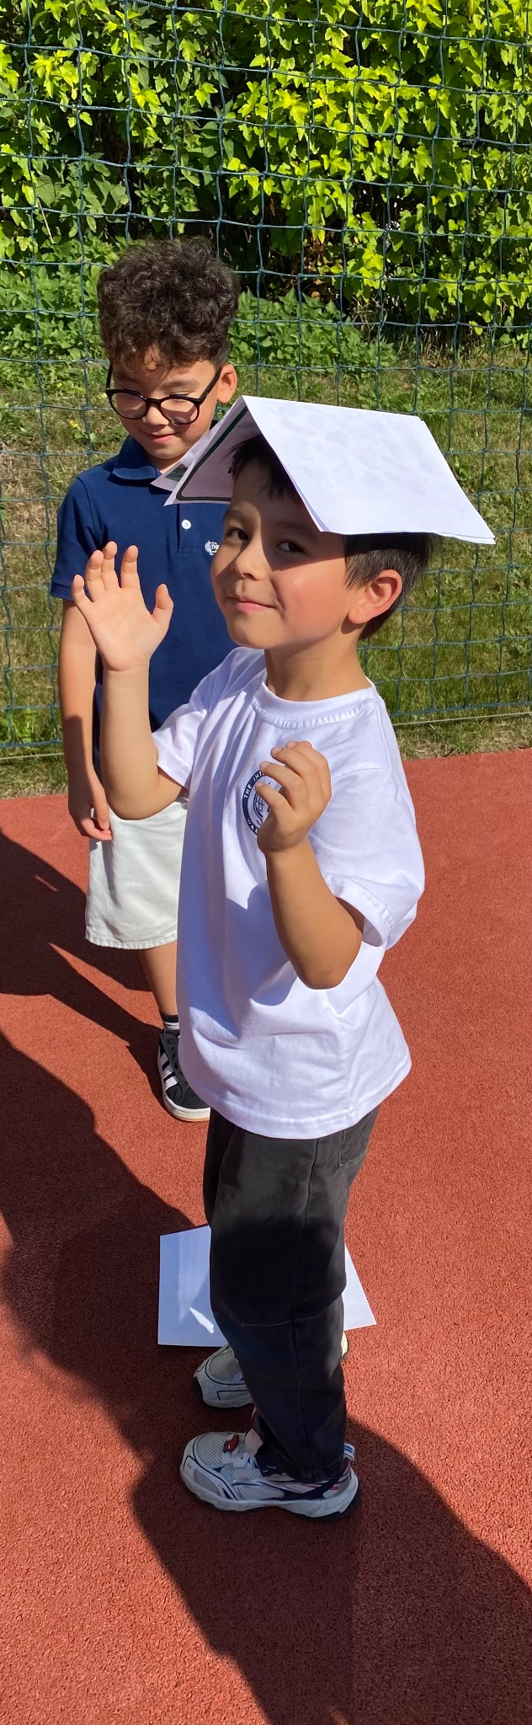
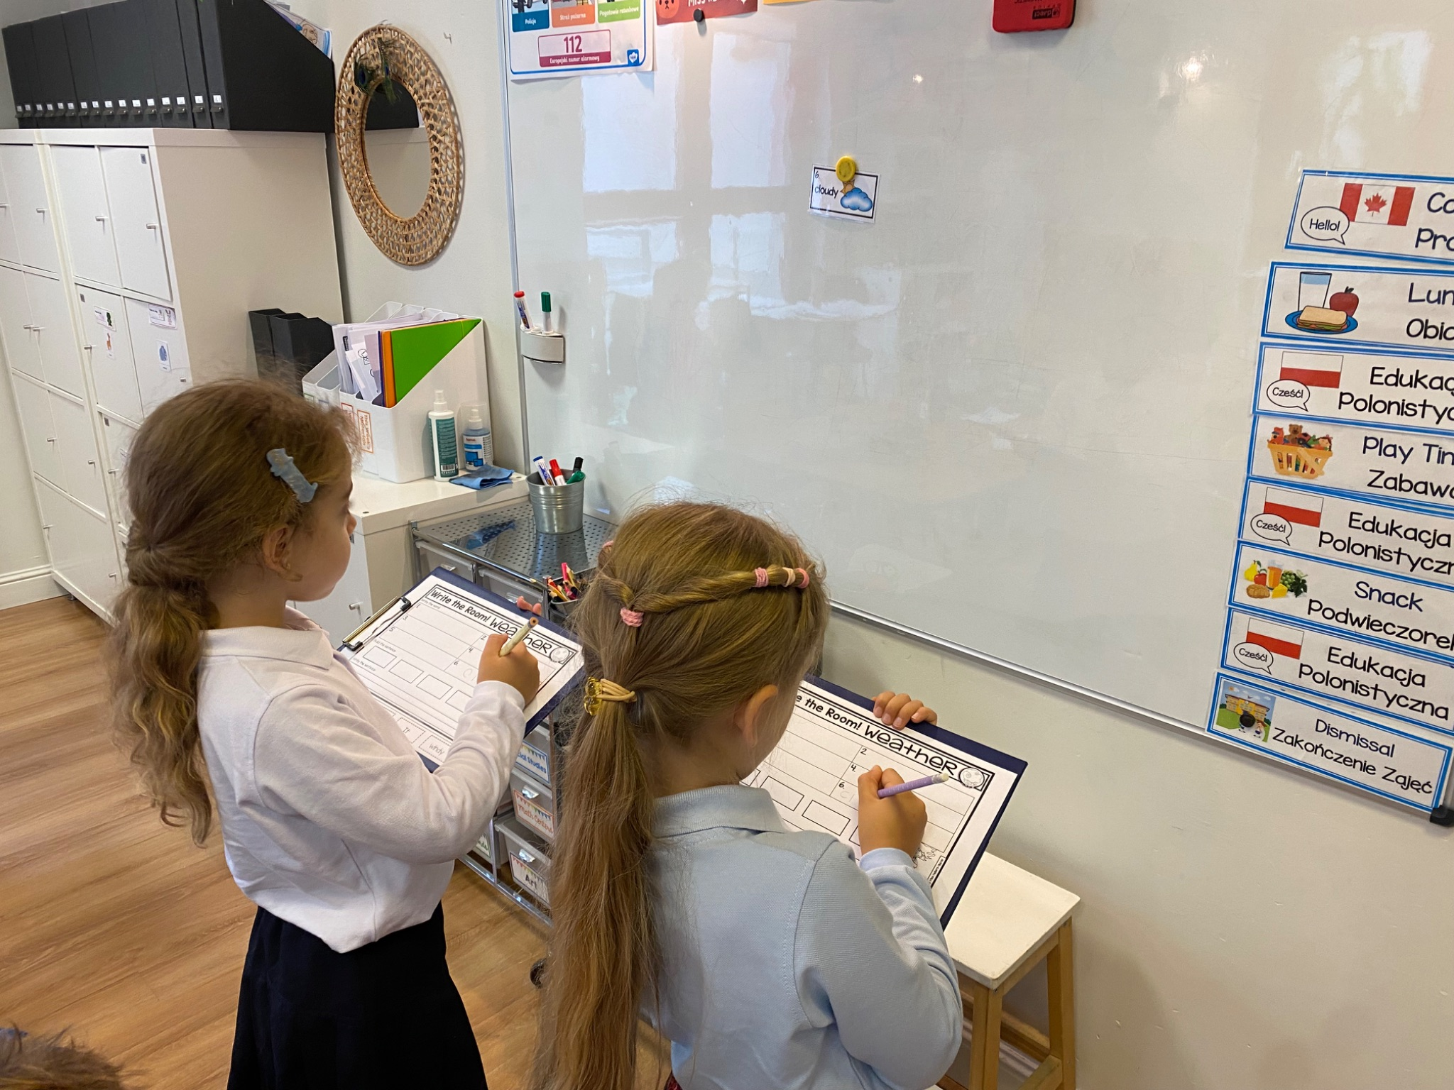


Grade 0 Newsletter - September in Review
Introduction
Welcome to a new school year! We began the year with a jungle-themed classroom, learning all about the places at our new school and important rules! Here’s what we learned this month…
Mathematics
We listened to a story about animals that teach us math skills, like Upton the Understanding fish, Max the Modeling Mouse and Daphne the Drawing Dragonfly. We also problem solve and use critical thinking skills!
Science
We began with weather patterns including: foggy, rainy, snowy and cloudy. We also learned about and even watched some severe weather patterns like tornados and hurricanes! We completed our first Write the Room activity, searching for words and transcribing them on our worksheets.
Language Arts
We are off to the races with letter sounds! We are covering letter names and sounds with the song “Pump Up Your Muscles and Learn the Letter Sounds” and also our Animal Antics A-Z stories. We also covered opposites with our fun “Opposites” song. Lastly, we began learning sight words - words that can’t be sounded out!
Social Studies
We learned members of our families - that includes our pets too! We drew our families and also made creative family trees. Next up - special people and places!
Art
In order to learn the names of colors and some important art rules, we listened to the story “The Day the Crayons Quit!” We then sang about primary and secondary colors and did a color mixing project! We’ll finish with our school-wide art project in which we’ll learn about the artist Sonia Delaunay.
Pictures, pictures, pictures!
September 26th - Modern Art Project
October 7th - Empathy Day
October 31st - Halloween
Important Dates:

