Slide 1


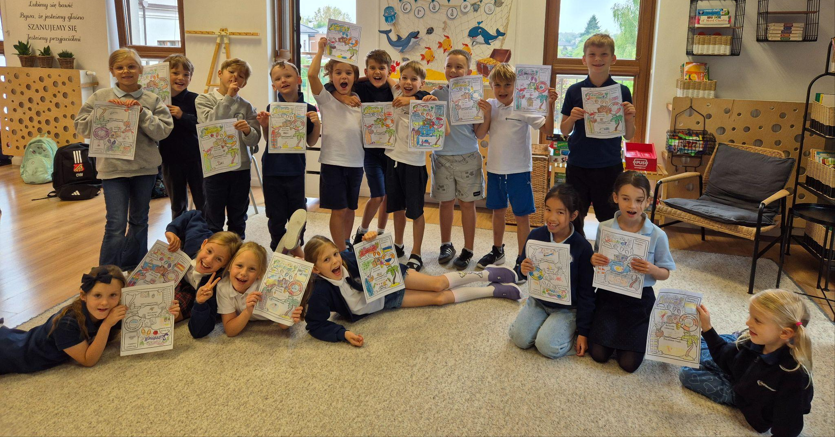
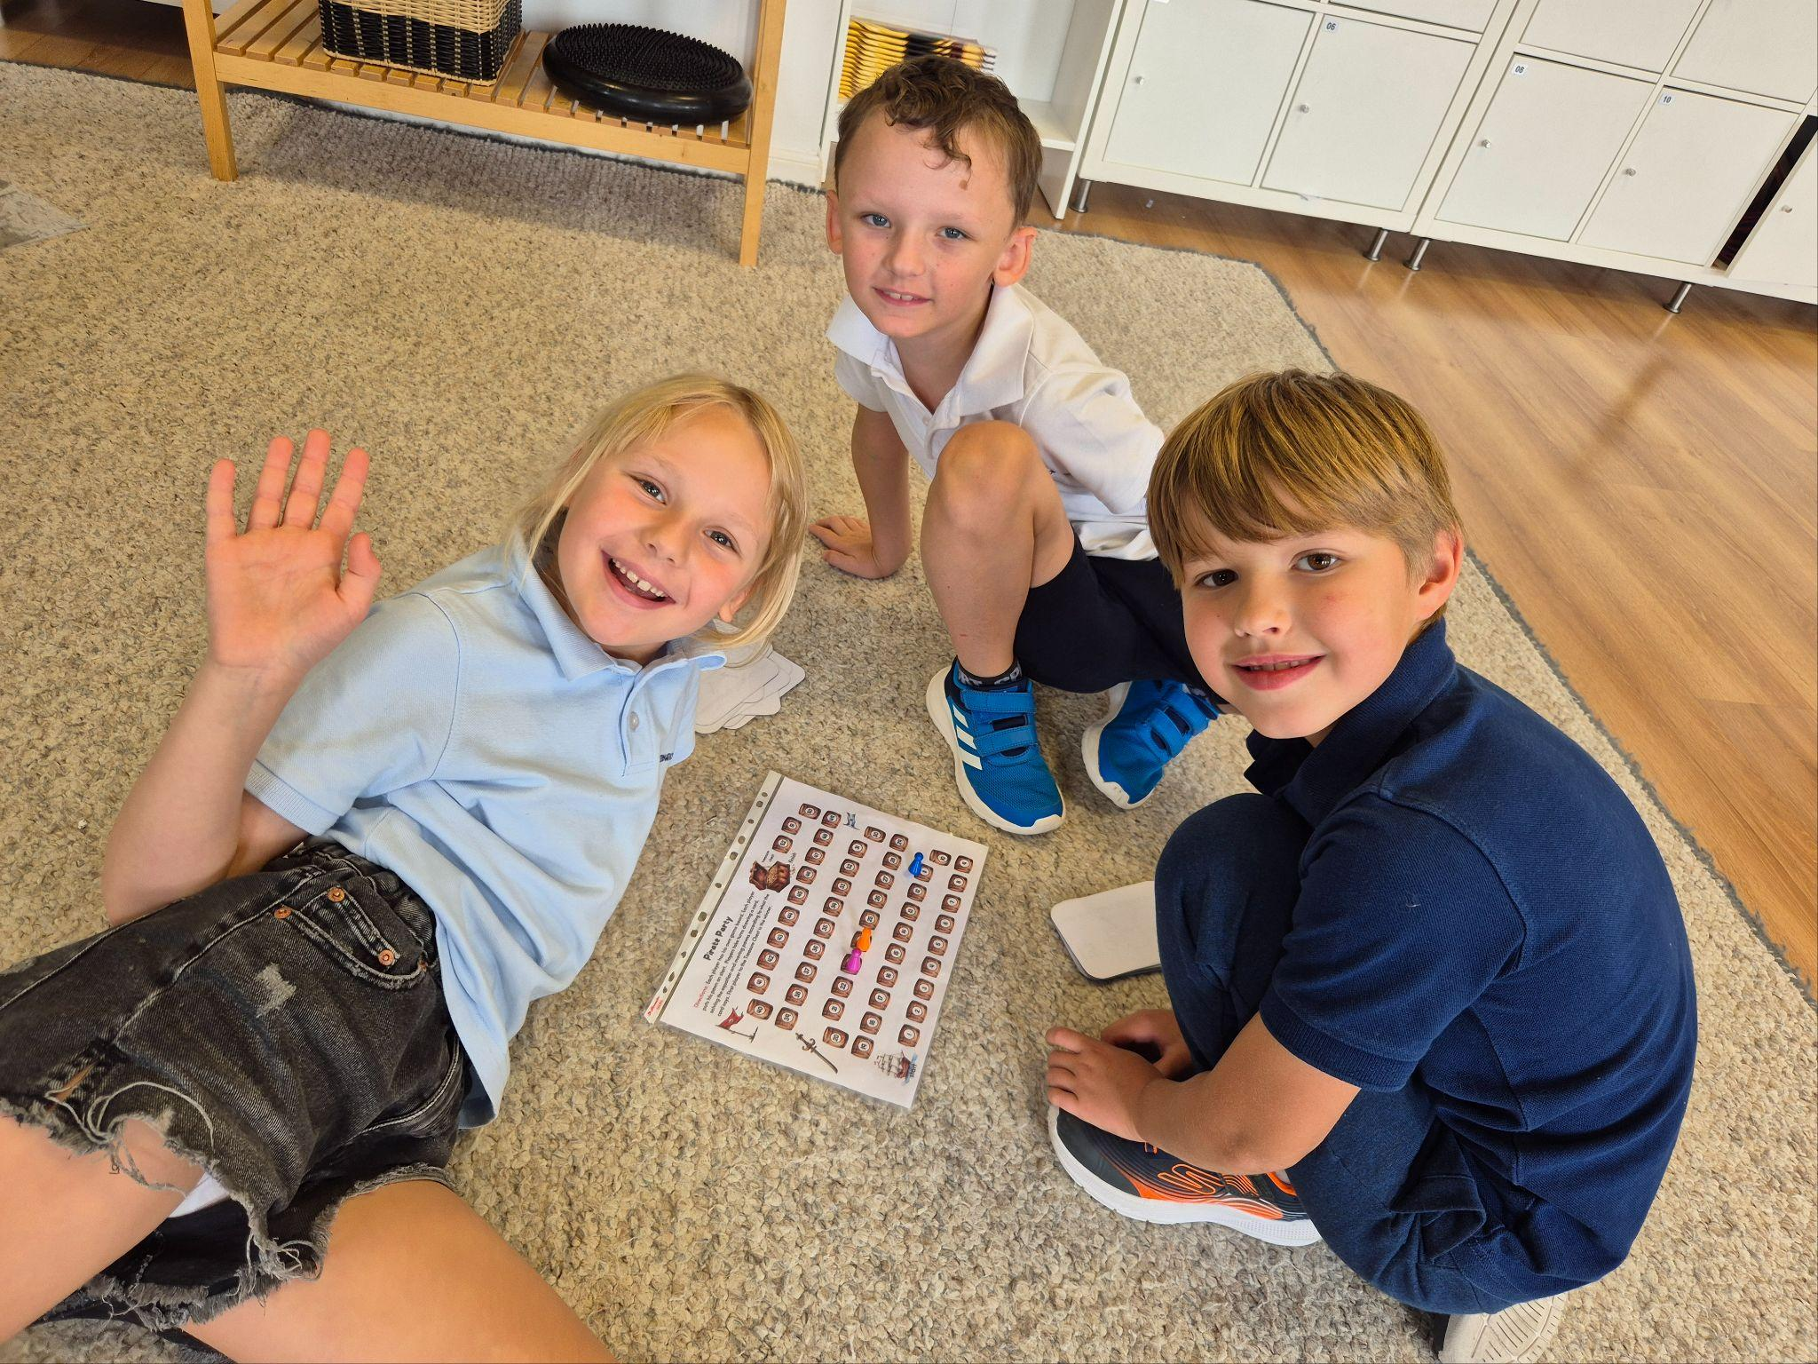
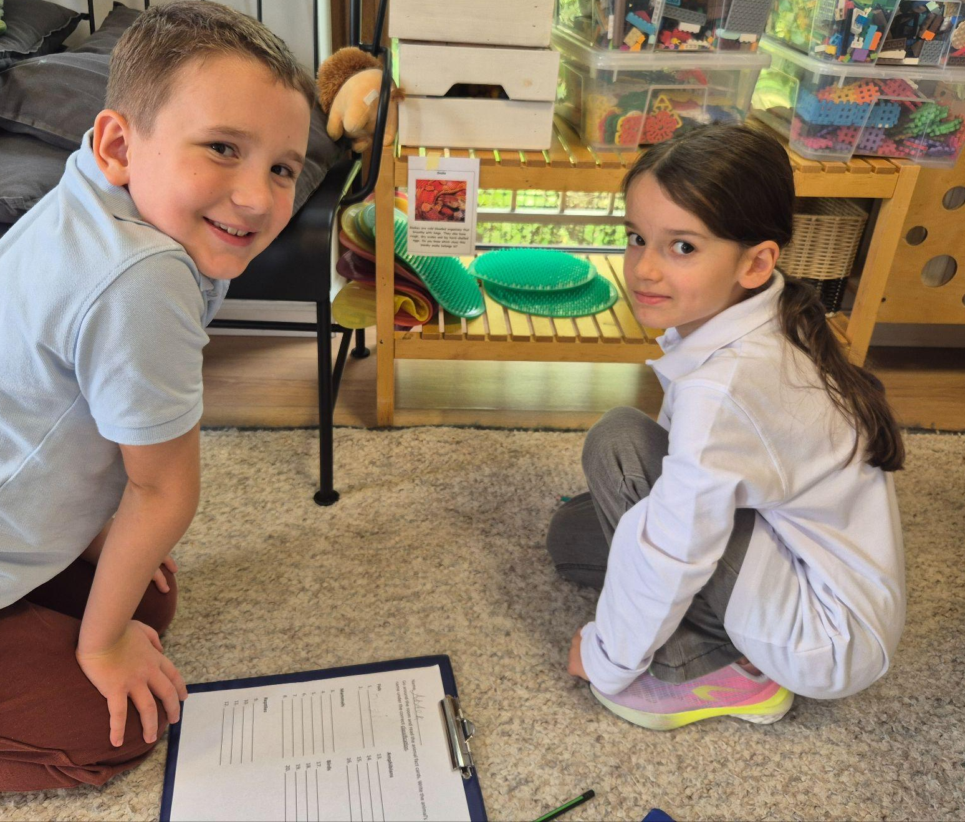
Grade 2 Newsletter - September in Review
Introduction
As we dive into the start of the school year, students were welcomed back with our Under the Sea theme - where we learned about sea creatures and what makes them so interesting!
Mathematics
We learned the numbers to 100 and how to skip count in 2s, 5s and 10s. We reinforced knowledge by playing the Pirate Ship maths game!
Science
We looked at animals and the different types of animal classifications. We played the animal classification hunt in pairs to reinforce knowledge.
Language Arts
We read short stories around sea animals and discussed the plot, themes and characters in small groups. We learned how to use the simple present to talk about things people do. Students wrote short paragraphs and presented to the class.
Social Studies
We started our class project on the Chromebooks - ‘Great inventions’ where students must research a great invention and present their findings to the class.
Art
We started our class project on modern artist David Hockney. Students learned about the artist, his inspirations and recreated pieces of work in his stye.
Pictures, pictures, pictures!
Important Dates:
10th October - Empathy Day
31st October - Halloween
4th November - Completion date for Great Inventions Project
10th-11th November - Independence Day (school closed
27th November - Thanksgiving Day
5th December - St. Nicholas Day

