Slide 1


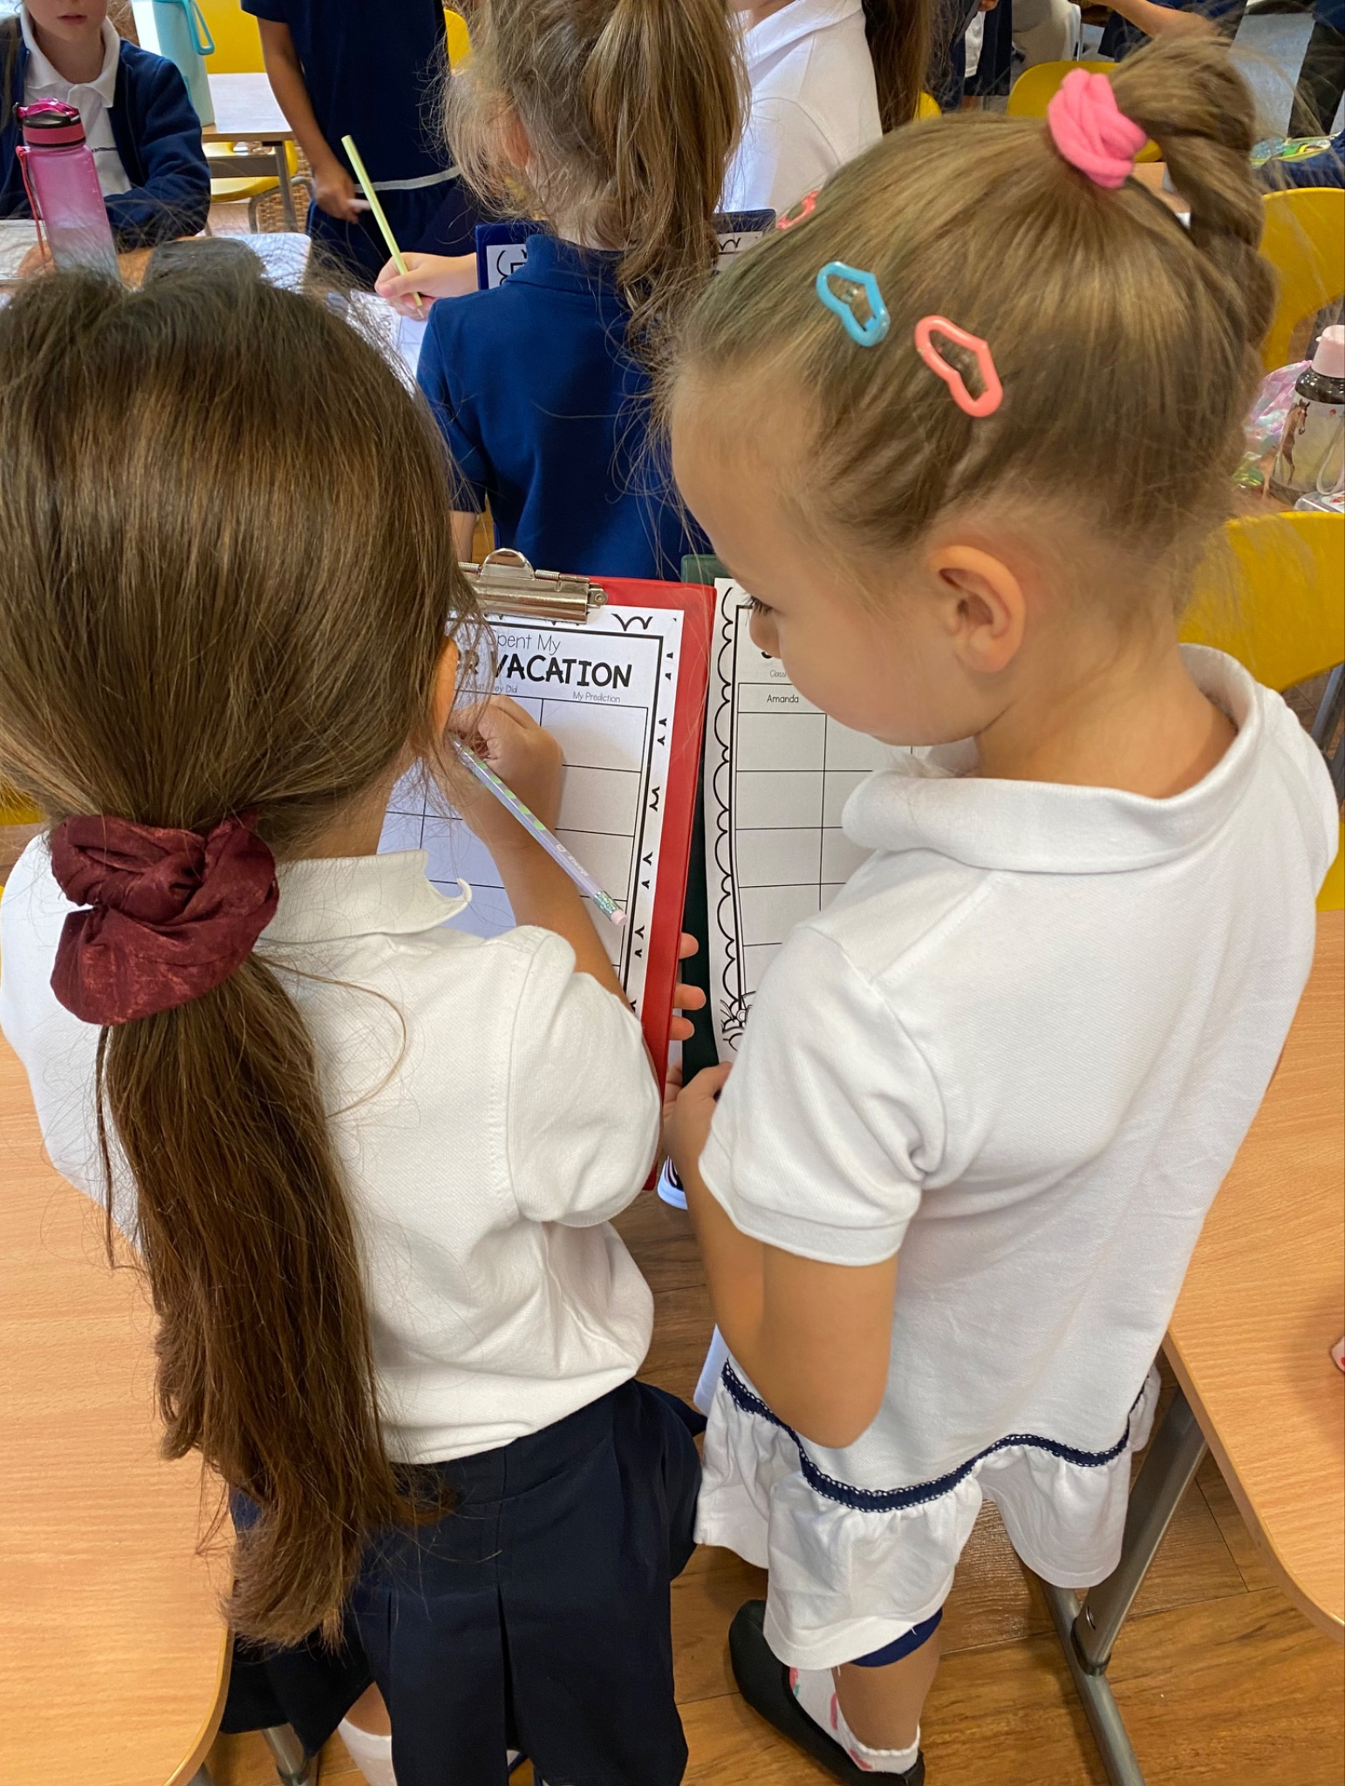

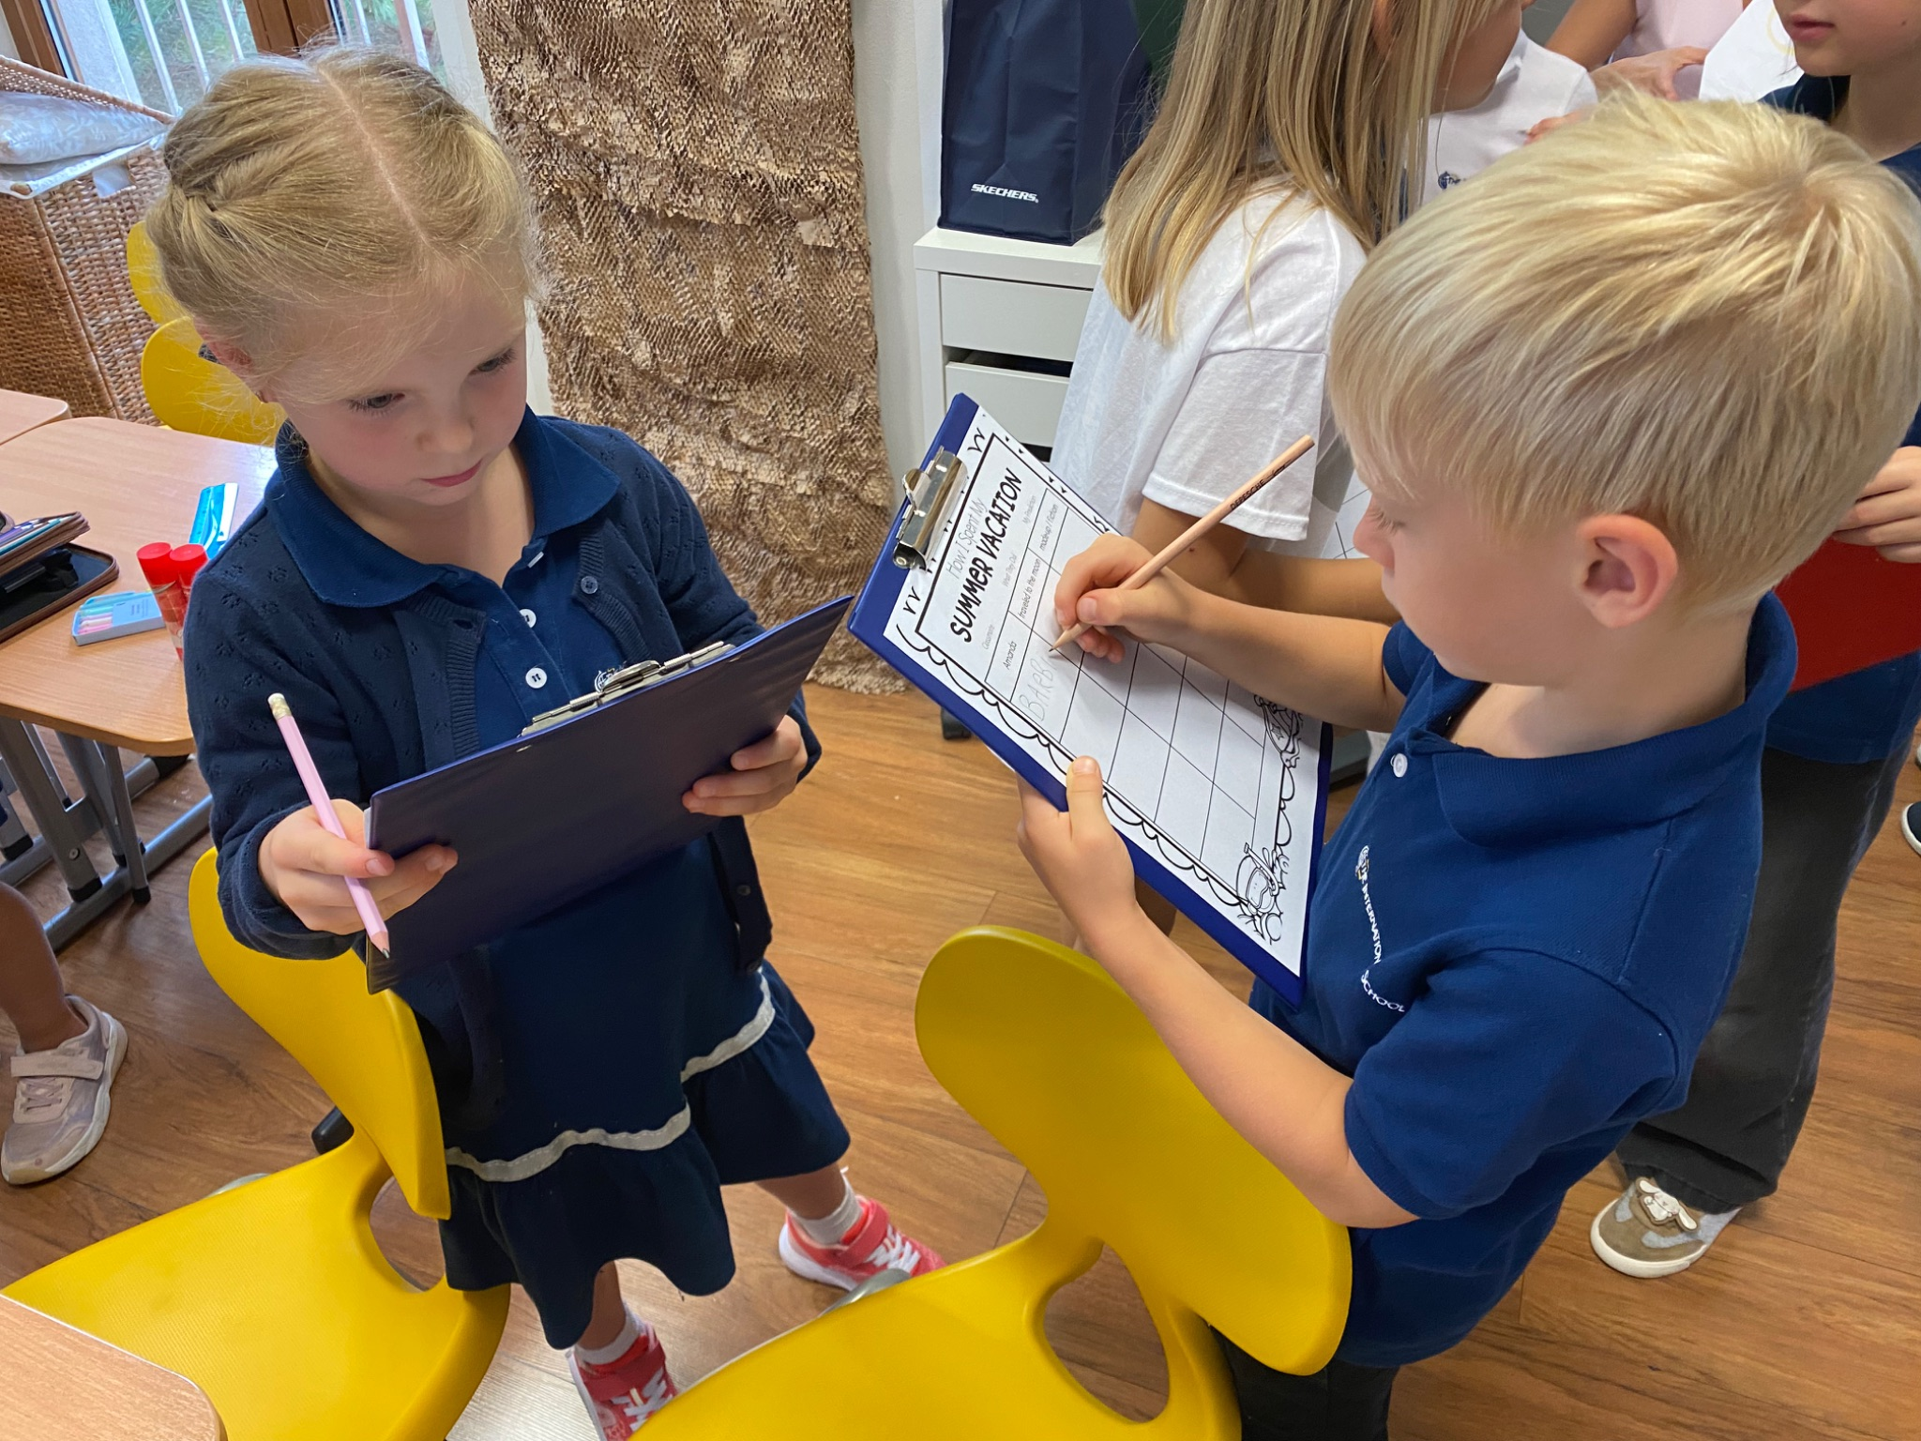

Grade 1 Newsletter - September in Review
Introduction
First grade here we come! We began with practice spelling quizzes, getting to know each other and talking about all the fun things we did this summer! Here’s what we are learning this month…
Mathematics
We completed our unit on measurements, which included comparative adjectives that use -er and -est at the end of the adjective. We will finish with ordering and sorting objects!
Science
We began the year making foil boats for our first STEM activity, which was also teambuilding in disguise! Next we learned about parts of the body and face with monsters! We’ll finish the month learning about our five senses and their corresponding sense organs.
Language Arts
We began our first unit on Changes asking ourselves “how will we change this year?” We reviewed phonics and learned grammar patterns like “be” verbs. Our reading strategies for the month are sequencing and previewing. We also read the story “The Mysterious Tadpole” and completed our first author study about Steven Kellogg.
Social Studies
We learned how we are unique individuals - there is no one on earth like us! We not only learned about our physical attributes, but features of our character: being funny, smart, empathetic, kind and so on!
Art
We learned about Claude Monet, a French painter and the founder of Impressionism. We took our first notes and then created poplars just like Monet! We’ll learn about American artist Alma Thomas for the Modern Art Project and all about the art style Orphism!
Important Dates:
Pictures, pictures, pictures!
September 26th - Modern Art Project
October 7th - Empathy Day
October 31st - Halloween

