Slide 1
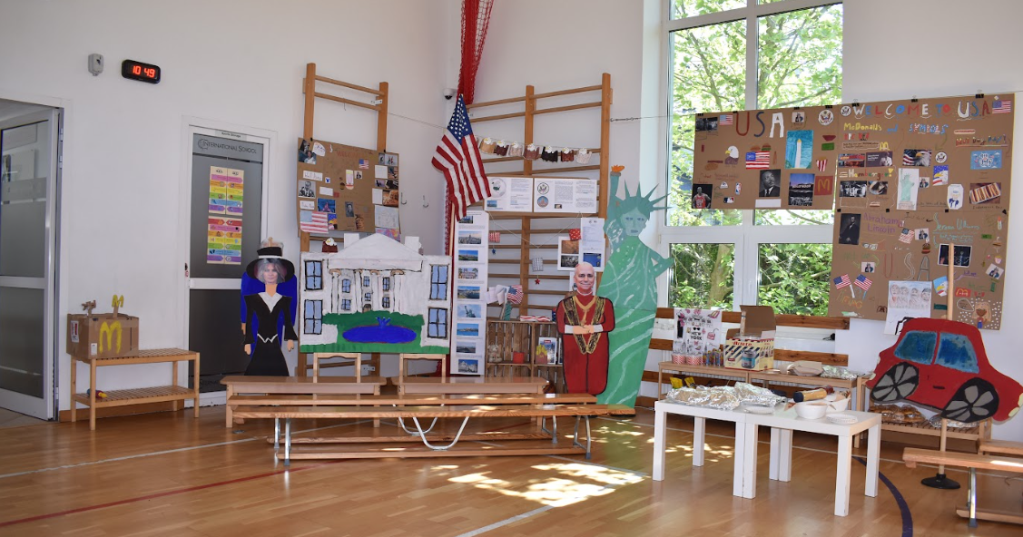
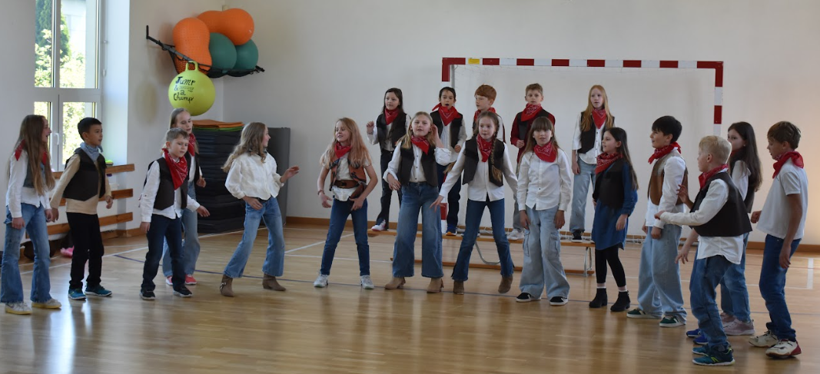
Grade 3 Newsletter - May in Review
Introduction
We had our first Around the World Festival in May where students learned all about the stars and stripes… the USA!
Mathematics
We reviewed the importance of graphs and how to read them. We also learned how to decipher mathematical patterns.
Science
This month, students explored what soil is and the layers it contains. They also learned about small organisms like earthworms and their role in soil health. Hands-on activities helped bring the topic to life.
Language Arts
We talked about great ideas and accidental inventions. We learned how some accidents can lead to good outcomes. We also looked at irregular verbs using the simple past in detail.
Social Studies
We discussed Ontario’s valuable resources and the many types of different land use in Ontario. We also discussed the impact coal mining has on the environment.
Art
We learned about the life and inspirations of Leonardo da Vinci. We looked at his famous works and recreated art in his style.
Pictures, pictures, pictures!
Important Dates:
9th June - Sports Day
9th & 10th June - Parent/Teacher meetings
11th to 13th June - Green School
19th to 20th June - Corpus Christi (school closed)
27th June - End of the School Year

