Slide 1
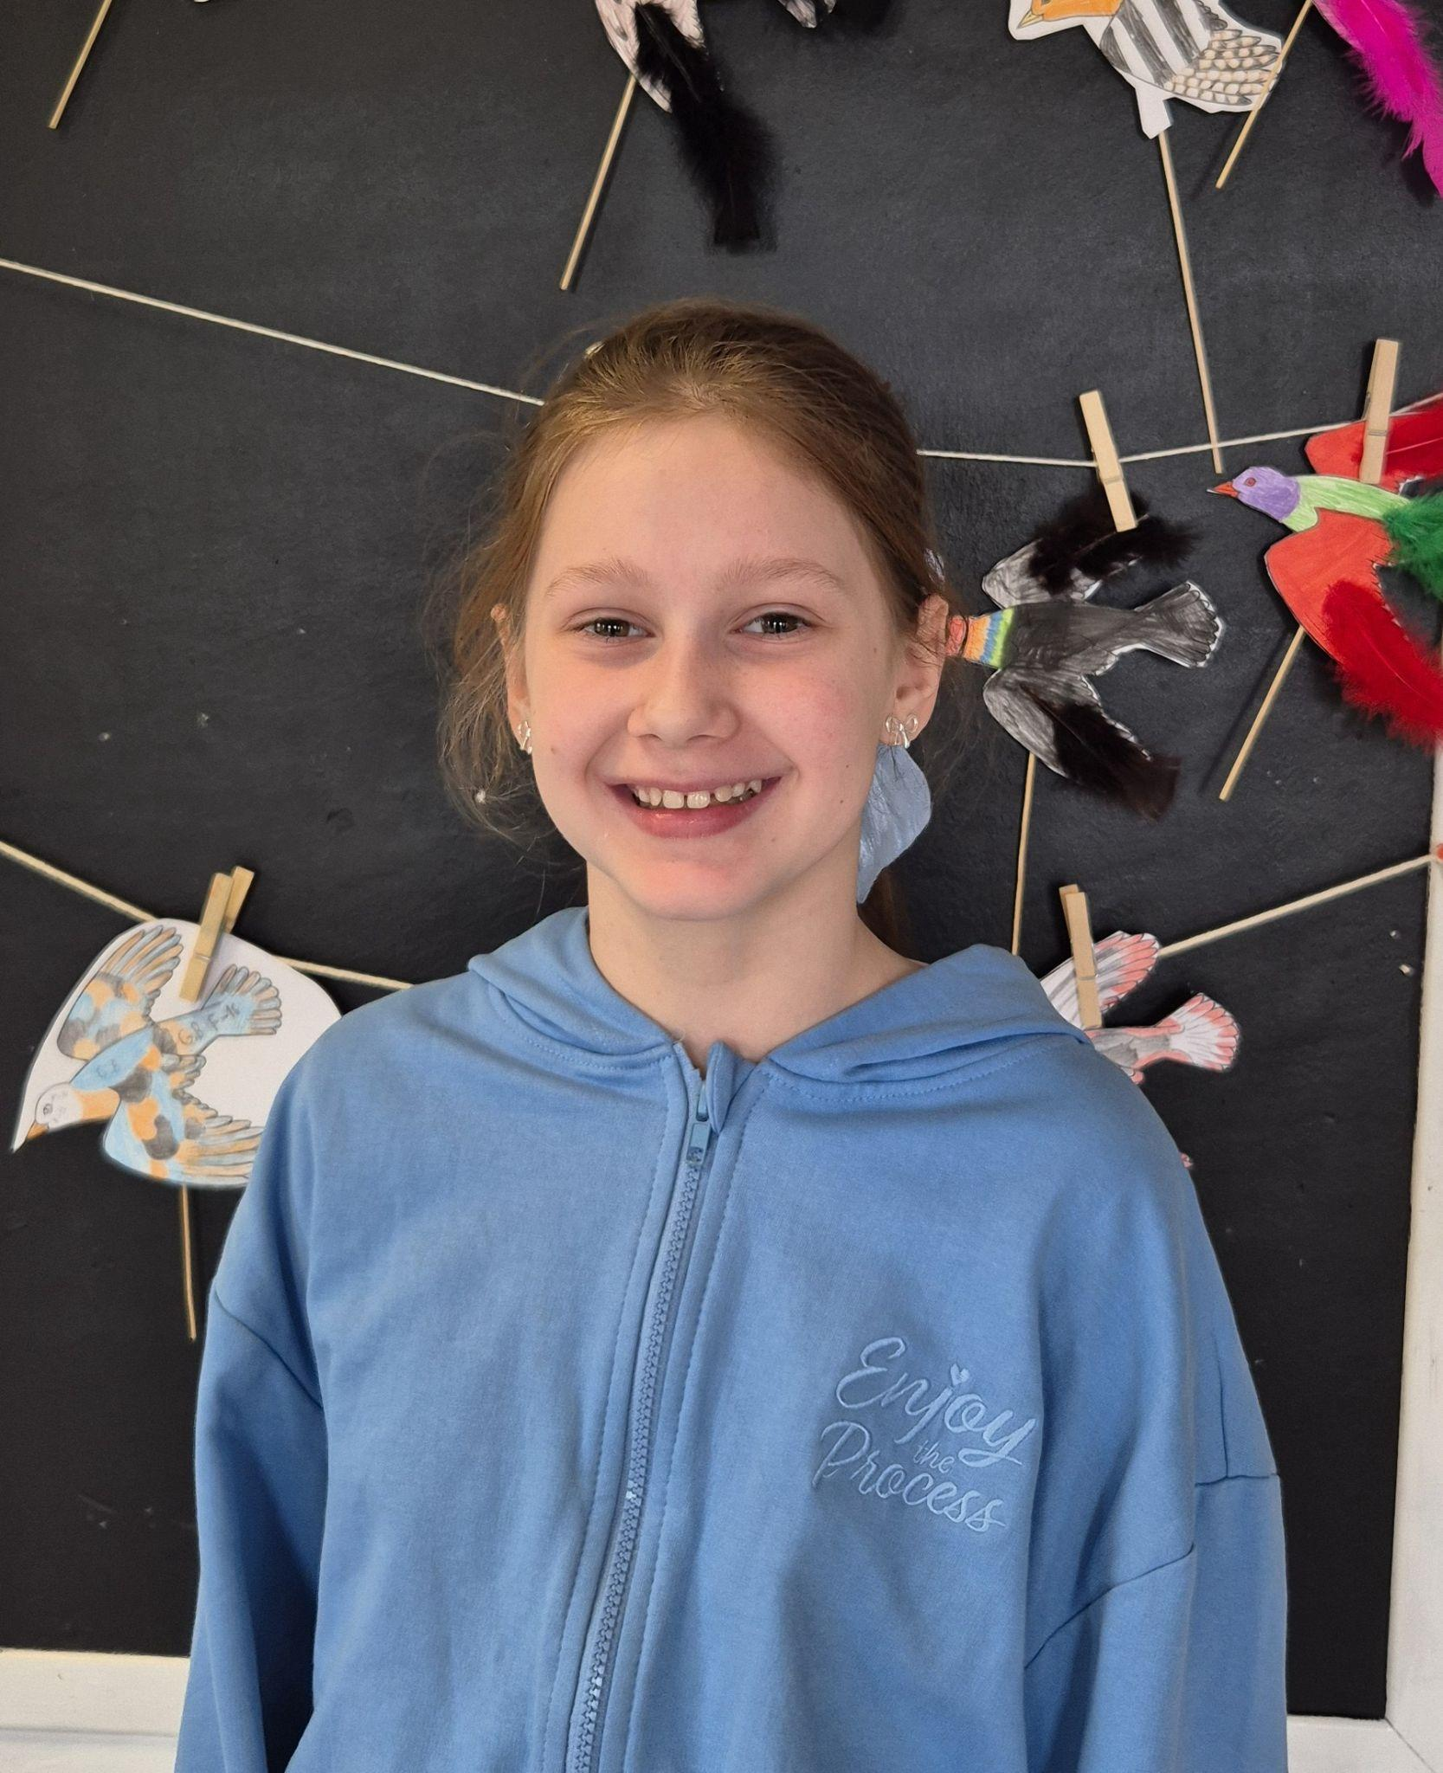
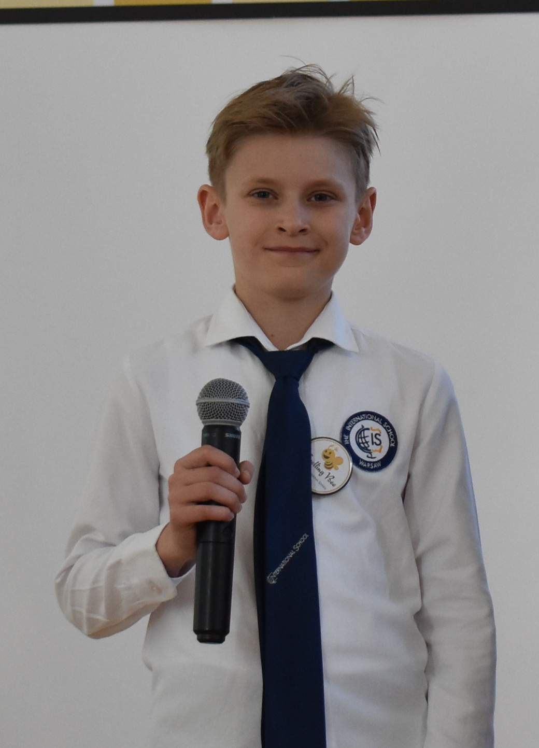
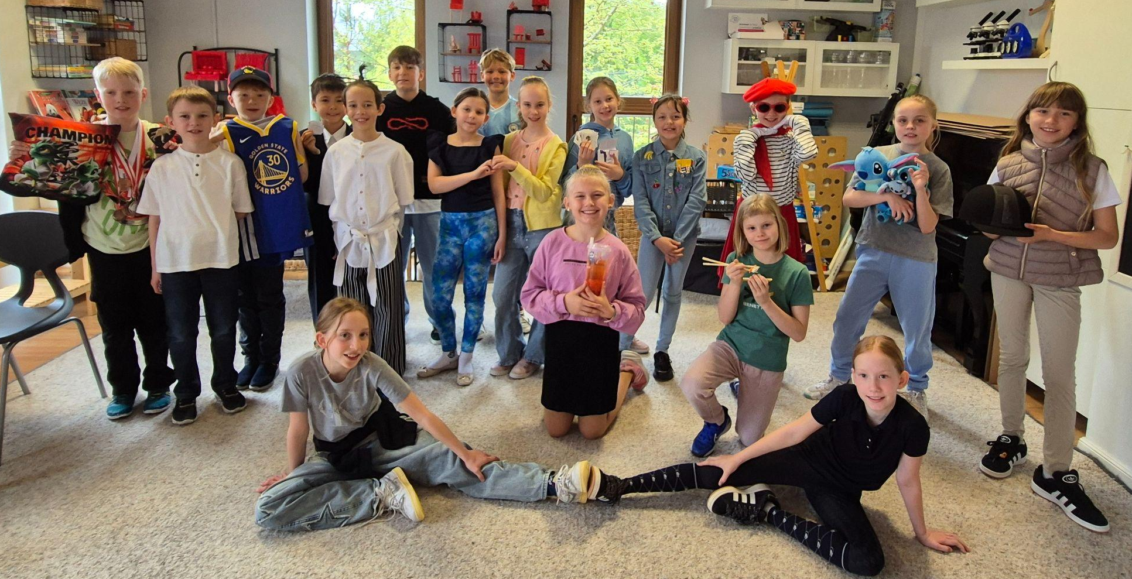
Grade 3 Newsletter - April in Review
Introduction
We welcomed the month of April by celebrating Easter with an Easter Egg Hunt and getting ready for the annual International School Speaking Contest.
Mathematics
We learned about 3D shapes and how to identify them. We also learned how to count the vertices and edges of each shape and how to identify the bases.
Science
Students presented their scientific experiments on the Science Fair. Each group made a carefully put together display board showing the steps of the experiment and how the results prove or disprove their hypothesis. The drive and dedication for this project was truly inspiring!
Language Arts
We learned about adverbs of time and sequence and how to use them. We also learned how to analyse differences and similarities in detail, using T-charts. Students competed in the annual International School Spelling Bee Finals - a special congratulations to our Grade 3 winner!
Social Studies
We learned about the land use in Ontario and prepared for the annual International School Speaking Contest. Students presented their speeches on various topics - a special congratulations to our Grade 3 winner!
Art
Students learned about Frida Kahlo and what inspired her. We also looked at the hardships she overcame in order to pursue her passion. Students created self portraits in her style.
Pictures, pictures, pictures!
Important Dates:
1st May & 2nd May (School Closed)
13th May - ‘Around the World’ festival (schoolwide)

