Slide 1
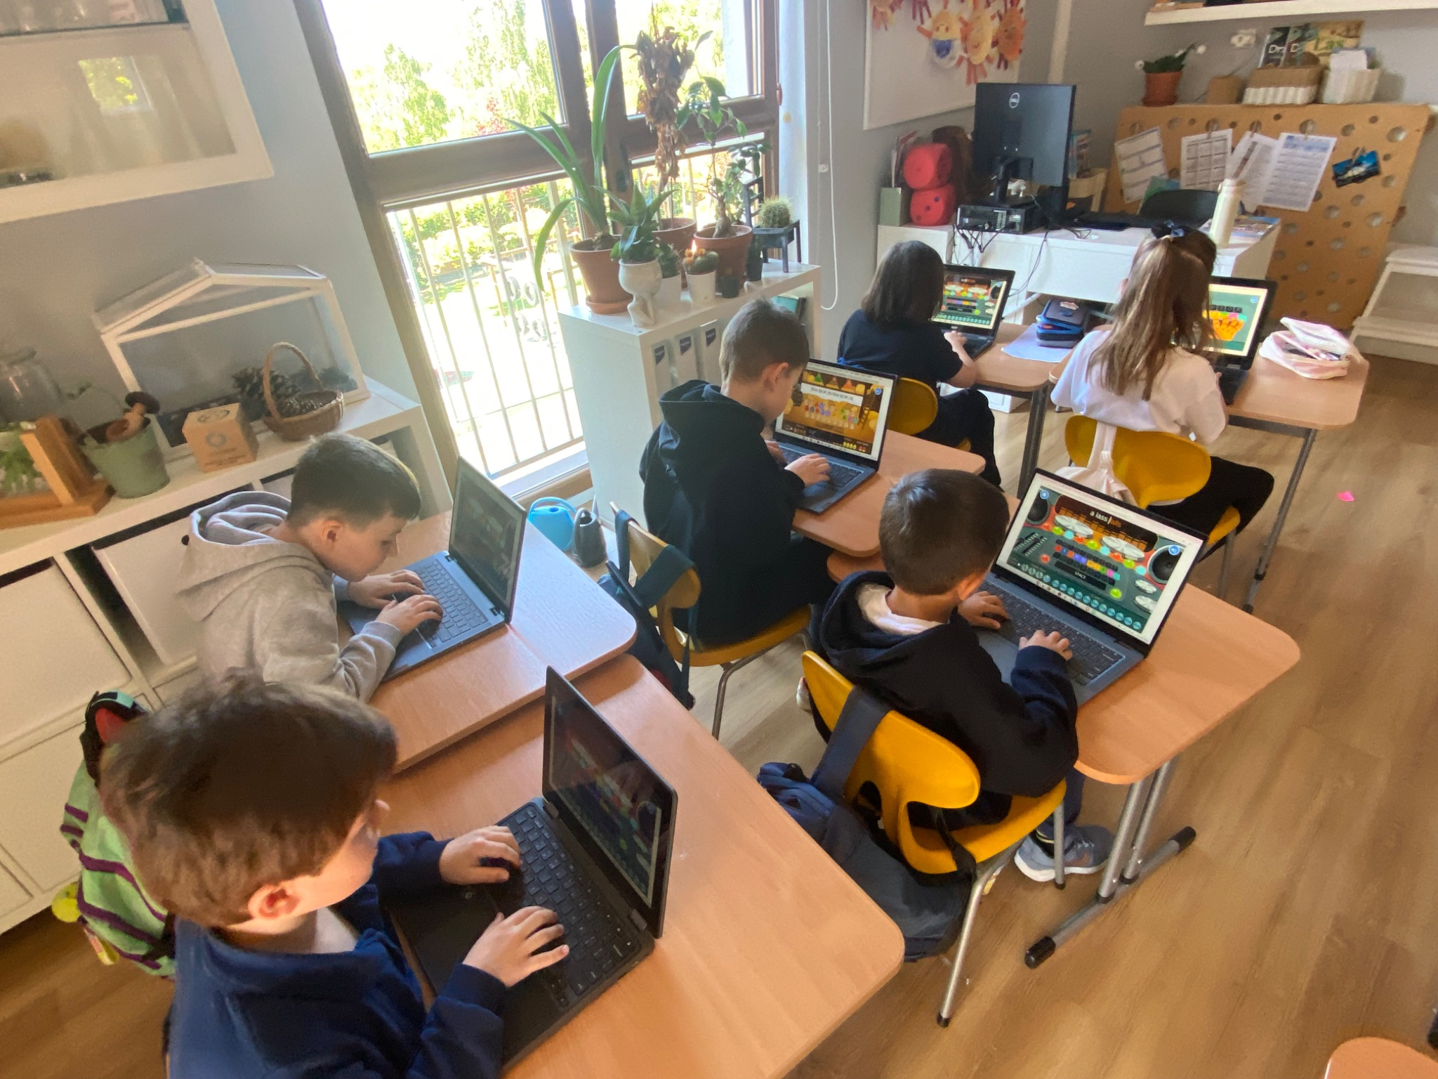
Grade 2 Newsletter - May in Review
Introduction
We payed homage to the Emerald Isle! That’s a nickname for irresistible Ireland. We sang to U2’s “It’s a Beautiful Day” and danced an irish jig for the Around the World Festival. Some say we can give the river dancers a run for their money!
Mathematics
We conquered division like champions, learning terms like “divisor,” “dividend” and “quotient.” We also dove into fractions, studying numerators and denominators. We can’t get enough! Next, we’ll look at capacity, volume and mass.
Science
Students learned about evaporation, condensation, and precipitation, and how the sun drives these changes in the water cycle. In groups, they are creating posters to show the stages of the water cycle. They will be displayed in the classroom when finished!
Language Arts
We learned a bit about Jane Goodall, a zoologist and great scientific mind. Did you know she had prosopagnosia? We continued learning new grammar concepts, like regular and irregular past tense verb forms, and also sight words, story words and phonics! We also practiced our typing skills using digital games!
Social Studies
We learned about sports and recreational activities in different climates, like skiing, hiking and camping. We also looked at the different cities and regions of Canada. Did you know most people live in the south because the north is too cold? completing research on all the wonderful things to know about Northern Ireland and the Republic of Ireland!
Art
We created amazing hand drawn posters about Ireland for the festival in groups! We also made Mexican suns after learning a bit about the Aztec sun stone. We finished with making Mother’s Day Love Jars for our special moms. We hope you love them as much as we love you!
Pictures, pictures, pictures!
Important Dates:
May 30th - Field trip to the movie theater to see “Flow”
June 9th - Sports Day
June 10th - End of Semester Meeting
June 11th through 13th - Green School
June 19th and 20th - Corpus Christi (school closed the 19th)
June 27th - Last day of school!

