Slide 1
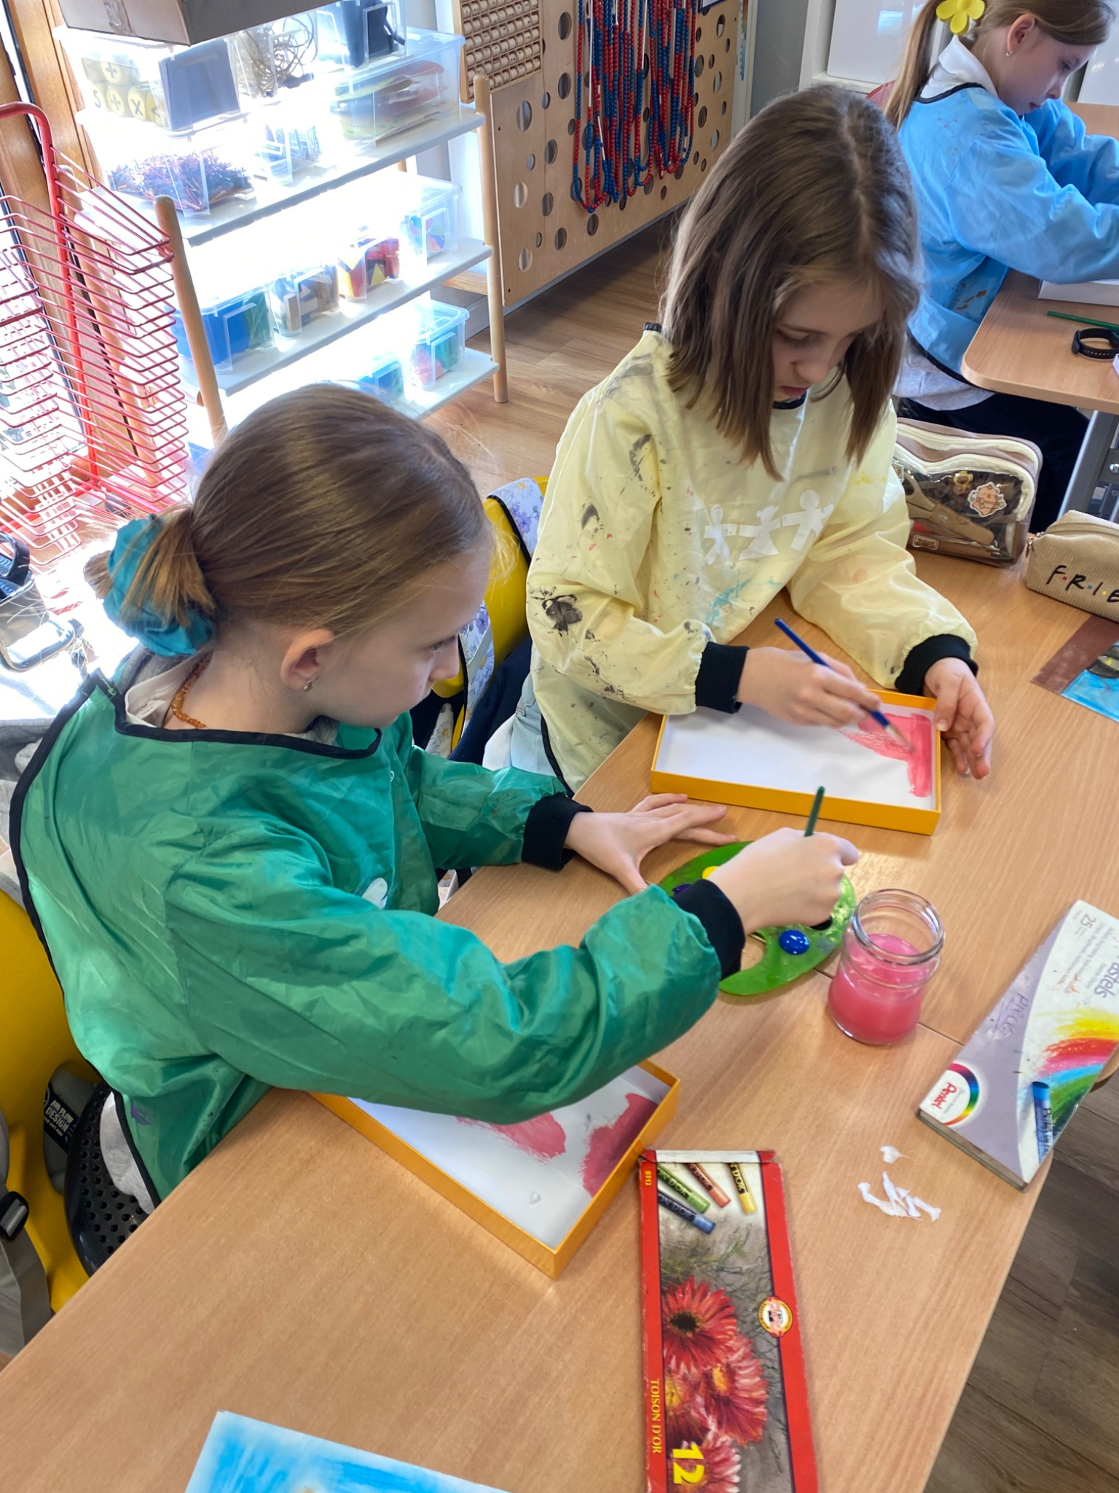
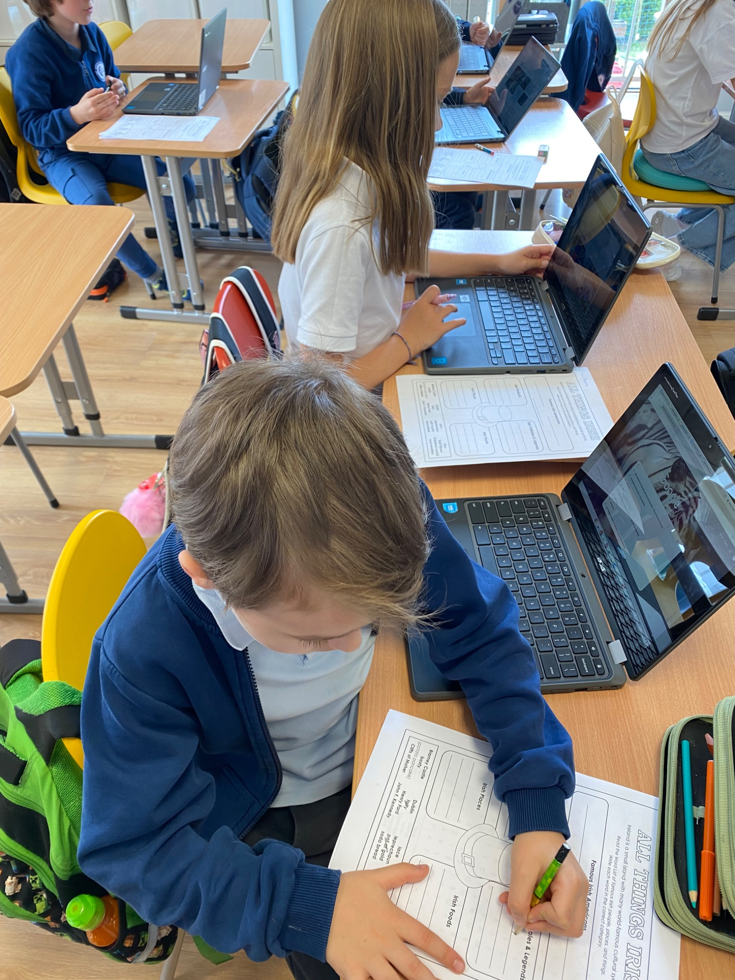
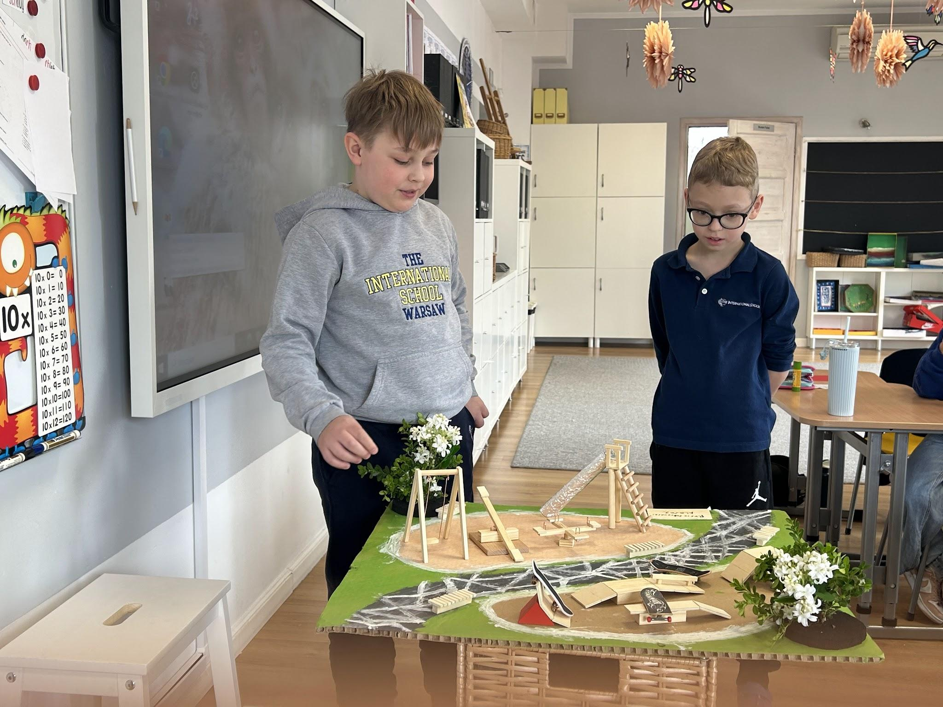
Grade 2 Newsletter - April in Review
Introduction
We celebrated Easter together with a sunny Easter egg hunt and a Peep adoption - a famous American sweet specifically enjoyed at Easter!
Mathematics
We had an introduction to division using delicious cookie crisp cereal and the story “The Doorbell Rang” by Pat Hutchins. We learned terminology like “divisor,” “dividend” and “quotient.” We are math geniuses!
Science
This month we concluded our unit about simple machines and their use with the playground model project. Everyone presented their playground, the simple machines it contains and how they can be used to have fun. The results were very creative!
Language Arts
We started our unit “Then and Now” comparing the past and our present. We learned how to make a historical timeline and spoke about different inventions and the period in which they were created. We also learned about. We learned about multiple meaning words and brainstormed a few too! We had our Speaking Contest, where we listened to topics ranging from gold to Hot Wheels!
Social Studies
We spoke about ancient and modern sports, comparing the two. We also looked at the Olympics of the past and present to see how the famous games have changed. Next, we’ll look at Canadian Sports! Finally, we began to learn about the culture, cuisine and customs of Ireland for the “Around the World Festival!”
Art
We learned about Frida Kahlo, a famous and influential Mexican artist. We made portraits of Frida and then used cardboard lids to decorate our own nicho frames (fanciful shadow boxes used to display pictures and other works of art).
Pictures, pictures, pictures!
Important Dates:
May 13th - Around the World Festival
June 9th - Sports Day
June 11th-13th - Green School
June 19th - Corpus Christi (school closed)

