Slide 1
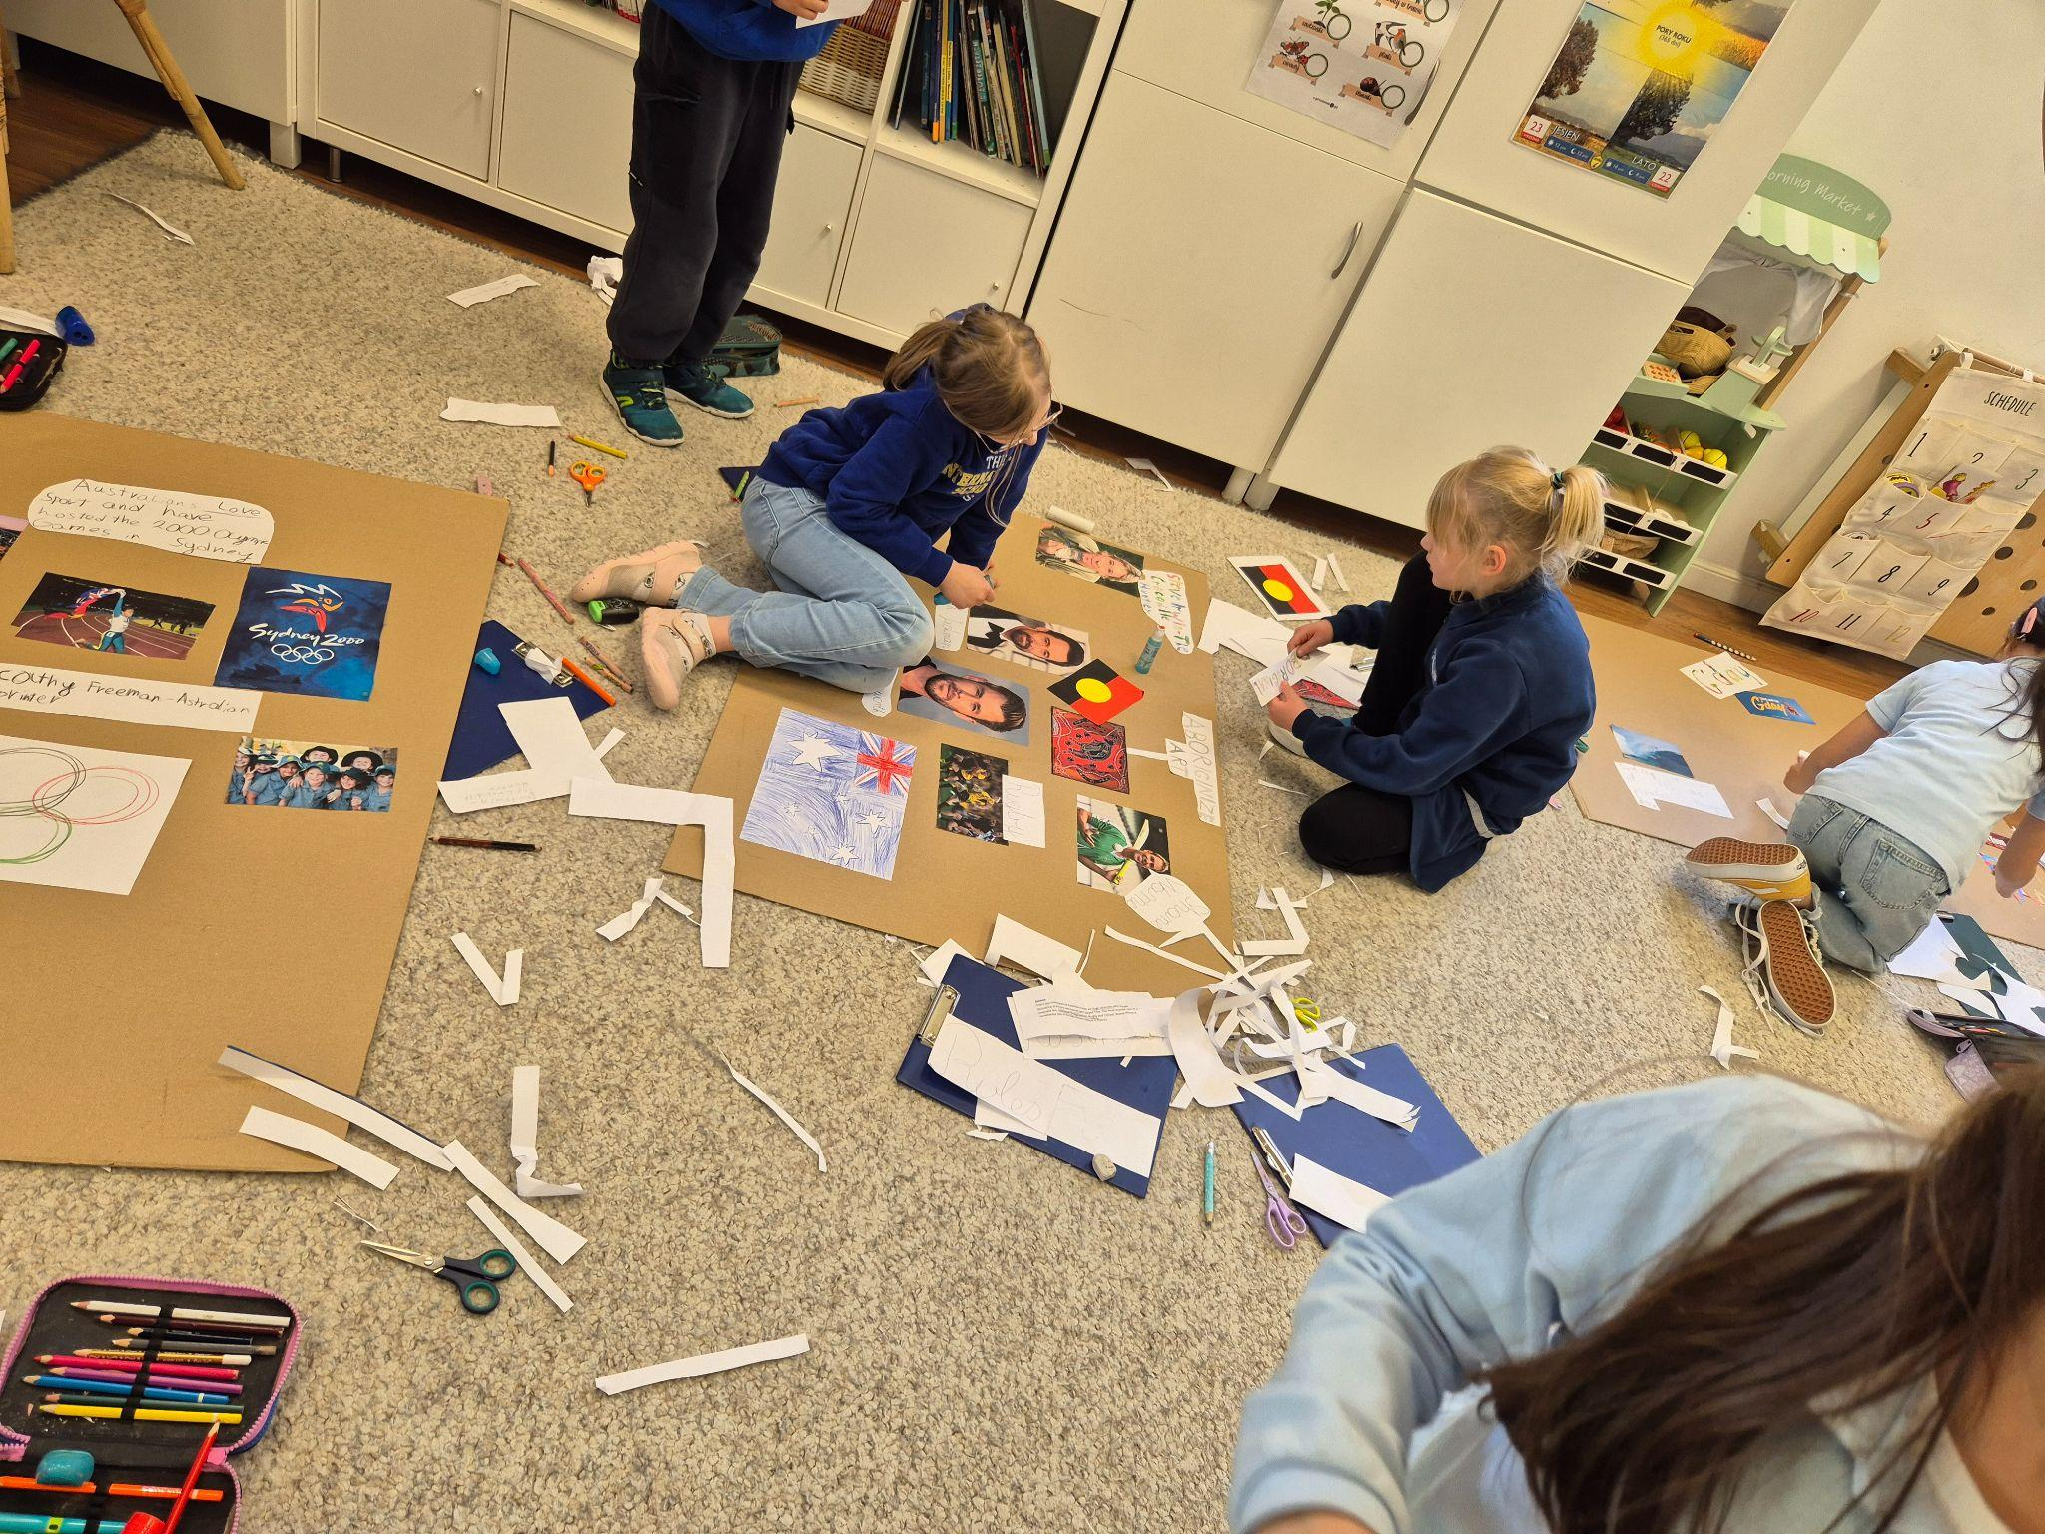
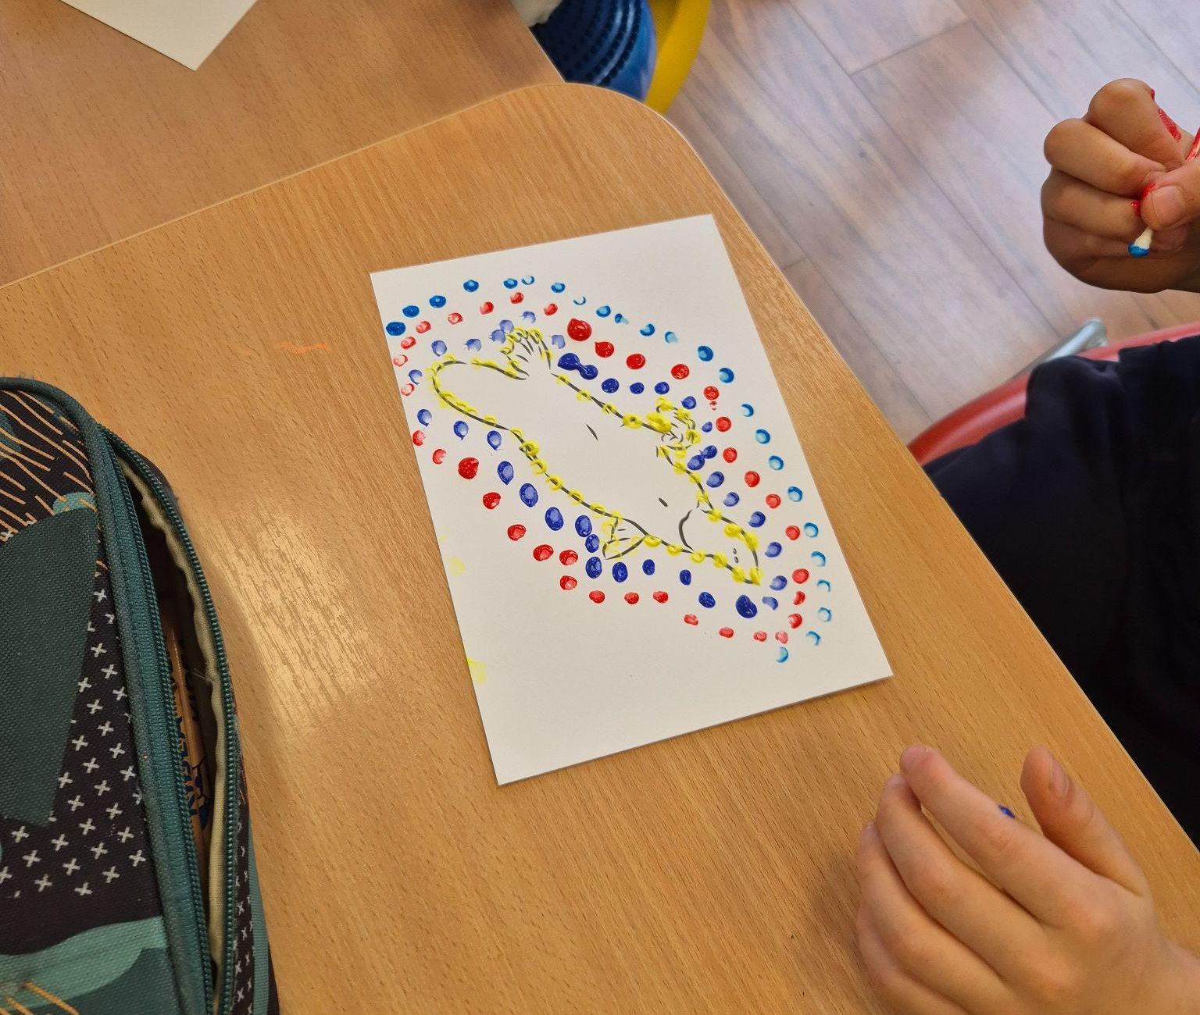
Grade 1 Newsletter - May in Review
Introduction
We had our first Around the World Festival in May where students learned all about the land down under… Australia!
Mathematics
We looked at mass in detail and how objects can be heavier or lighter. We reinforced knowledge by finding objects in the classroom and discussing whether they were heavier or lighter and putting them in order.
Science
Grade 1 students are learning how the Earth's rotation and the sun influence weather and seasons. They explored how calendars help track seasonal changes. We also learned what a weather forecast is and how it can help us in our daily lives.
Language Arts
We learned all about life on a cruise ship and how crew members work hard to ensure passengers have a great experience! We also learned how to write sentences using the simple past and students wrote about a fun experience they had.
Social Studies
We learned how our home and our neighbourhoods are similar and different. We also talked about how important it is to project nature areas all around us.
Art
We drew pictures that were inspired by Paula Rego. We also used pastels to create summer sunsets to welcome in the long, summer days!
Pictures, pictures, pictures!
Important Dates:
9th June - Sports Day
9th & 10th June - Parent/Teacher meetings
11th to 13th June - Green School
19th to 20th June - Corpus Christi (school closed)
27th June - End of the School Year

