Slide 1
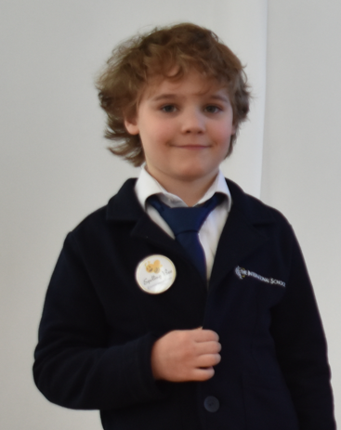
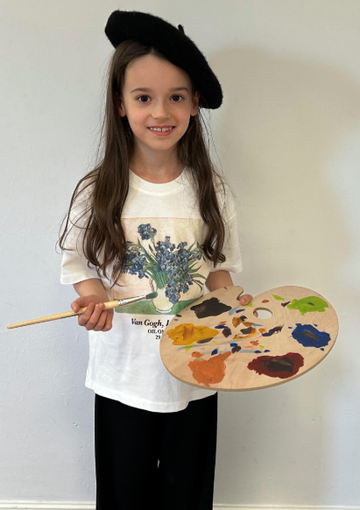
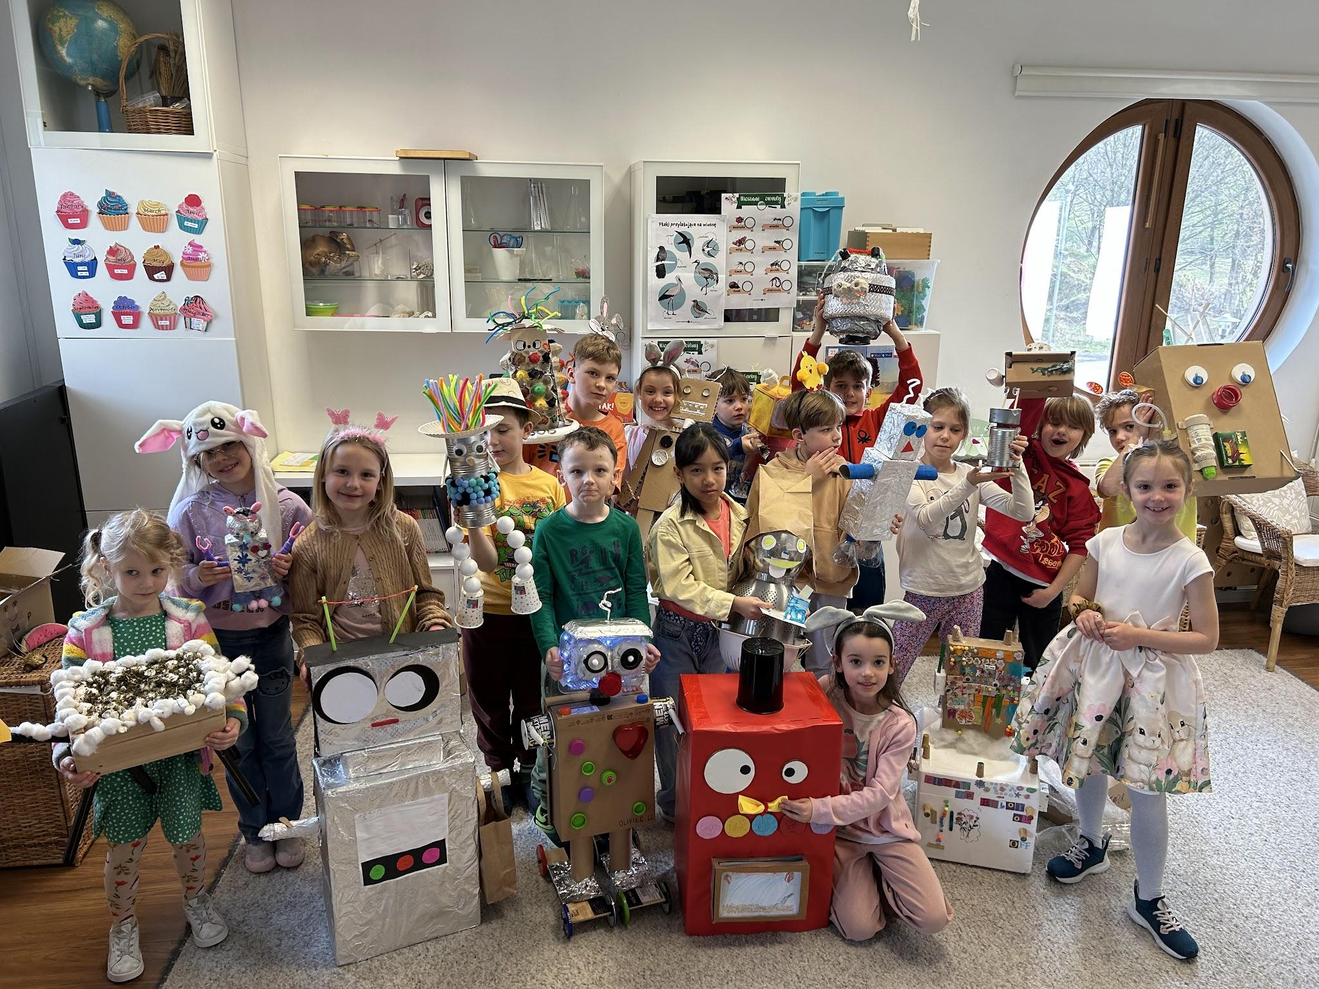
Grade 1 Newsletter - April in Review
Introduction
We welcomed the month of April by celebrating Easter with an Easter Egg Hunt and getting ready for the Grade 1 Speaking Contest!
Mathematics
We learned about the seasons, temperature and capacity. To reinforce knowledge, students had a class activity where they had to guess how many glasses of water it took to fill a water bottle!
Science
Students made their own robot, concluding our unit on materials and fasteners. Each student presented their rbot to the rest of the class. Each robot had a specific job and some even had a name. It was great to see how dedicated they were and how all robots were truly unique.
Language Arts
We learned to compare and contrast using Venn Diagrams and the differences between proper nouns and common nouns. Students also completed in the annual International School Spelling Bee Finals, a special congratulations to our Grade 1 winner!
Social Studies
We prepared for the annual International School Speaking Contest and students presented their speeches on various topics. A special congratulations to our Grade 1 winner!
Art
We created artwork in the style of Yayoi Kusama and started studying our next artist - Piet Mondrian. We looked at how his artwork also inspired the world of music and fashion!
Pictures, pictures, pictures!
Important Dates:
1st May & 2nd May (School Closed)
13th May - ‘Around the World’ festival (schoolwide)

