Slide 1
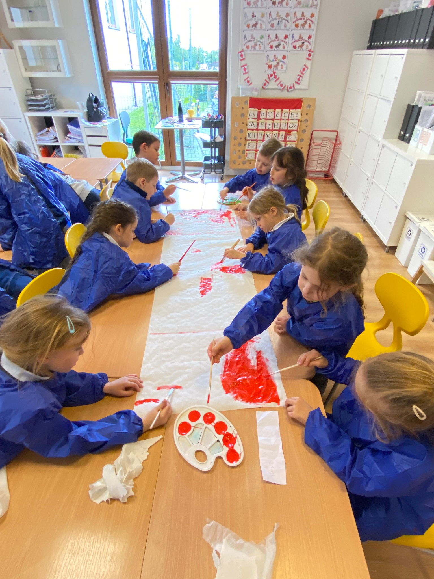
Grade 0 Newsletter - May in Review
Introduction
This month we participated in our first “Around the World Festival!” We presented facts about Canadian food, famous people and places to the entire school. We also performed a song and dance - get ready for it!
Mathematics
We continued practicing addition and subtraction as well as skip counting by 2’s, 5’s and 10’s to prepare for first grade. We looked at equal groups and also learned about fact families! Coming up, we’ll tackle place values!
Science
Students began exploring different materials and their properties. They learned to tell the difference between natural and human-made materials. A classroom scavenger hunt helped them identify and sort items by type and how to use tally marks.
Language Arts
We continued reading short texts and answering multiple choice questions about the stories we read. We learned new sight words and high frequency words too! We practiced opinion writing, describing reasons we like cookies or ice cream. It made our mouths water! We practiced typing skills on our Chromebooks too.
Social Studies
We had a virtual guest speaker from Montreal, Canada talk to us about the country we were representing at the festival! We learned about wants versus needs and also made lists of our own! We reviewed community helpers and also described their jobs. Next, we’ll look at goods and services!
Art
This month was all about white and read - Canada that is! We learned about the Canadian artist Ted Harrison and also made Canadian-themed windsocks with tin cans. We put together geese and drew all the things we love about Canada. Lastly, we made Mother’s Day cards for our amazing moms!
Pictures, pictures, pictures!
Important Dates:
May 30th - Field trip to the movie theater to see “Flow”
June 9th - Sports Day
June 9th - End of Semester Meeting
June 11th through 13th - Green School
June 19th and 20th - Corpus Christi (school closed the 19th)
June 27th - Last day of school!

