Slide 1
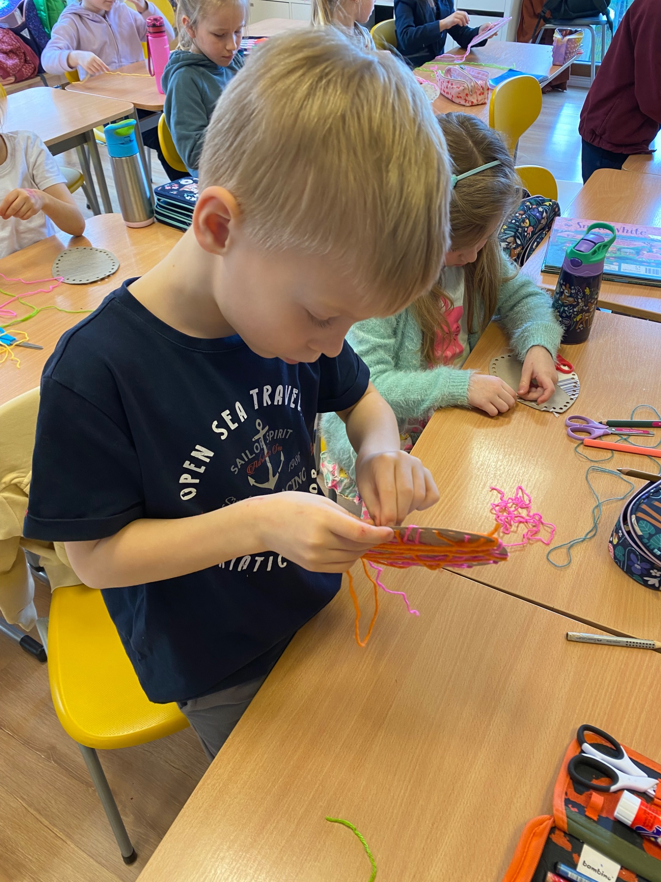
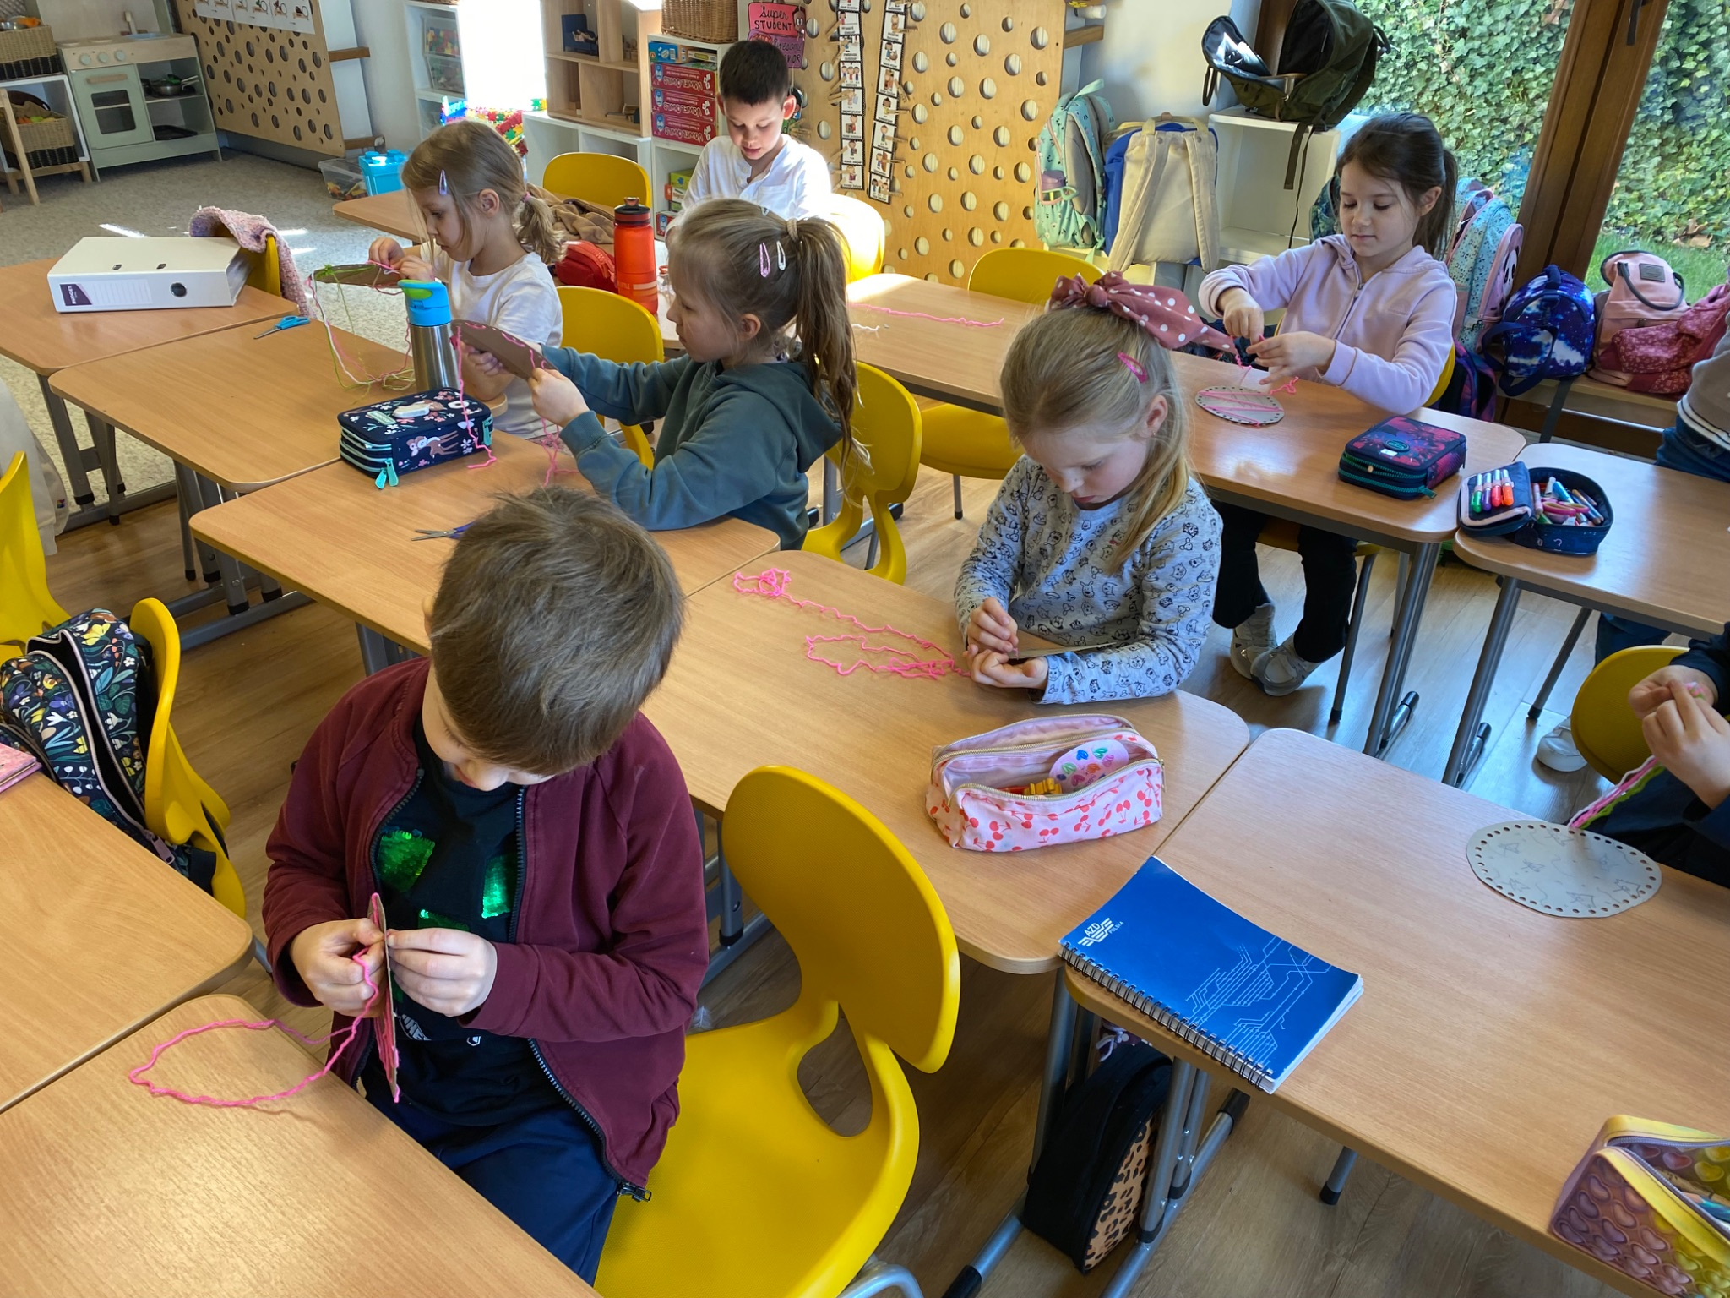
Grade 0 Newsletter - April in Review
Introduction
In April we celebrated Easter with an Easter egg hunt and a Peep “adoption!” Did you know Peeps were first sold in 1948 and are a staple in American homes over Easter?
Mathematics
In math we measured miniature American symbols, graphed data and worked on multi-digit addition and subtraction problems! We used the keypad on a phone to match letters and numbers to solve addition problems too.
Science
This month we mainly focused on simple machines: machines with little to no moving parts. They can be found anywhere and make our lives easier. We completed several worksheets and went on a simple machine hunt on the playground.
Language Arts
This month we learned about verbs - specifically, action verbs! We also had an introduction to adjectives with some yummy lollipops that we even got to eat! We started learning about vowel teams too! Last but not least, we learned about adult animals and the names of their babies, like chicks and bunnies.
Social Studies
We learned about American symbols like the Statue of Liberty and Bald Eagle! We also spoke about Canadian symbols, like the famous Royal Canadian Mounties and maple syrup! We began studying Canada for our upcoming “Around the World Festival!”
Art
We made chicks and ladybugs from plasticine to decorate our classroom. We also created cardboard eggs and decorated them so that we could practice our fine motor skills by putting thread through the holes! We learned about Earth Day with “The Lorax” by Dr. Seuss and made our our lorax with paper plates and construction paper.
Pictures, pictures, pictures!
Important Dates:
May 13th - Around the World Festival
June 9th - Sports Day
June 19th - Corpus Christi (school closed)

