Slide 1
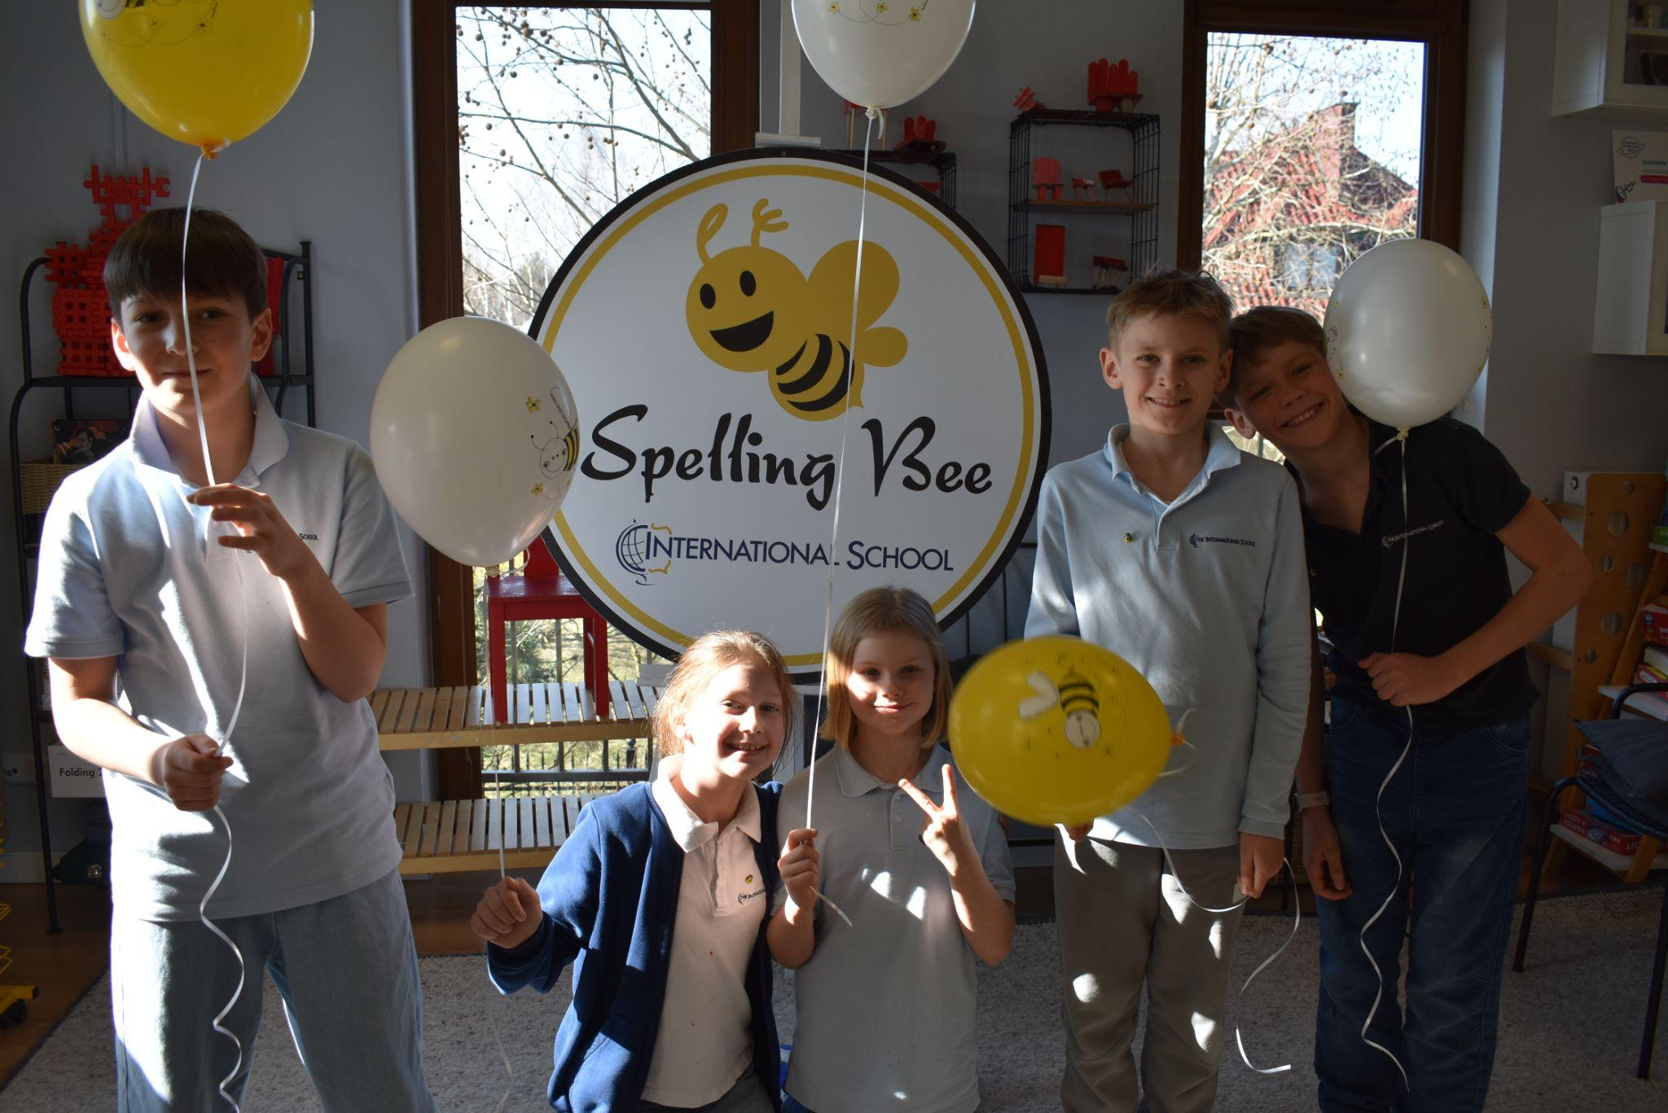
Grade 3 Newsletter - March in Review
Introduction
We wrapped up the month of March with students competing in the annual Spelling Bee tradition! Congratulations to the five finalists!
Mathematics
We learned about right angles and how to analyse data using pictographs. Students had a class activity whereby they had to analyse data from a school that had collected cola cans!
Science
The science fair is coming up, and students are hard at work on their projects. In class, we are continuing our unit on strong and stable structures. We are learning what makes structures strong and how to test their stability. Stay tuned for exciting science fair projects!
Language Arts
We started looking at simple past irregular verbs and adverbs. We reinforced knowledge by writing chapter summaries of Anne of Green Gables.
Social Studies
We wrapped up our ‘Space Travel Agency’ class project with students presenting their travel agency to the class. We also started working on the Speaking Contest.
Art
We learned about Cubism and discussed the inspiration and the artists behind this movement. We will be creating paintings in this style!
Pictures, pictures, pictures!
Important Dates:
3rd April - Spelling Bee Finals
7th & 08th April - Parent/Teacher Meetings (exact date TBC)
17th April - 22nd April - Easter Break (School Closed)
24th April - Speaking Contest (Class finals)

