Slide 1
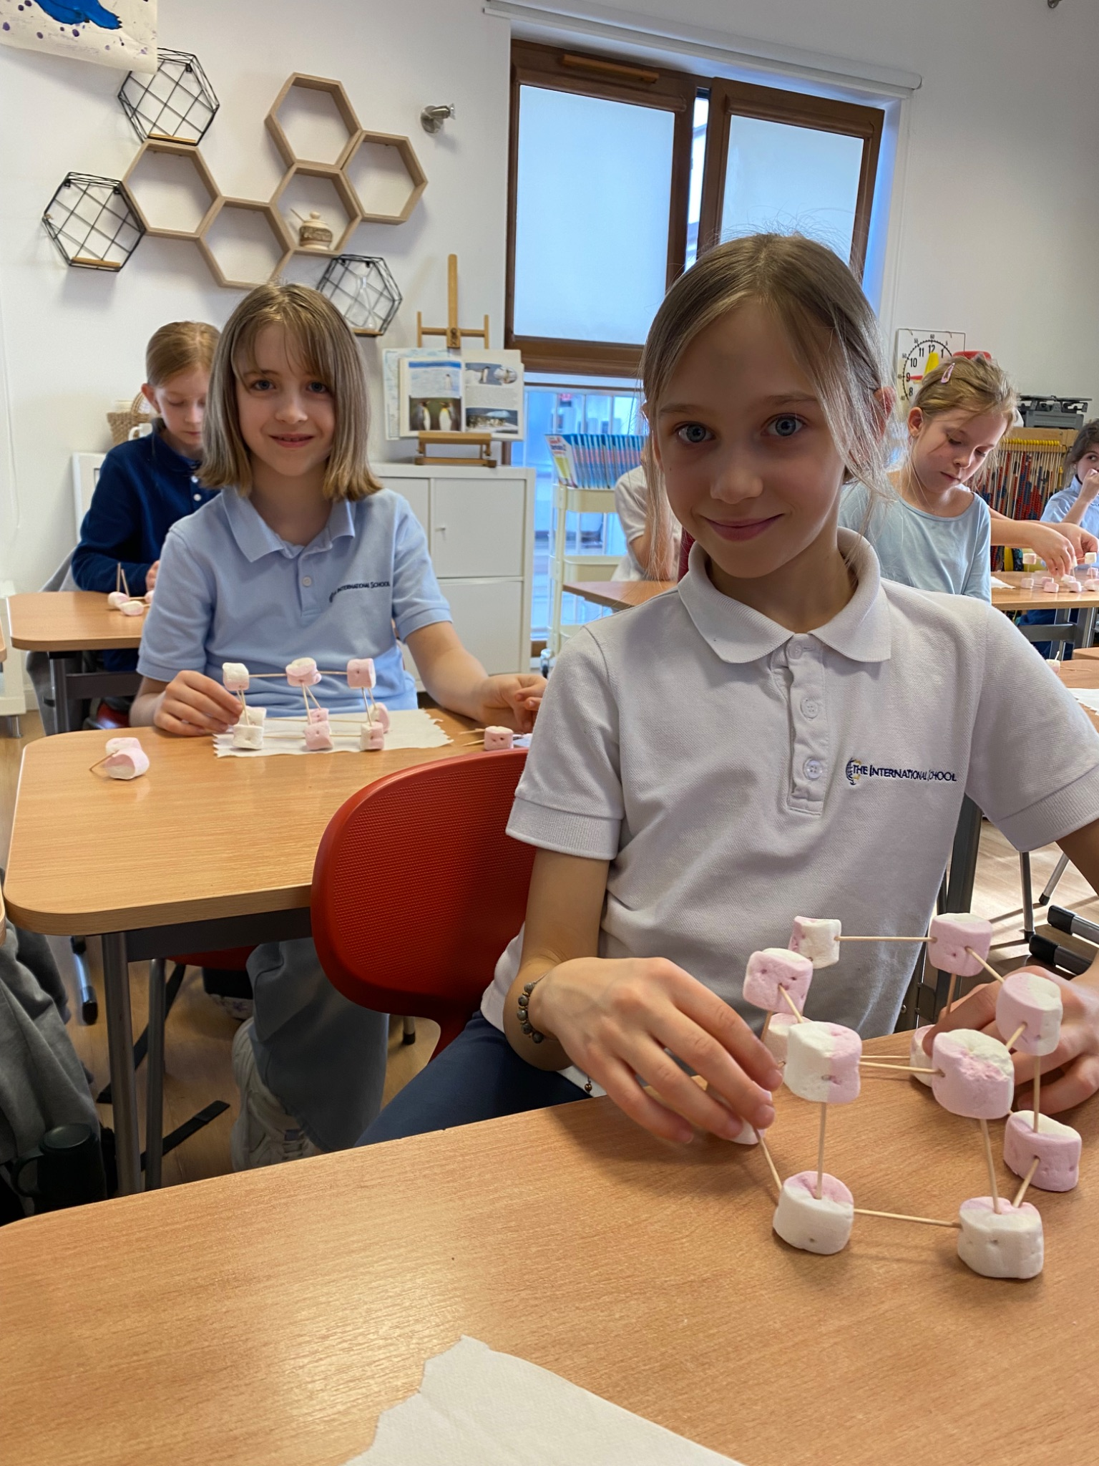
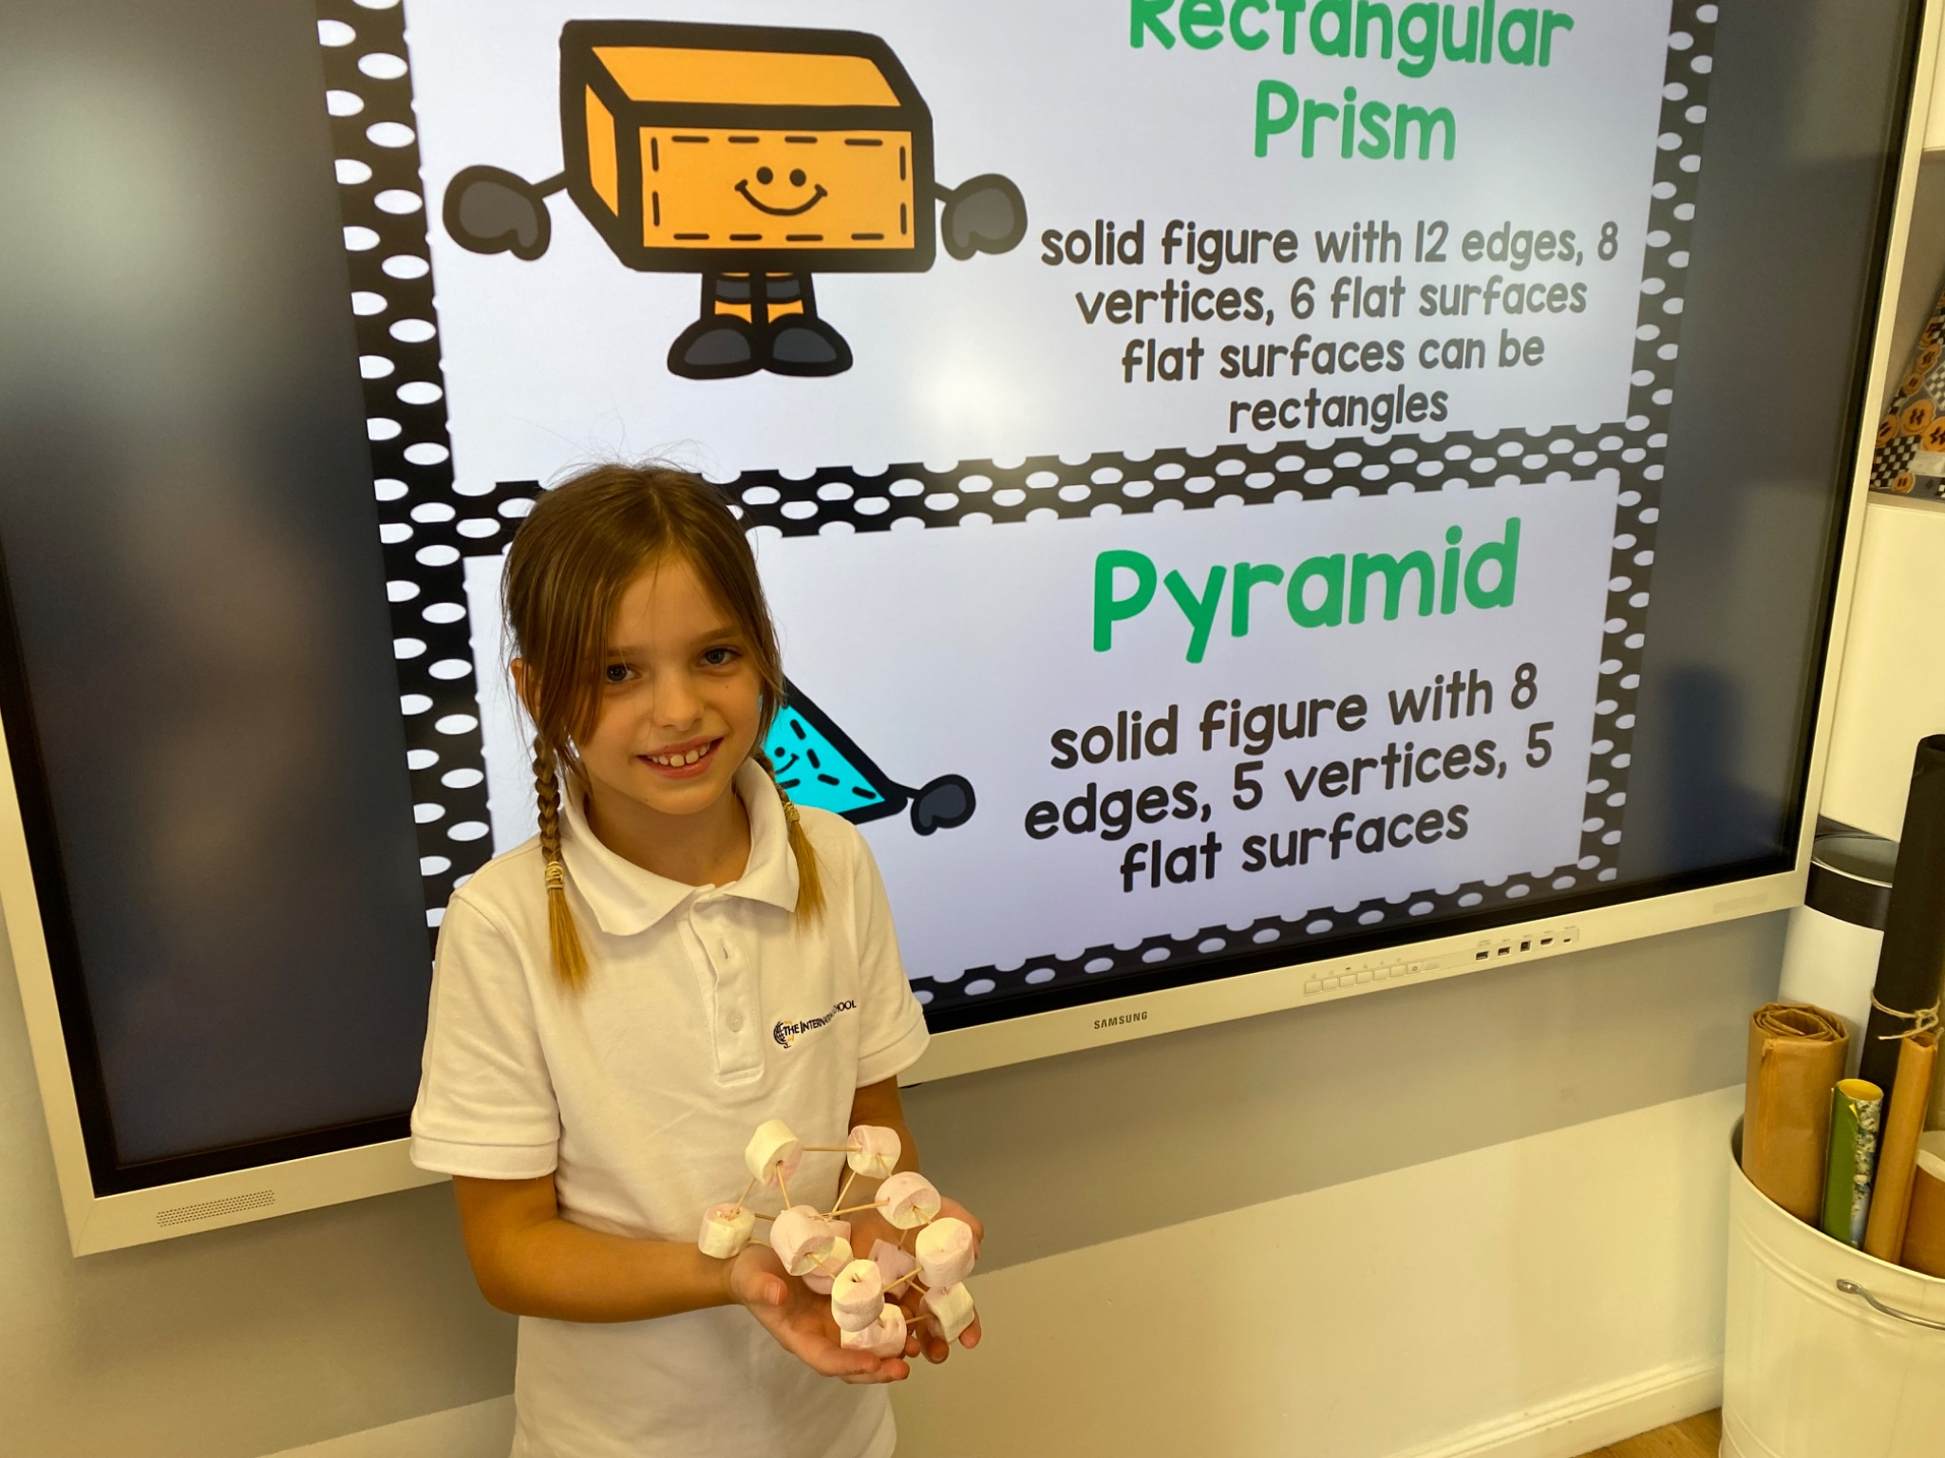
Grade 2 Newsletter - March in Review
Introduction
This month we had our first contest - the Spelling Bee! We spelled so many words the competition lasted a full two hours! We look forward to supporting our classmates at the finals on April 3rd.
Mathematics
We finished our 3D Figures unit making our own models with marshmallows and toothpicks. We also began learning about multiplication with some challenging vocabulary, like “zero property,” “identity property,” “product,” and “factor.” We made arrays and equal groups models with yummy Skittles!
Science
Our unit on simple machines is now complete, ending with a quiz and vocabulary review. Students will soon create a model playground, showcasing different simple machines. Next month, they will present their models and explain how the machines work. Design planning has already begun!
Language Arts
We wrapped up Unit 3 and began our next unit “Then and Now,” comparing and analyzing the past and future. We also learned about poetry - what it is and how we read it differently than other types of writing. We wrote diamante poems, cinquain poems, acrostics and haikus to name a few! This culminated in our very own Poetry Books.
Art
This month we celebrated St. Patrick’s Day by making leprechaun directed drawings. We also drew beautiful seascapes in honor of World Water Day!
Social Studies
We learned a bit about Mongolian and how clothing, food and shelter are different there. We have a curiosity for the world and will continue to explore ways people live and dress in our next unit!
Important Dates:
Pictures, pictures, pictures!
March 31st- Biography Presentation Projects
April 3rd - Spelling Bee Finals
April 8th - Individual Parent-Teaching Meetings
April 17th-22nd - Easter Break (school closed)
April 24th - Speaking Contest Presentations (in class)

