Slide 1
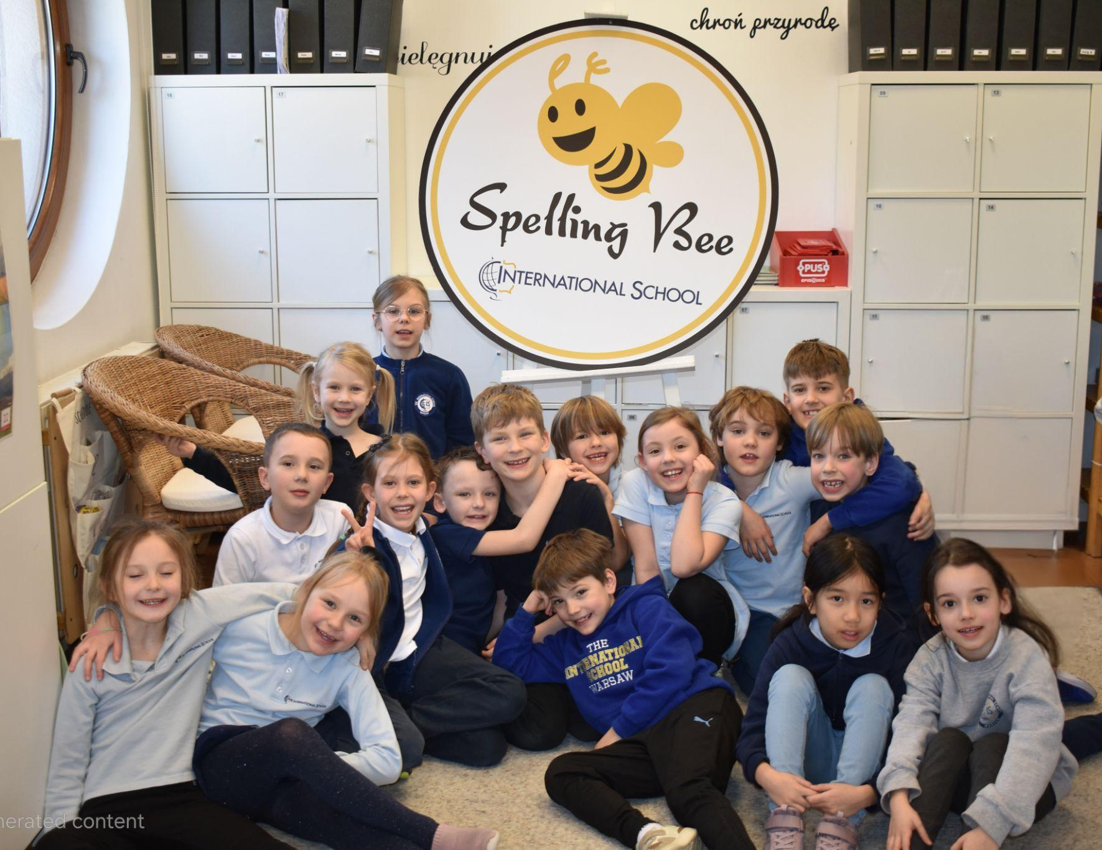
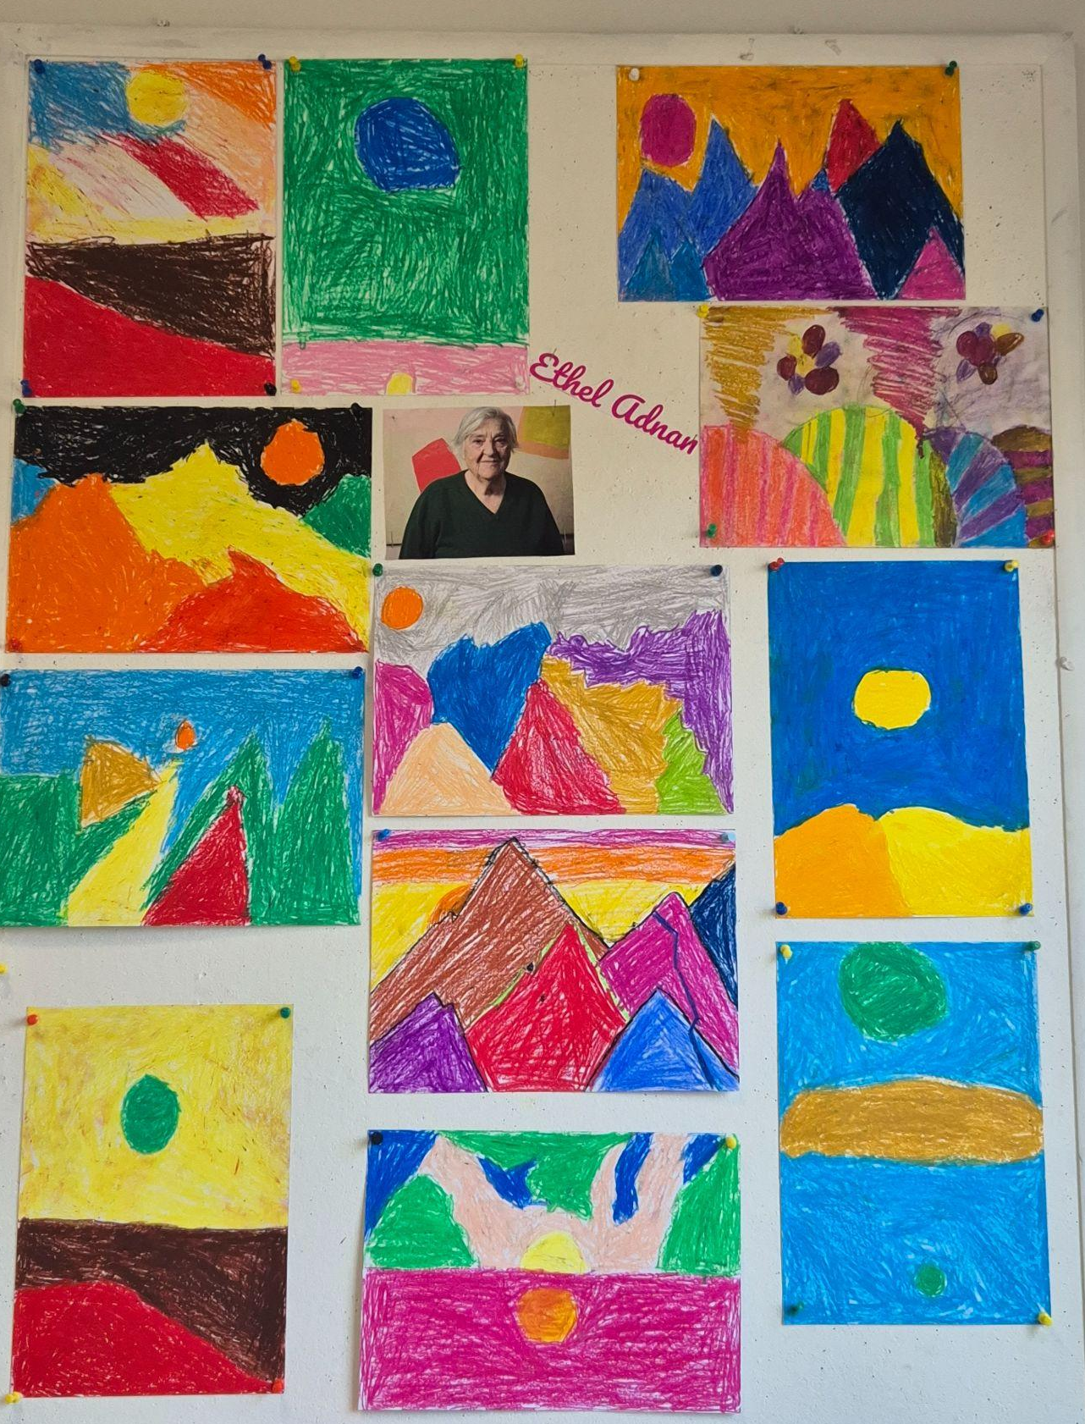
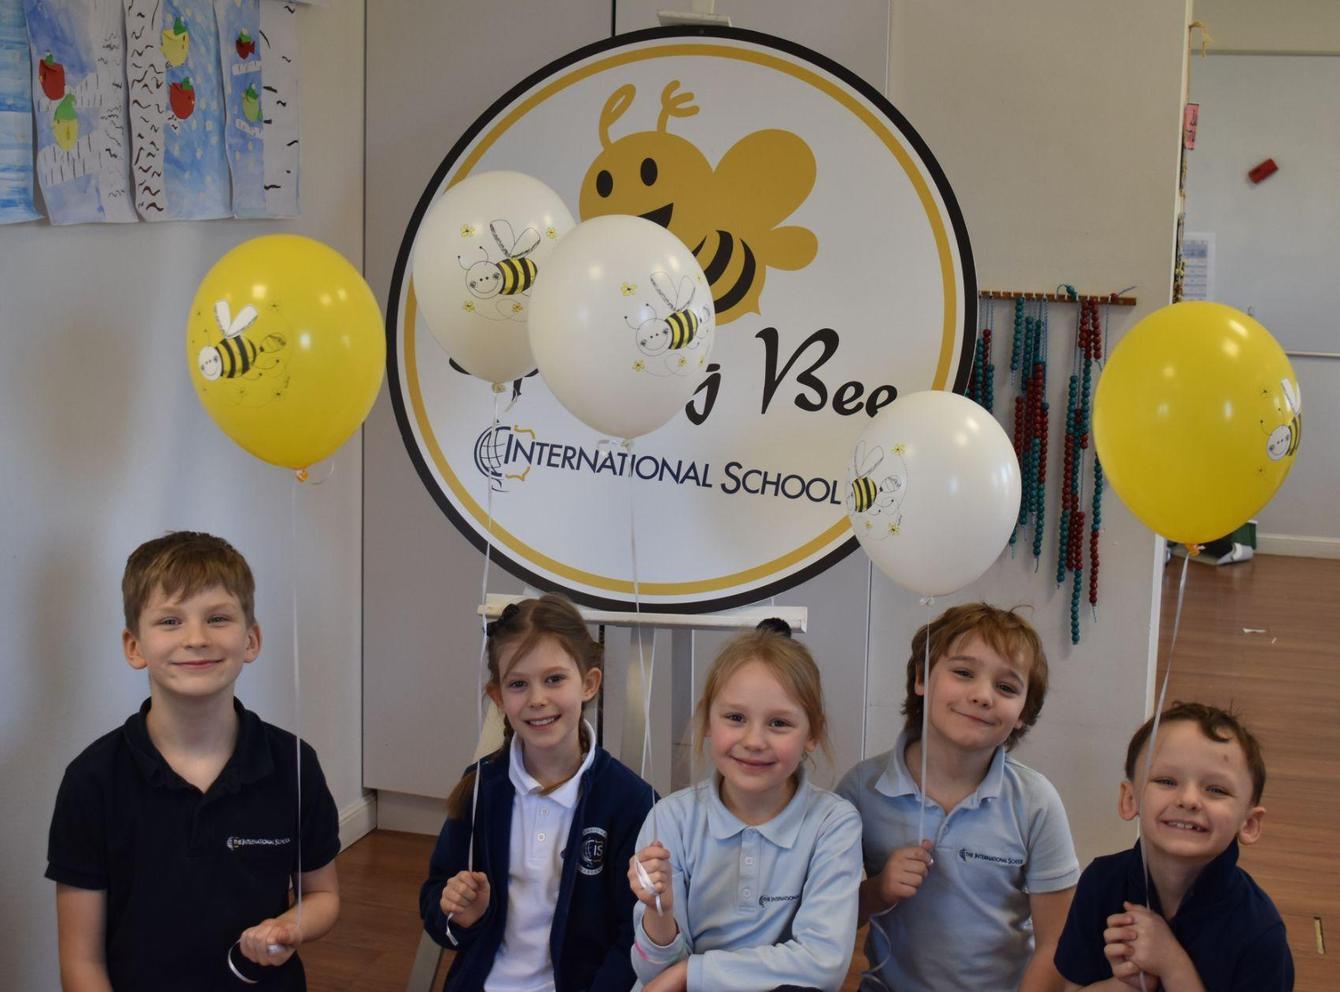
Grade 1 Newsletter - March in Review
Introduction
As we begin the transition to Spring, we wrapped up our ‘Going Places’ project and had our first ever Spelling Bee! Congratulations to our top 5 spellers!
Mathematics
We learned about fractions and how to name and number them. We also started looking at 3D shapes and reinforced knowledge by finding objects in our classroom that resemble 3D shapes.
Science
We wrapped up our unit on materials and structures with a final quiz. Students worked through their unit workbooks to review key concepts. Next month, we will begin building robots using recycled materials. They have already started designing their ideas in class!
Language Arts
We finished reading Nate the Great and started working on the novel. We also learned about the importance of time order words and how to use them in everyday situations.
Social Studies
We talked about New Experiences and how these experiences change as we grow older! We also discussed how someone helped us on our first day of school and how we helped a new student
Art
We created artwork in the style of Etel Adnan and we started studying our next artist - Yayoi Kusama!
Pictures, pictures, pictures!
Important Dates:
3rd April - Spelling Bee Finals
7th & 08th April - Parent/Teacher Meetings (exact date TBC)
17th April - 22nd April - Easter Break (School Closed)
24th April - Speaking Contest (Class finals)

