Slide 1
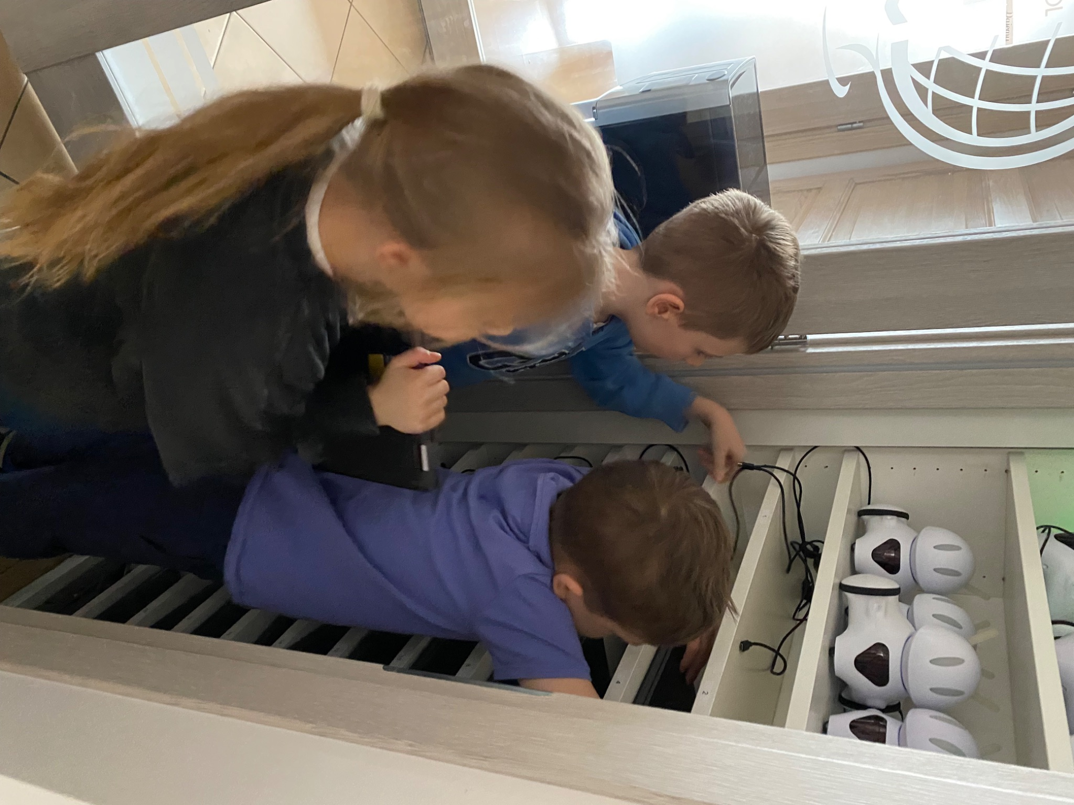
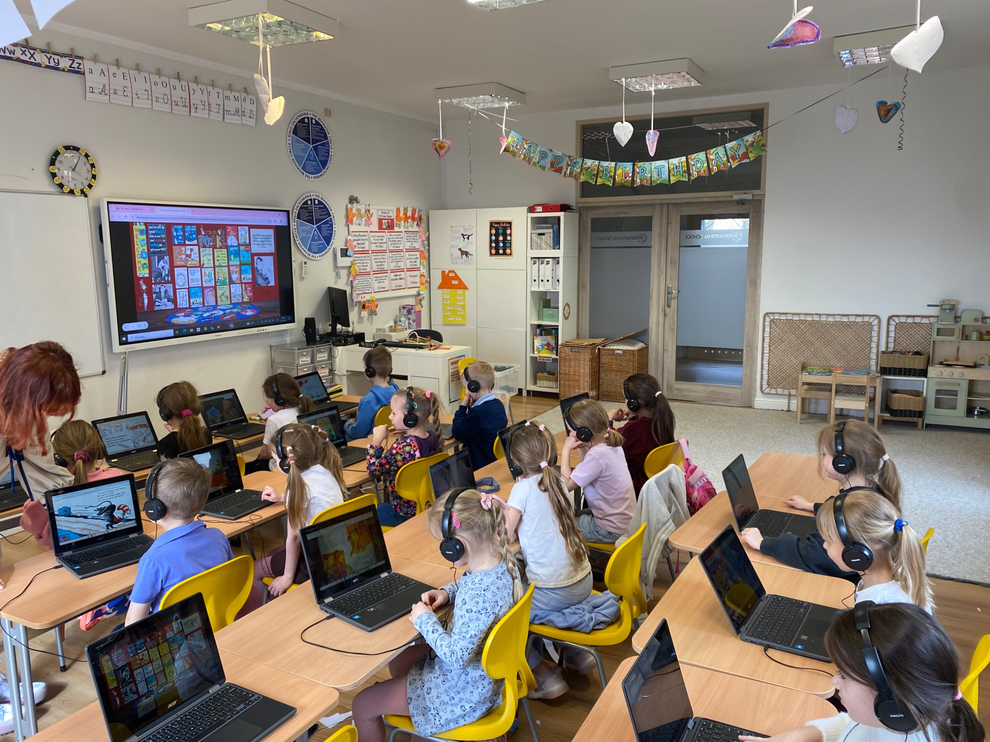
Grade 0 Newsletter - March in Review
Introduction
Leprechauns came to visit us in the month of St. Patrick’s Day and oh, how generous they were! We also took a field trip to Smart Kids Planet to learn about internet safety and of course, play!
Mathematics
We continued solving story problems after singing our “STEP Problem Solving Song” and also had an introduction to even and odd numbers and graphing. We reviewed simple subtraction and addition too!
Science
This month, we explored the solar system, stars, and the life cycle of a star. We also looked at constellations and zodiac signs. Students enjoyed learning how stars form patterns in the sky. They also created drawings of their zodiac signs based on their birthdays!
Language Arts
This month we learned rhyming words and blends! We finished our Dr. Seuss series and read many of his books, like “Oh the Places You’ll Go” and “One Fish Two Fish Red Fish Blue Fish.” We wrote silly poems in the style of Dr. Seuss and brainstormed the places we might be when we grow up. Finally, we learned about nouns with our groovy noun song!
Social Studies
We learned all about the calendar including: days of the week, months of the year and dates! We practiced our calendar reading skills and even learned the difference between the US and Polish calendar. Can you guess what it is?
Art
We created leprechaun elaborate leprechaun traps with an array of materials and gold coins from self-hardening clay to celebrate St. Patrick’s Day! We also made our own Dr. Seuss bookmarks and painted our hands to create our own red fish and blue fish!
Pictures, pictures, pictures!
Important Dates:
April 7th - Parent-Teacher Meetings
April 17th-22nd - Easter Break (school closed)
May 1st-2nd - Labor Day Holiday
May 22nd - Around the World project

