Slide 1
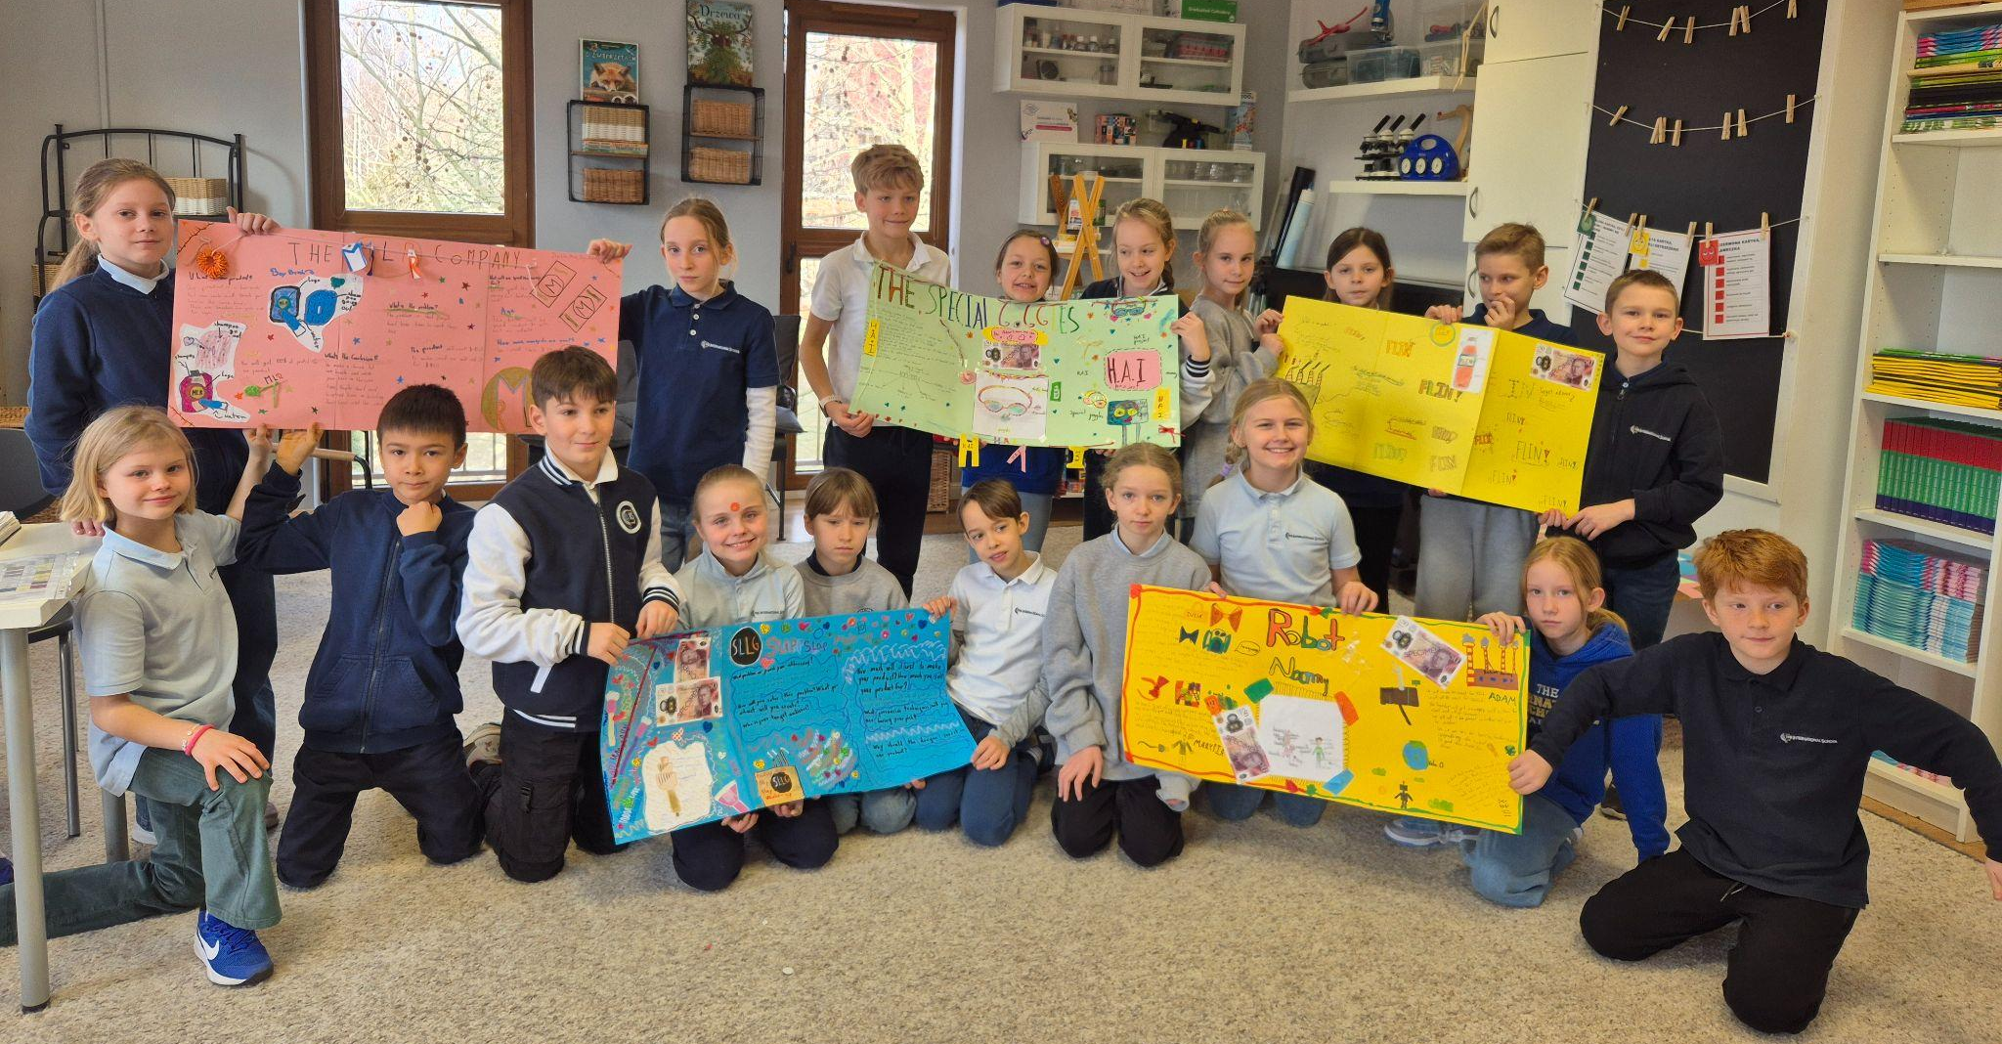
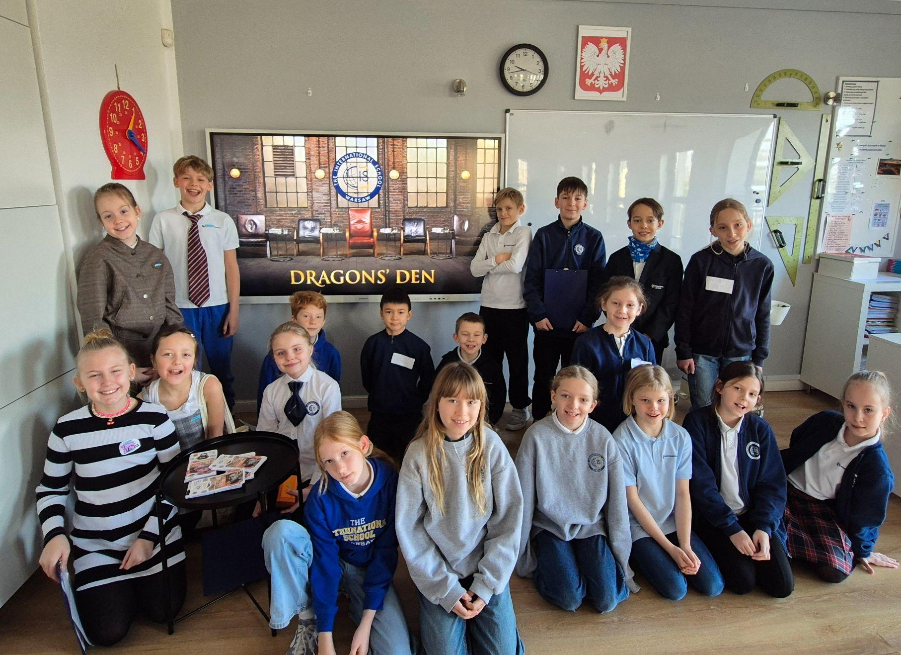
Grade #3 Newsletter - January in Review
Introduction
We welcomed the New Year with a bang! Students wrapped up their Dragons’ Den Project and novel study…
Mathematics
We continued with fractions and learned about their equivalents and how to write fractional numbers.
Science
This month, we learned about stable structures, as well as how load and force affect them. We’ve also started preparing for our science fair project, which will take place in mid-April. Everyone is excited to explore their ideas and start experimenting
Language Arts
We learned about consonant clusters and spent time reviewing the simple past with regular verbs. We also finished our novel study of ‘The Secret Garden’.
Social Studies
We read ‘Tiddalick the Frog’ and discussed the themes of teamwork, the importance of the environment and not wasting resources. We also finished our Dragons’ Den Project with students pitching their original product to the Dragon (me!)
Art
We made abstract collages in the style of Henri Matisse and learned about Canadian artist Ted Harrison. We also made crafts to celebrate Lunar New Year.
Pictures, pictures, pictures!
Important Dates:
February 3rd - 14th - Winter Break
February 18th - Space Travel Agency Project
March 20th - Spelling Bee (Class round)
March 27th - Spelling Bee (Finals)

