Slide 1
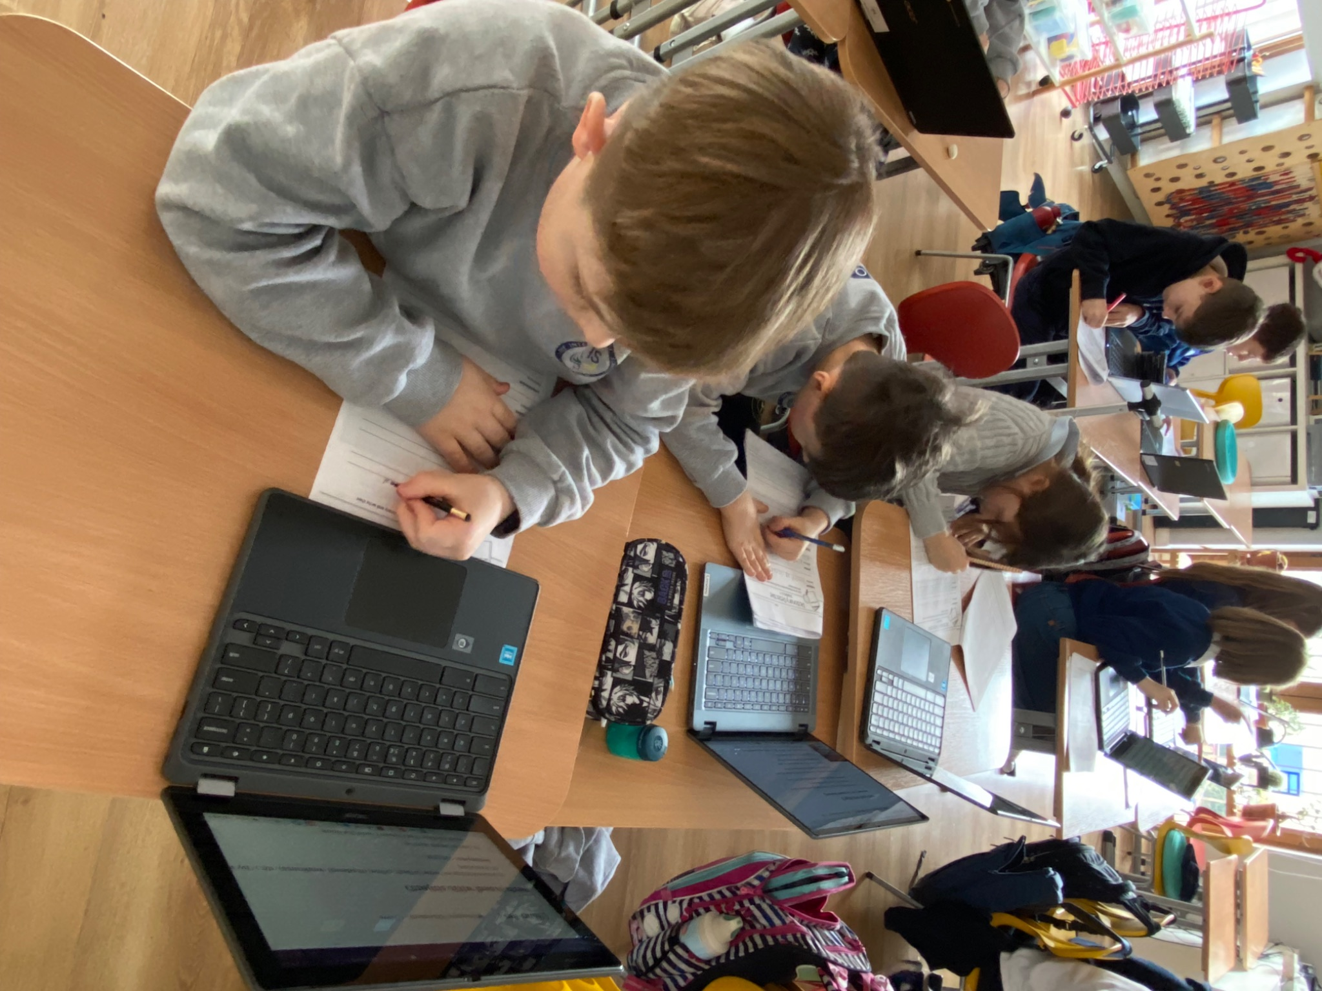
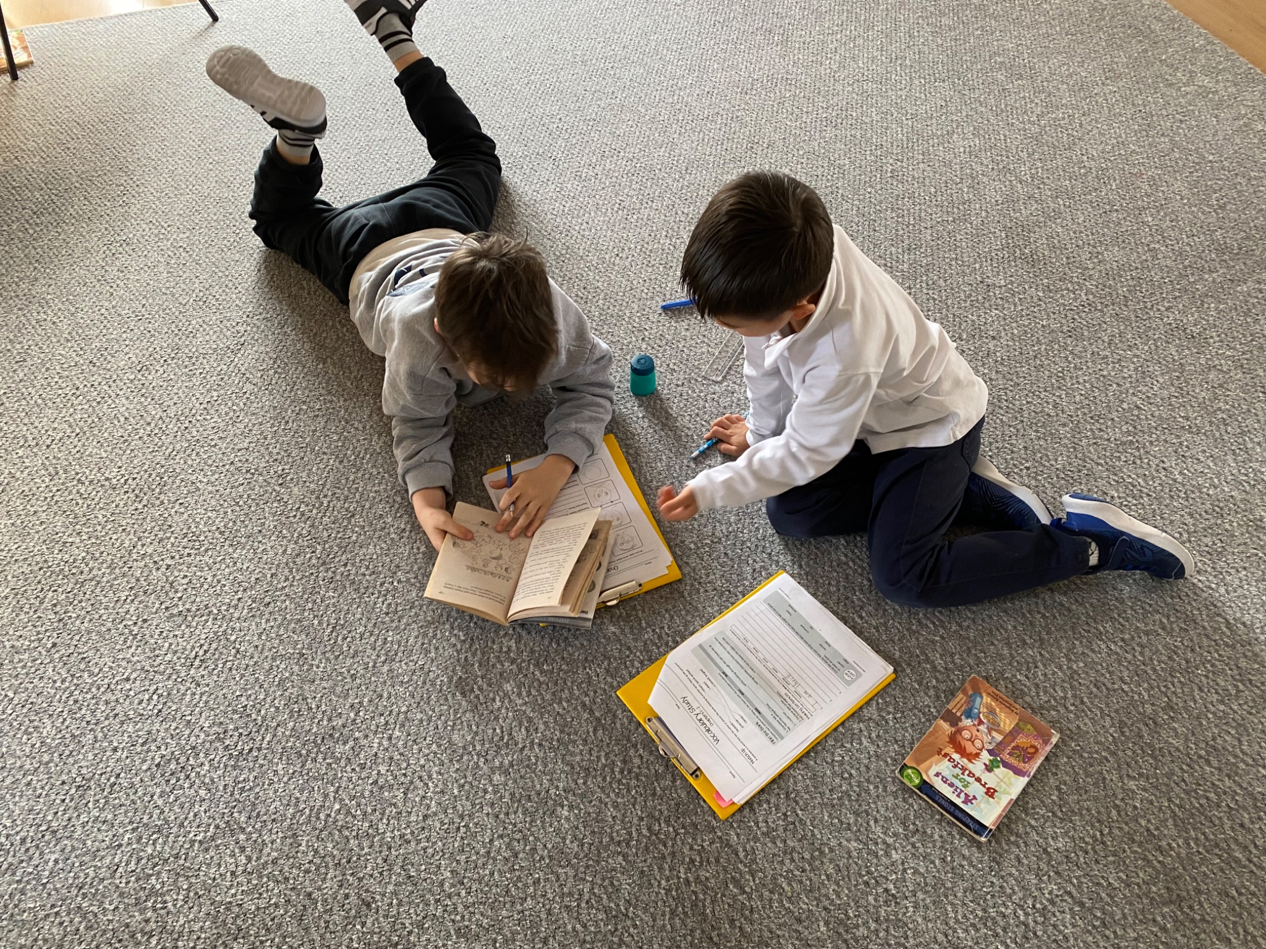
Grade 2 Newsletter - January in Review
Introduction
We began our second novel study, “Aliens for Breakfast!” We were also able to continue listening to the story “The Witches” even though Halloween has passed. Reading has become one of our favorite ways to learn.
Mathematics
We spent the month reviewing 2D shapes and creating figures with tangrams. We learned how to tell stories with tangrams and wrote our own too! Next, we’ll look at 3D shapes!
Science
Second graders learned about the six simple machines and how they make work easier. We even did a fun experiment using a wedge (a knife) to cut through Plasticine. This hands-on activity helped us see how simple machines work in real life!
Social Studies
We looked at the ancient temples of Asia, like the Senso-Ji in Tokyo and the Kinkaku-Ji in Kyoto! We discovered many historical and ancient symbols of places like Mali, China and Thailand. We think the pandas native to Sichuan are the cutest!
Language Arts
We began taking spelling quizzes with twelve words - and we are aceing them! In Unit 3, we’ve learned about synonyms and antonyms and an author’s purpose. Soon we’ll review nouns! We’ve also completed a short study on the book “Love Splat” for Valentine’s!
Art
We looked at the way different countries celebrate New Year’s Eve! We drew inspiration from these scenes to create our own New Year’s Eve art. We also crafted our goals and resolutions for the year 2025! Finally, we finished by making our very own Valentine’s crafts.
Pictures, pictures, pictures!
Important Dates:
February 3rd-14th: Winter Break
March 17th: Biography Projects
March 20th: Spelling Bee (Class Round)
March 27th: Spelling Bee (Finals)

