Slide 1

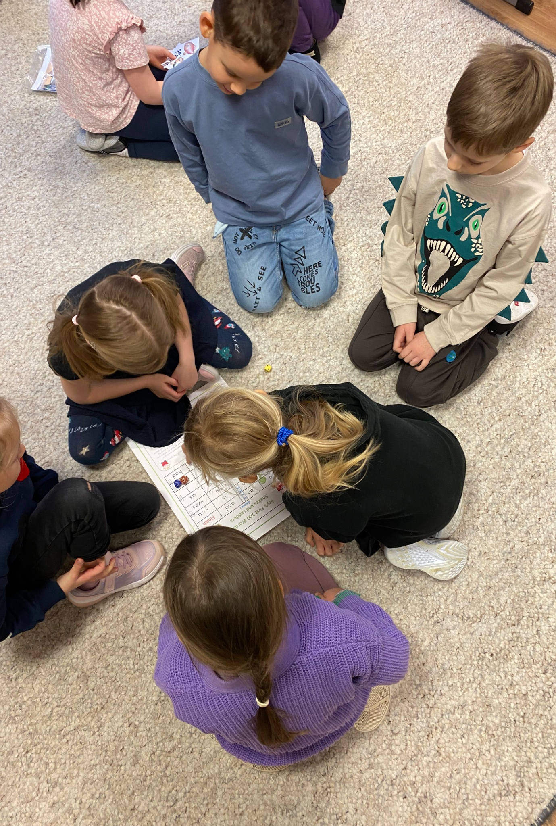
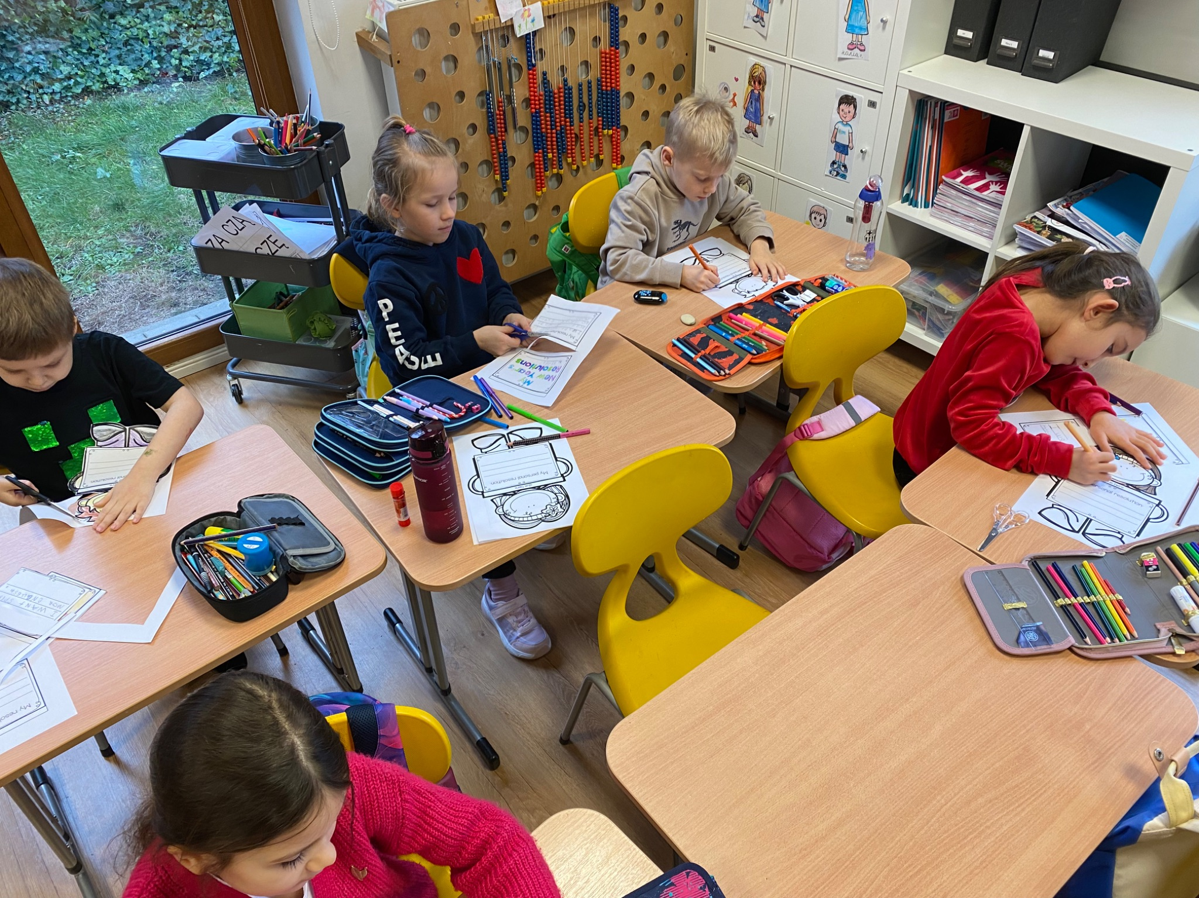

Grade 0 Newsletter - January in Review
Introduction
Happy New Year! We had a great Christmas break, but are happy to be back together! We’ve been learning about our New Year and also Lunar New Year. It’s the year of the snake!
Mathematics
We learned about the hungry alligator that wants to eat the number that is greater! We named three dimensional shapes, like a cube and sphere, and counted their edges, vertices and faces! We finished with skip counting by 2’s, 4’s and 10’s.
Science
Our learners explored the five food groups and why each one keeps our bodies healthy. We also learned about the importance of drinking enough water to stay strong and energized. Fun activities helped us understand how food and water give us the energy we need to play, learn, and grow!
Language Arts
We finished learning the alphabet and matched capital and lowercase letters! We began learning about Silent E and Digraphs, which help us read and write. We practice sight words and high frequency words and sorted nonsense words from real words. Last, but not least, we reviewed the six question words that help us to be better writers!
Social Studies
We made New Year’s goals and resolutions for 2025! We began learning about time with “My Day,” drawing what we normally do during the morning, afternoon, evening and night. Next, we’ll look at months, days and weeks!
Art
We made Chinese lanterns and handprint dragons for Lunar New Year! We also made Digraph Snowmen and began a mini-unit on symmetry, making symmetry snowflakes!
Important Dates:
Pictures, pictures, pictures!
February 3rd-14th: Winter Break
April 1st: Science Project

