Slide 1
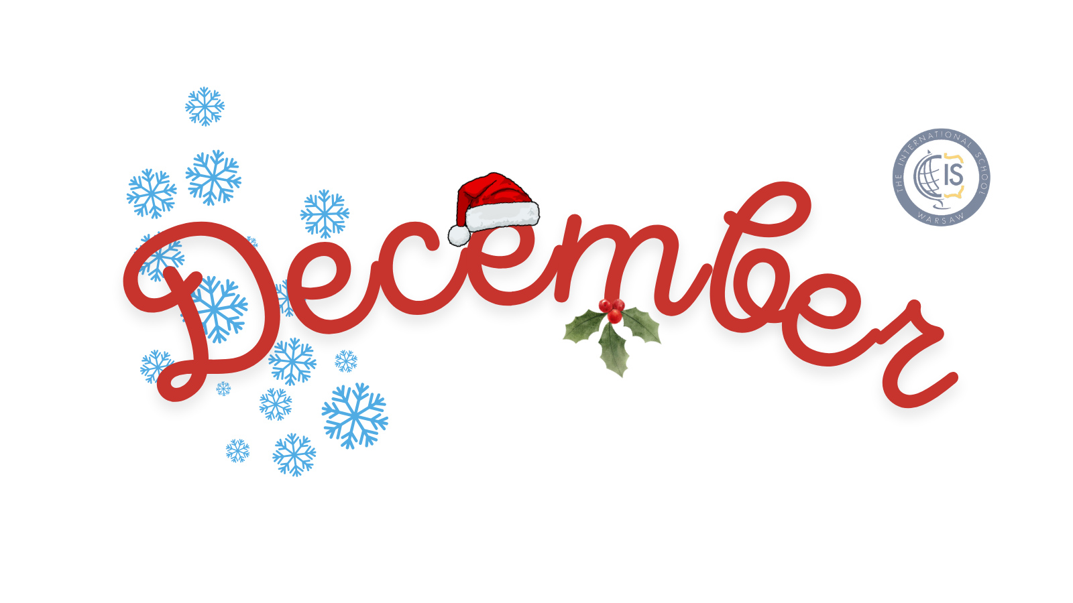
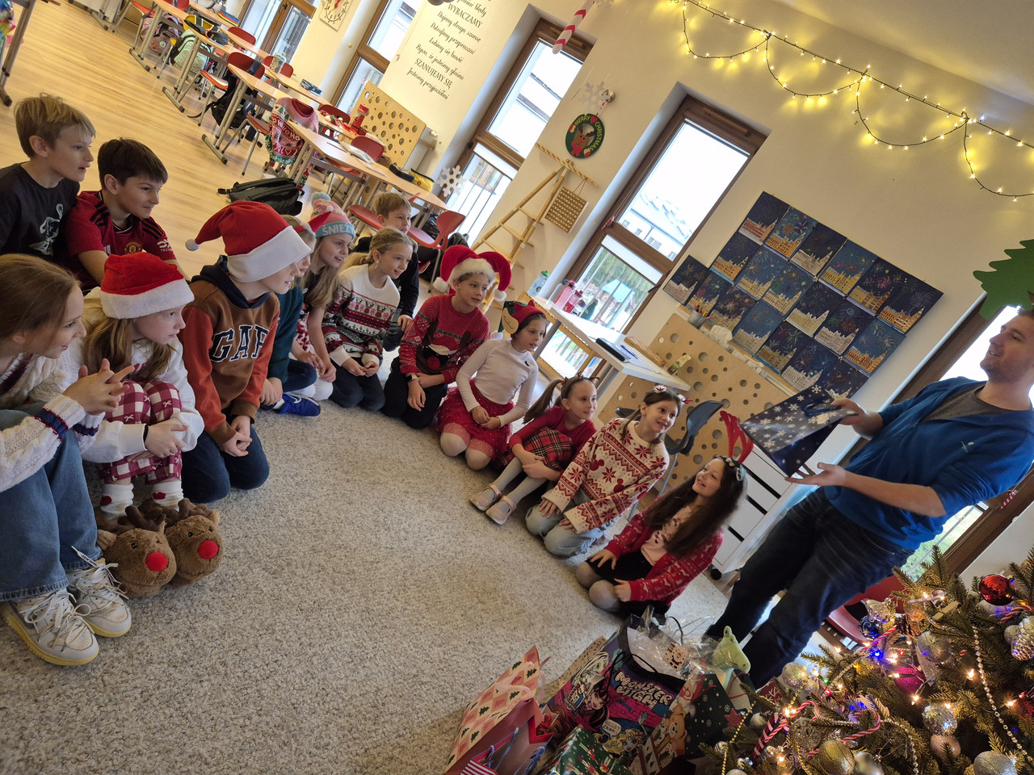
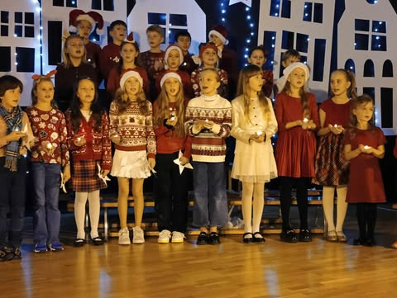
Grade 3 Newsletter - December in Review
Introduction
The month of Thanksgiving came and went! We spent the month of December getting into the festive spirit by learning about different Christmas traditions around the world and making Christmas crafts!
Mathematics
We reviewed division with remainders further and started to look at fractions.
Science
We finished the unit about forces. Students completed the final quiz at the end of their booklet as a graded assignment. We started talking about the science fair, which will take place in the second semester (the exact date TBC). Some students had questions about black holes, so we will learn more about what black are and how forces play a role in this cosmic phenomenon.
Language Arts
We had a board game morning and played games in English. We also became detectives with ‘The Christmas Present Thief’ mystery, where we had to investigate and crack codes to uncover the culprit who stole the Christmas presents!
Social Studies
We discussed the history behind St. Nicholas and how Christmas is celebrated around the world.
Art
We painted Christmas trees and made candy cane crafts.
Pictures, pictures, pictures!
Important Dates:
January 27th - End date of ‘Dragon’s Den’ Project
January 28th - Grade 3 Group Parent Meeting
February 3rd - 14th - Winter Break

