Slide 1
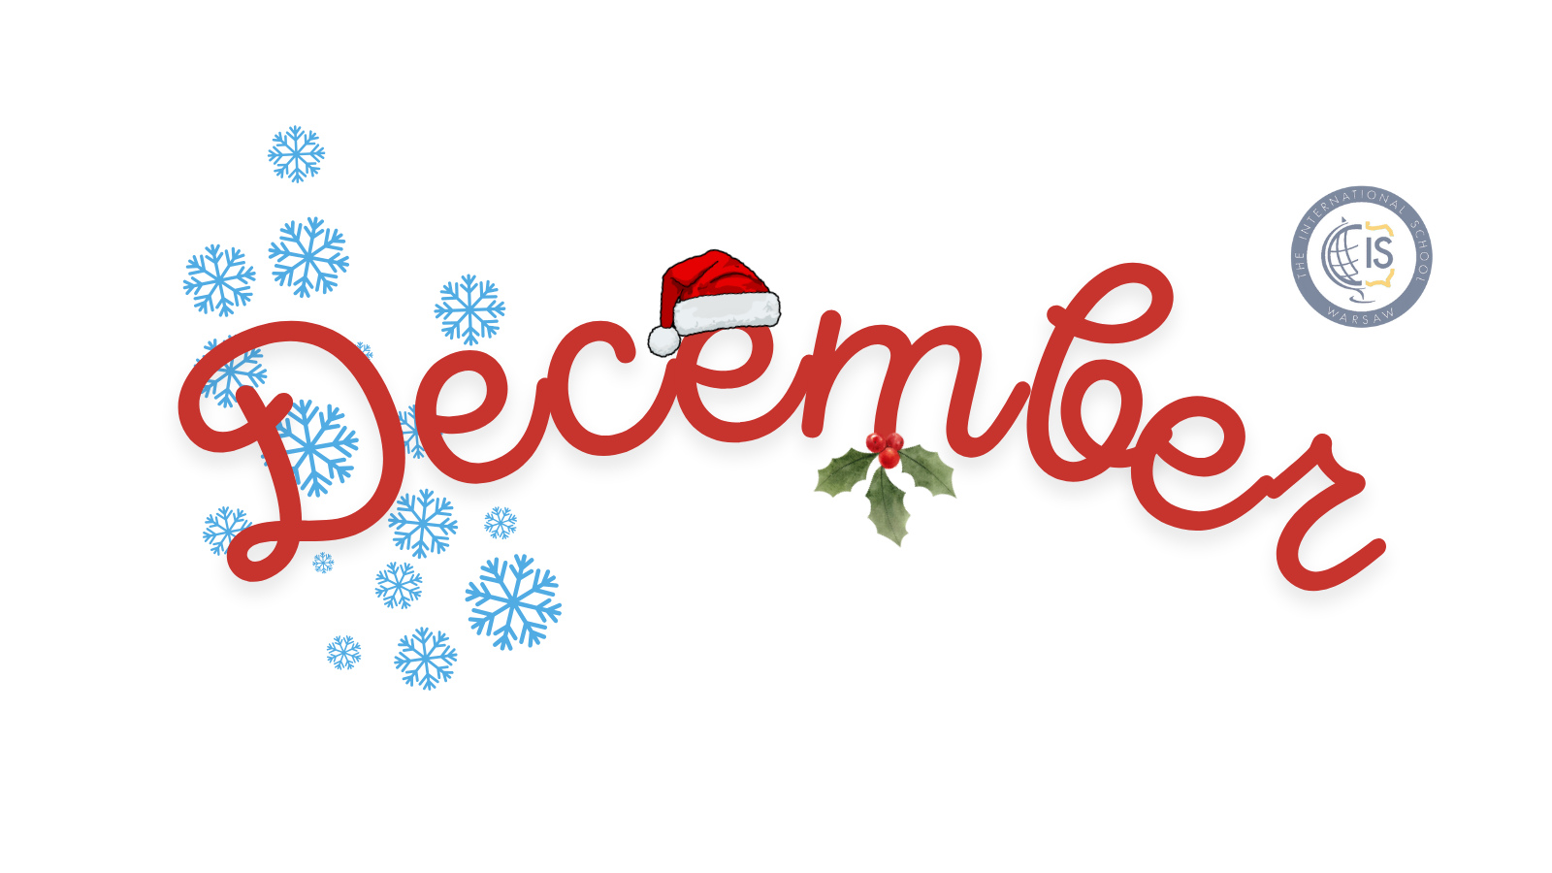
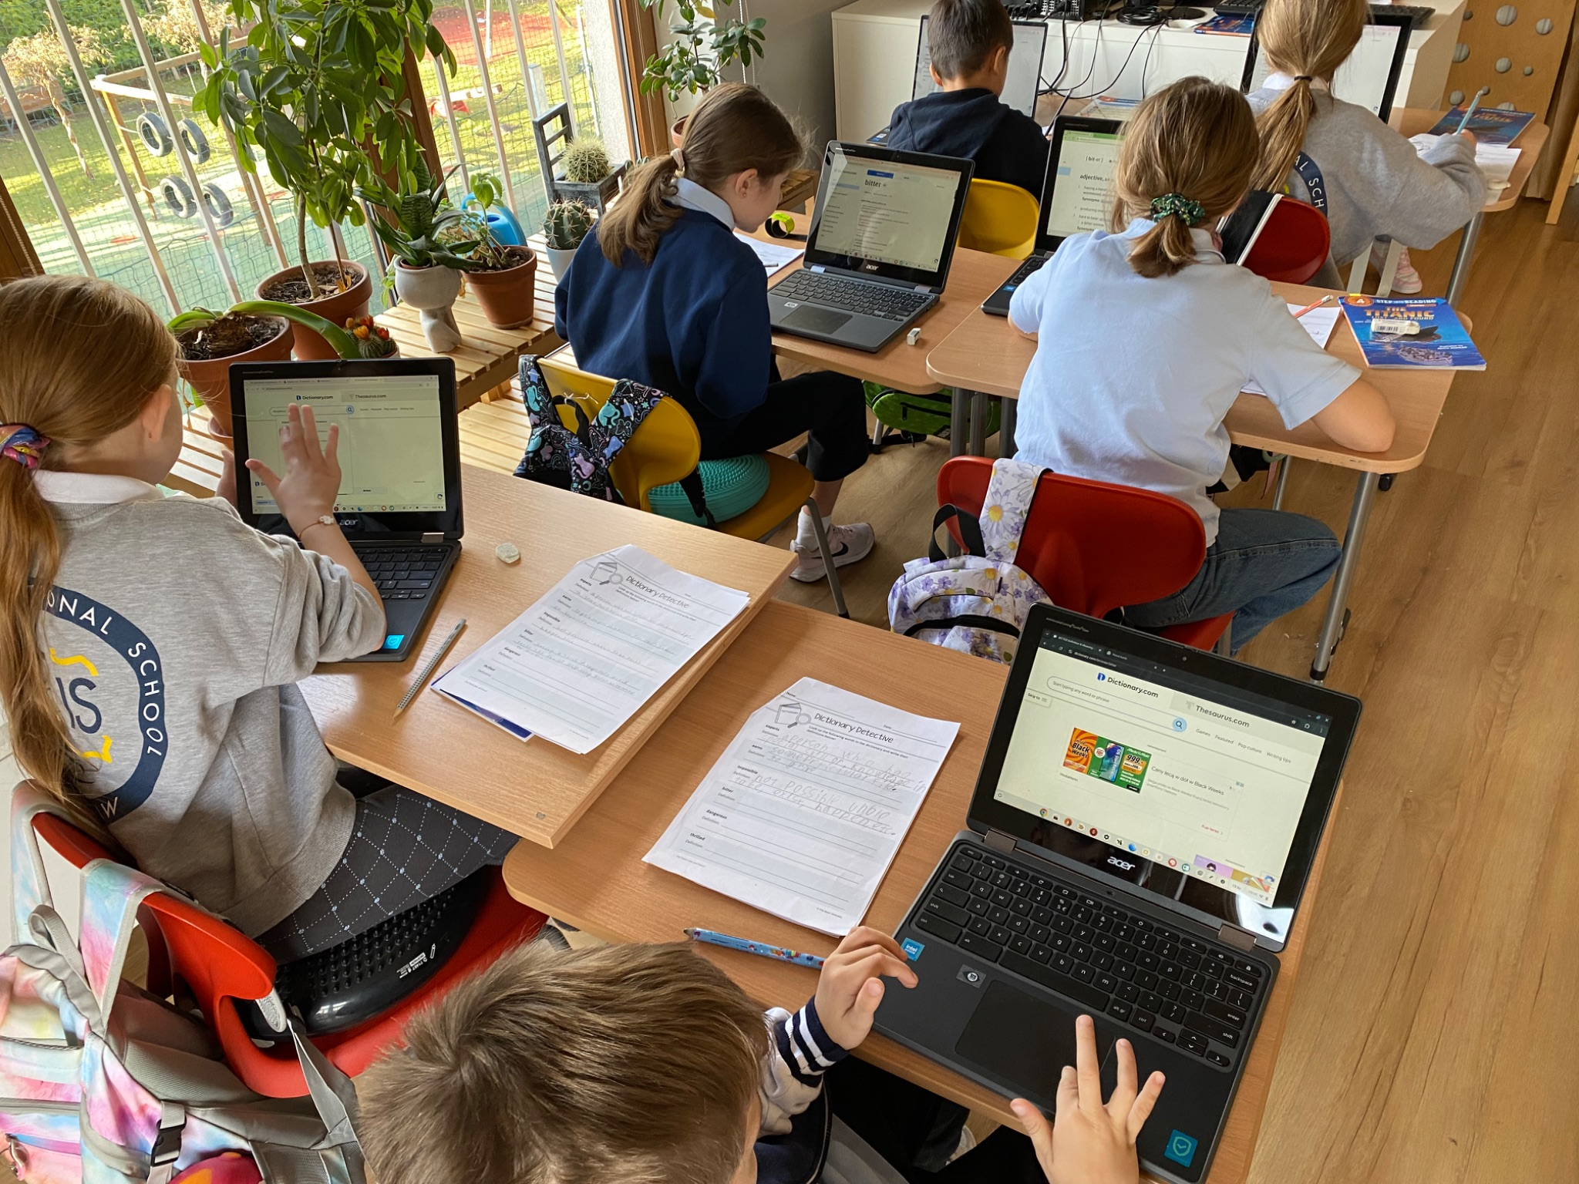
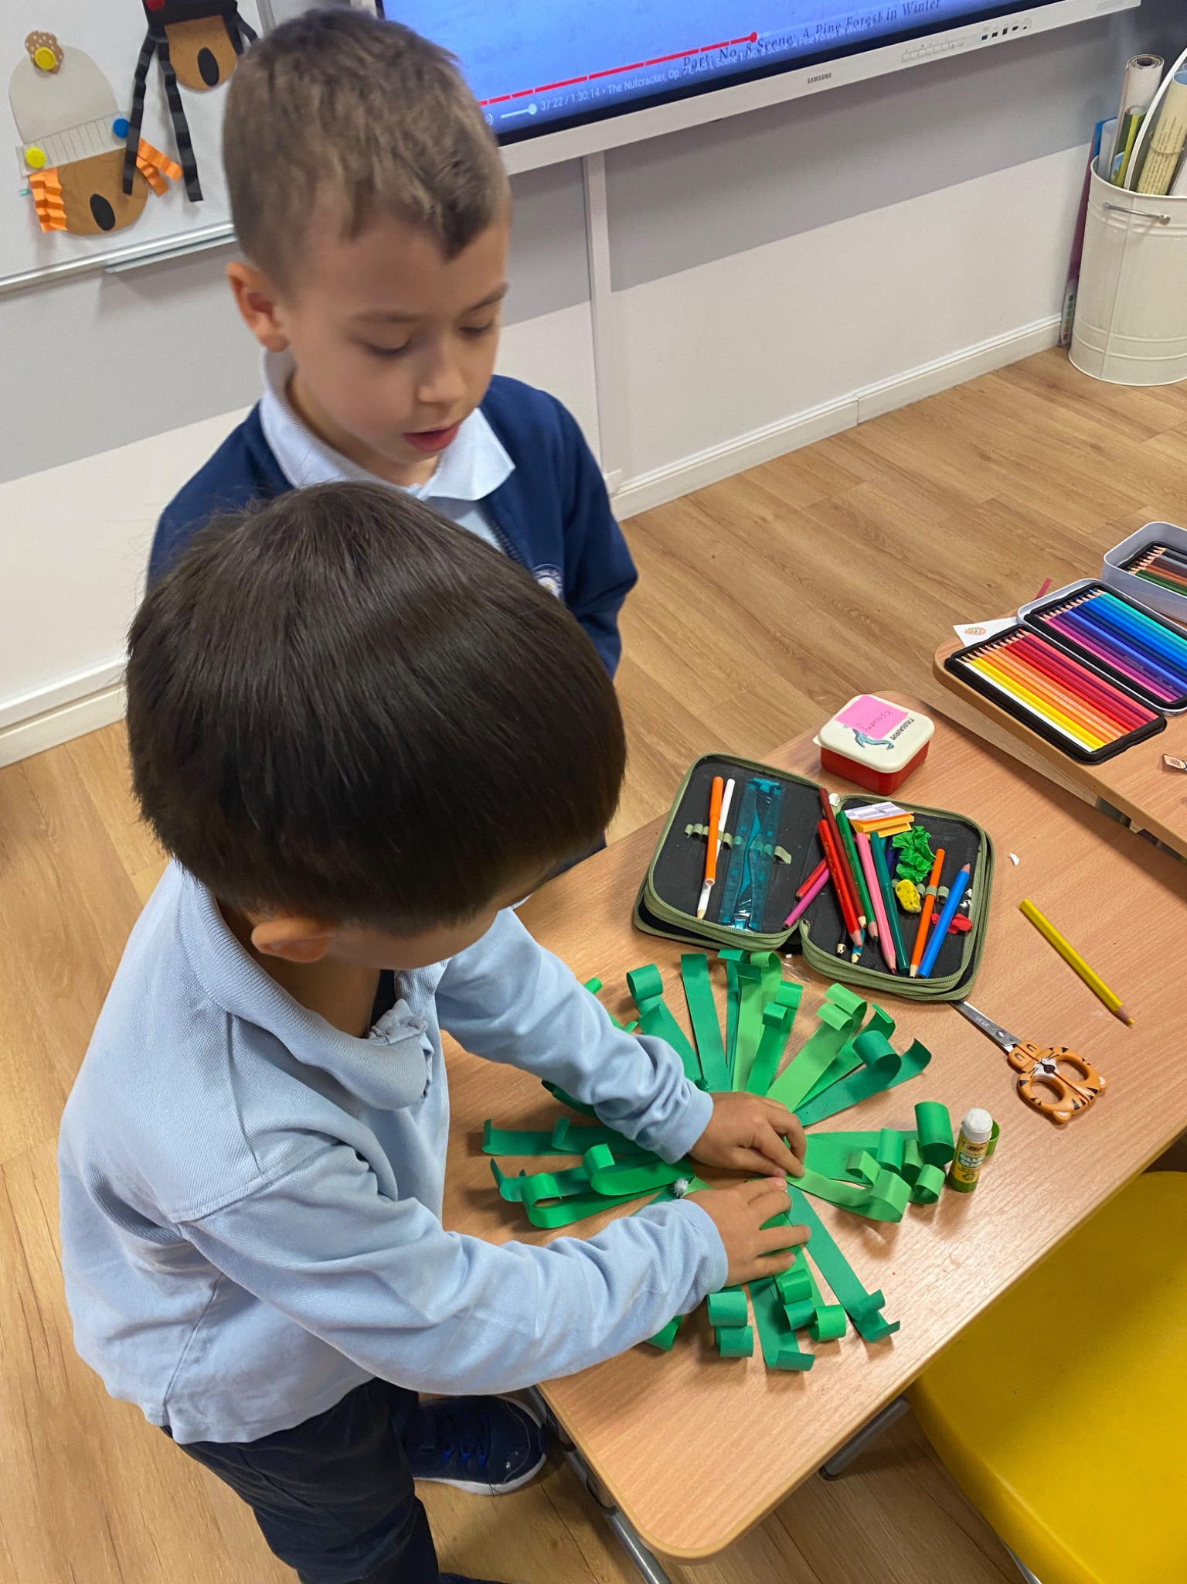
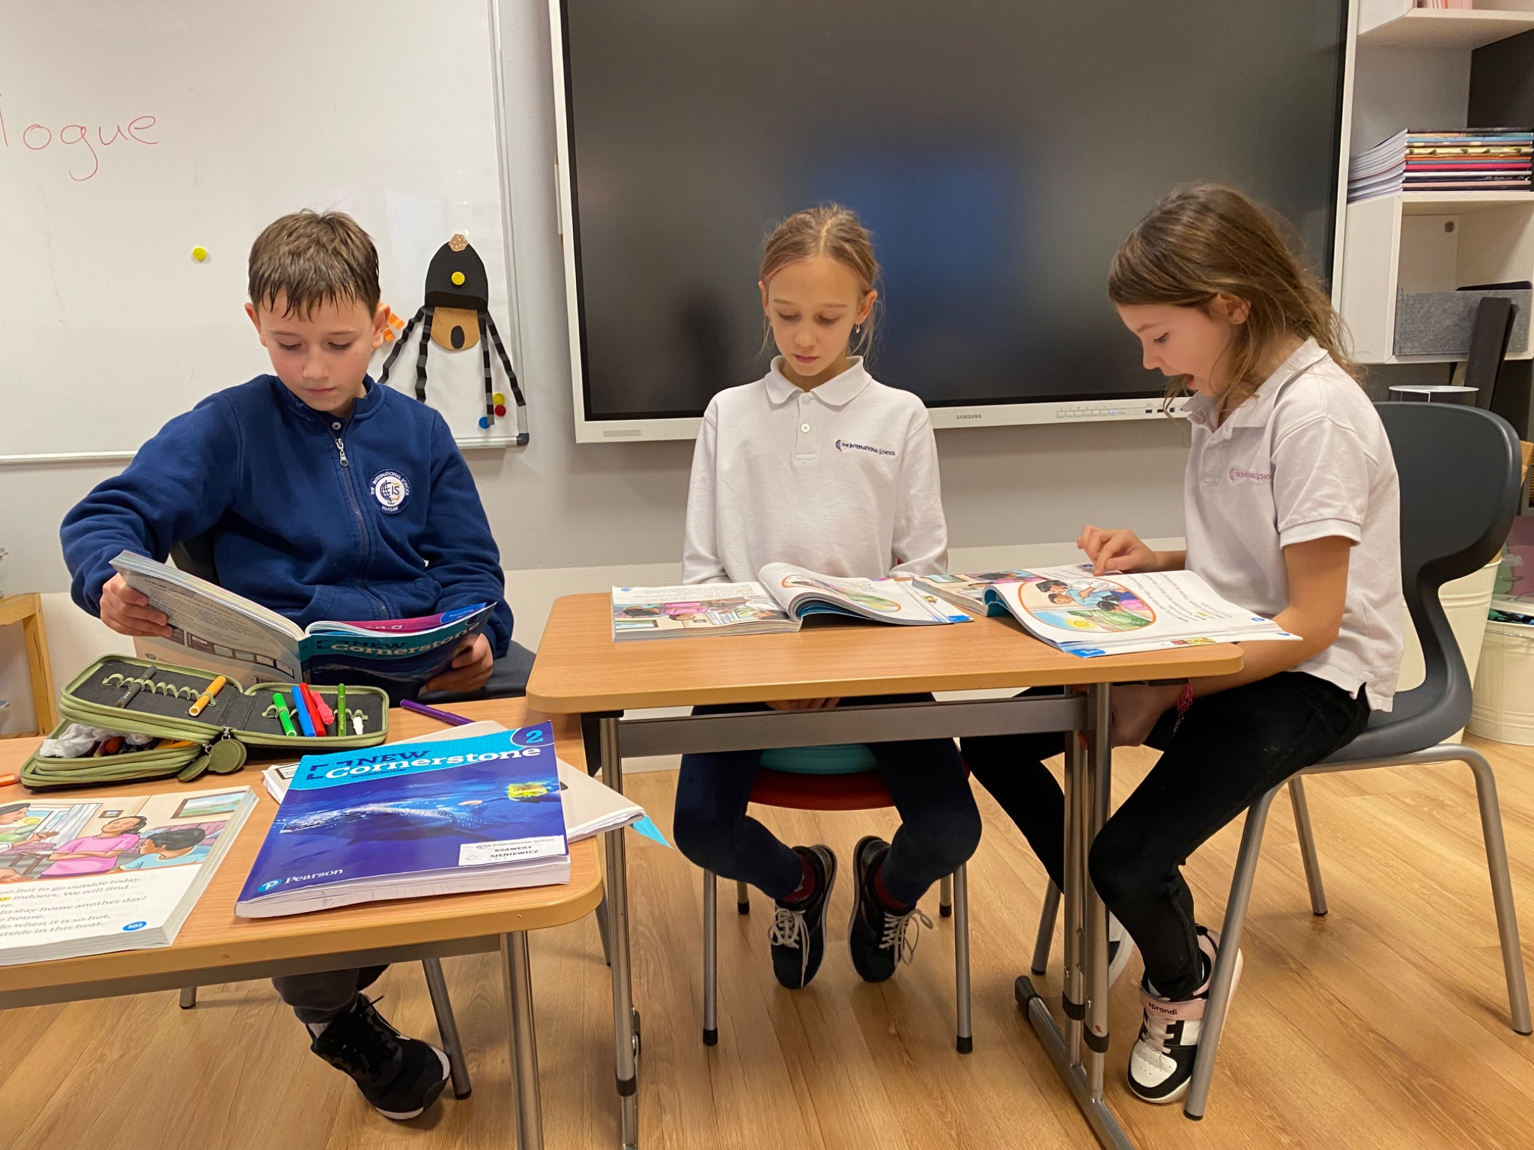
Grade 2 Newsletter - December in Review
Introduction
What an exciting month we’ve had! We exchanged Secret Santa gifts, decorated our classroom and made gingerbread cookies. We ended with our 3rd annual Christmas Pajama Party!
Mathematics
We began our long awaited unit on Canadian money, naming the coins and stating their values. We also added and subtracted money and found the sale price and total savings on different items too!
Science
Last week, we finished our unit on the properties of solids and liquids. In order to illustrate irreversible changes of matter, we made our way to the school kitchen and prepared some delicious Dutch gingerbread cookies. It was a tasty way to learn about irreversible changes and chemical reactions!
Language Arts
We completed our study on figurative language, using hyperbole like pros! We acted out a dialogue from our text, discovered the world of synonyms and antonyms, point of view and character traits! We also read fairy tales like “Little Red Riding Hood” and also a book from the wolf’s perspective titled “Honestly, Little Red Riding Hood was Rotten!”
Social Studies
We read Christmas books from around the world, like “The Nutcracker,” originating from France, “Tree of Cranes” a Japanese Christmas story, and finished with “The Christmas Book Flood” from Iceland. We made nutcrackers, paper cranes and wrote about our favorite Christmas gift we’ve ever received.
Art
We made magazine Christmas trees and paper Christmas wreaths! The magazine trees tested our focus and patience, but in the end it was worth the effort!
Pictures, pictures, pictures!
Important Dates:
December 23rd-31st - Christmas Break (School Closed)
January 1st- New Year’s Day (School Closed)
January 2nd-3rd - Days Off
January 6th - Epiphany (School Closed)
January 28th - Grader 0 Group Parent Meeting
February 3rd-14th - Winter Break

