Slide 1
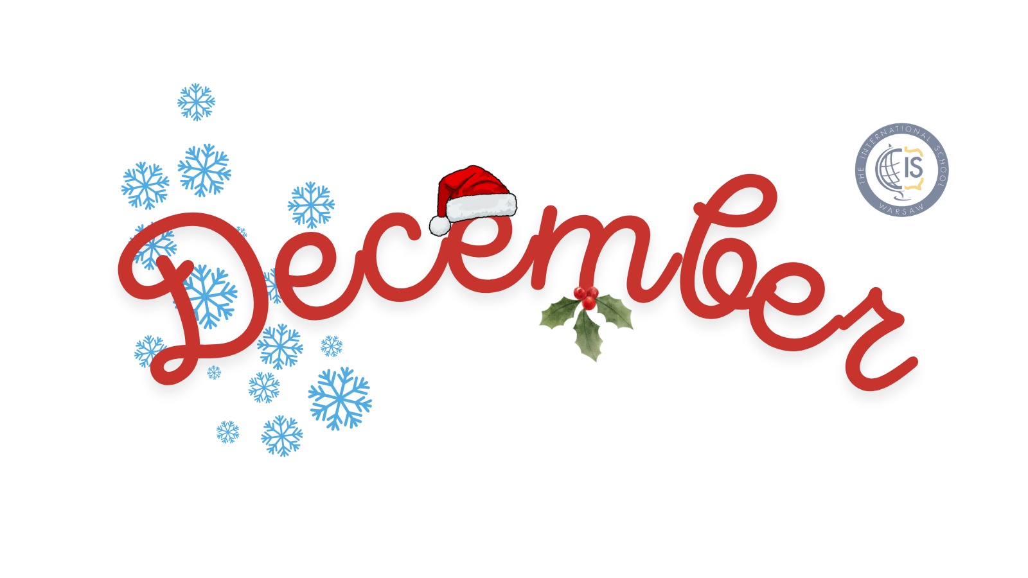
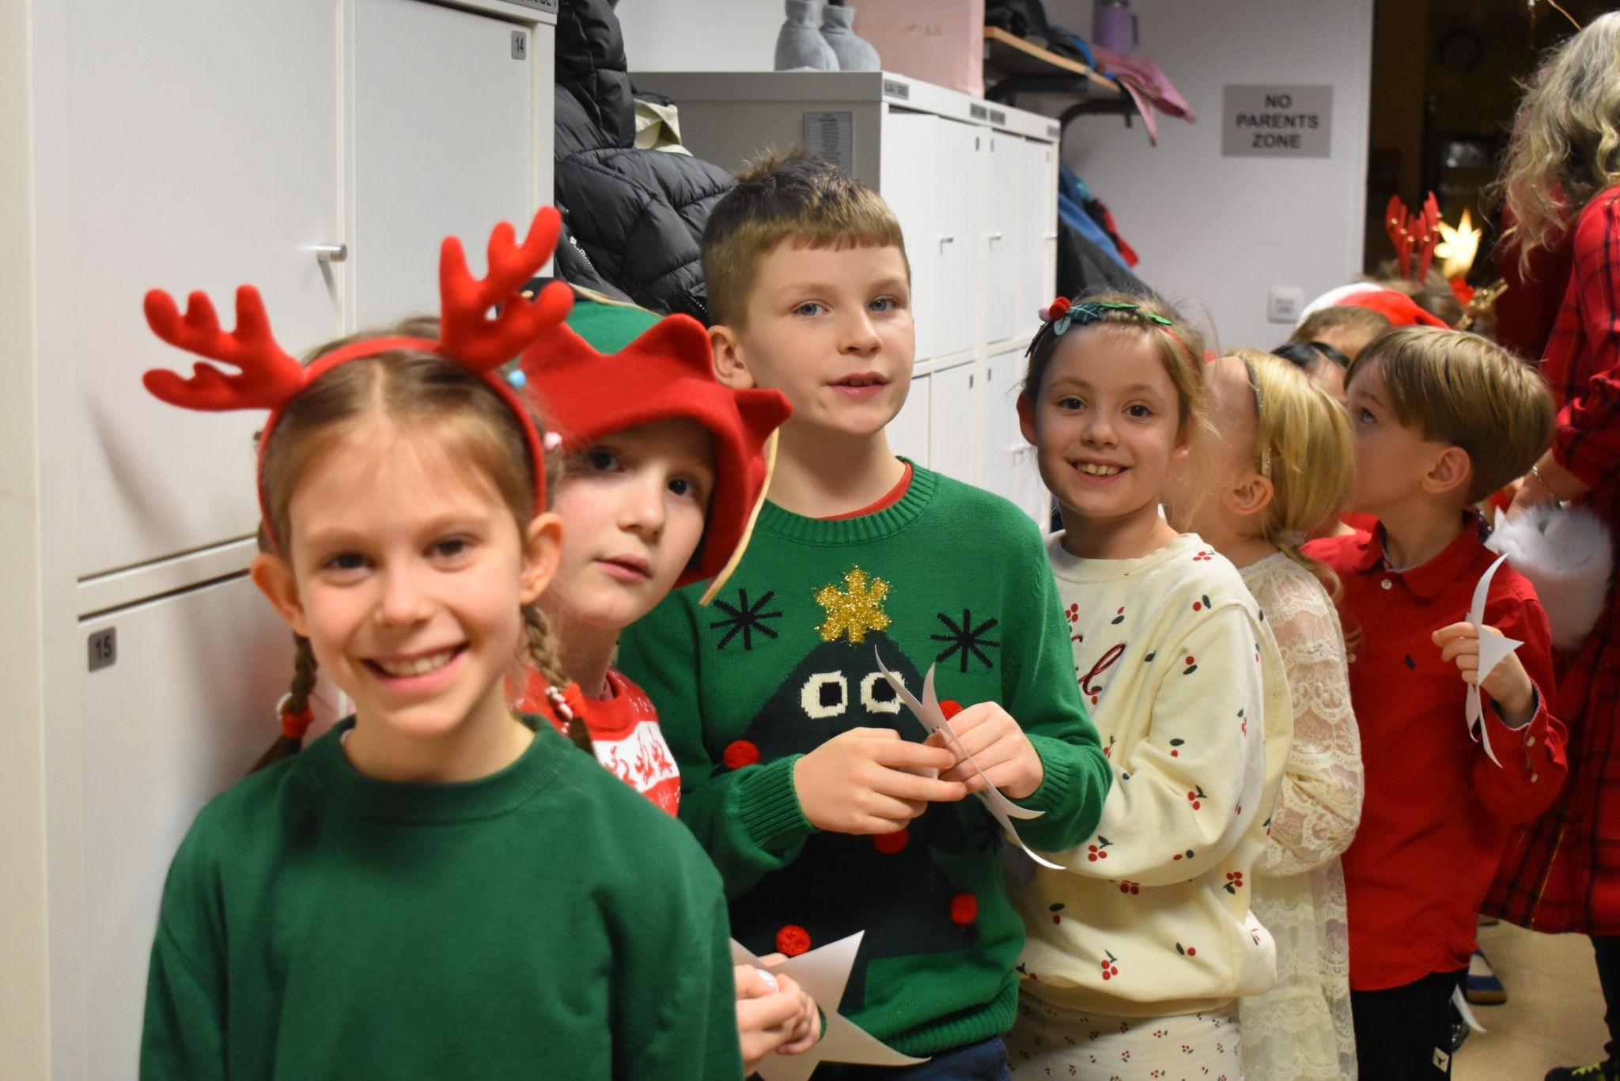
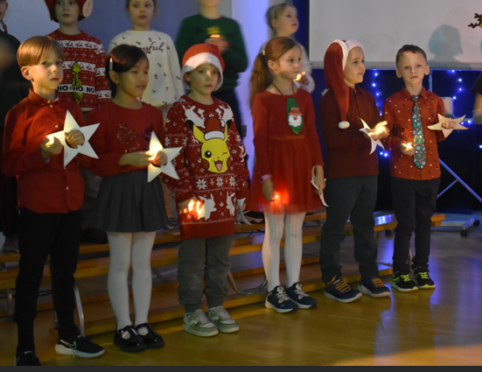
Grade 1 Newsletter - December in Review
Introduction
The month of Thanksgiving came and went! We spent the month of December getting into the festive spirit by reading the Polar Express and making Christmas crafts.
Mathematics
We learned about Canadian money and the different coins which are in use in Canada. We also learned how to add using Canadian coins.
Science
Grade 1 learned about the difference between renewable and non-renwable energy sources. By showing a video I took at Bełchatów power plant, the largest of its kind in Europe, we saw how a non-renewable energy source can affect a surrounding area. We also had a fun and interactive lesson about the food chain. Students were divided into small groups and asked to make different living organisms from plasticine. Everyone got to present their work and show how their food chain works.
Language Arts
We did a short novel study on The Polar Express where students discussed the themes in groups.
Social Studies
We discussed how we can help other people and how people in our communities can help us. We also wrote postcards to Santa!
Pictures, pictures, pictures!
Art
We made Christmas jumpers and pop up Christmas cards.
Important Dates:
January 20th - Start of the ‘Going Places’ class project
January 27th - Grade 1 Group Parent Meeting
February 3rd - 14th - Winter Break

